Slide 1
Instructions as you enter the WebEx Virtual Classroom:
01
Make sure your name in the participant list on the right-hand side of the screen shows up as your code that Mara provided you via email (example: 01 01) If your name is not your code, please leave the WebEx virtual classroom and re-enter after you have updated your listed name.
02
Mute yourself by clicking on the microphone icon at the bottom of your screen. Click the button until it is red. You are muted if the microphone icon looks like this:
03
Make sure your camera is on by clicking on the camera button at the bottom of the screen. If it is red, your camera is not on. Click the button until it is NOT red. Your camera is on if the icon looks like this:
Your settings are correct if the bottom of your screen looks something like this and you should see a small picture of yourself in the top or bottom corner:

Slide 2
Welcome!
Lesson 1 Grow. Prepare. Eat.
Monday July 6th, 2020
Notes:
HIT RECORD!

Slide 3
Today’s Lesson Overview:
Introductions
4. Intro to Fruit!
2. WebEx Etiquette and ClassDojo
5. Seed to Plate
3. Surveys
6. Planting a seed!
Notes:
HIT RECORD!
-Grades
-gardening/cooking questions
-fave food typed into chat

Slide 4
WebEx Etiquette
1. Be on Time!
2. Make sure your microphone is on mute when you enter, and stay on mute unless you are called on.
3. Be Respectful! – To the teacher and your classmates
4. Stay Focused and try not to get distracted!
5. If you have a question, use the ‘Raise Hand’ button and wait for permission to talk from your teacher.
6. Only chat appropriate questions or comments into the chatbox.
Notes:
etiquette = being polite
Have everyone practice coming on and off of mute
practice raising and lowering “hand”

Slide 5
ClassDojo
We are using ClassDojo for class announcements and as a way to post information about the hands-on at-home activities you will complete after each lesson.
Please log into ClassDojo after each class to see instructions for the hands-on activity.
Please also submit a picture or video (according to the directions) of your hands-on activity to your online profile.
Notes:
Has anyone ever used ClassDojo before?

Slide 6
Surveys
This class is part of a really cool research project. A research project is kind of like a science experiment!
Part of what we are hoping to learn is if a class like this that’s online instead of in person can actually be fun for students!
We sent your parents/guardians two surveys that we need you to complete. These surveys help us learn about how well we’re doing with this class.
Please complete them before the next class and upload them on ClassDojo under the portfolio called “Surveys”

Slide 7
What is this?

Slide 8
Watermelon

Slide 9
What are some words you can think of to describe this fruit?

Slide 10
What is this?

Slide 11
Cantaloupe

Slide 12
What are some words you can think of to describe this fruit?

Slide 13
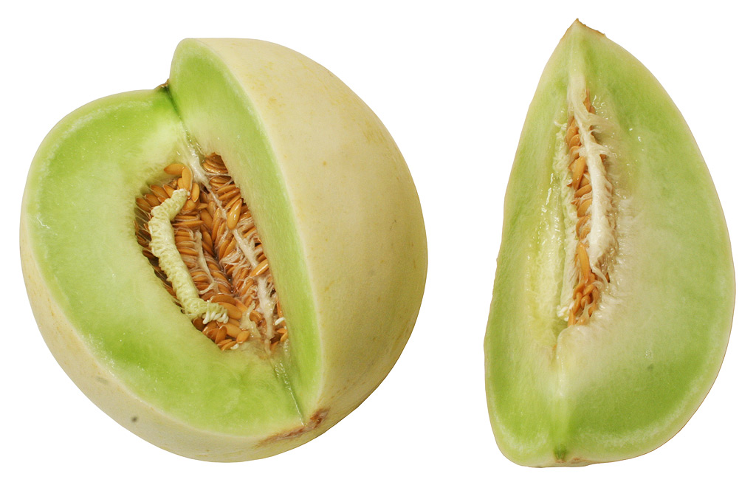
What is this?

Slide 14
Honeydew melon

Slide 15
What are some words you can think of to describe this fruit?

Slide 16
How do you think these fruits got their names?
Notes:
92%

Slide 17
How do these melons grow?
In what season do they grow in New Jersey?

Slide 18
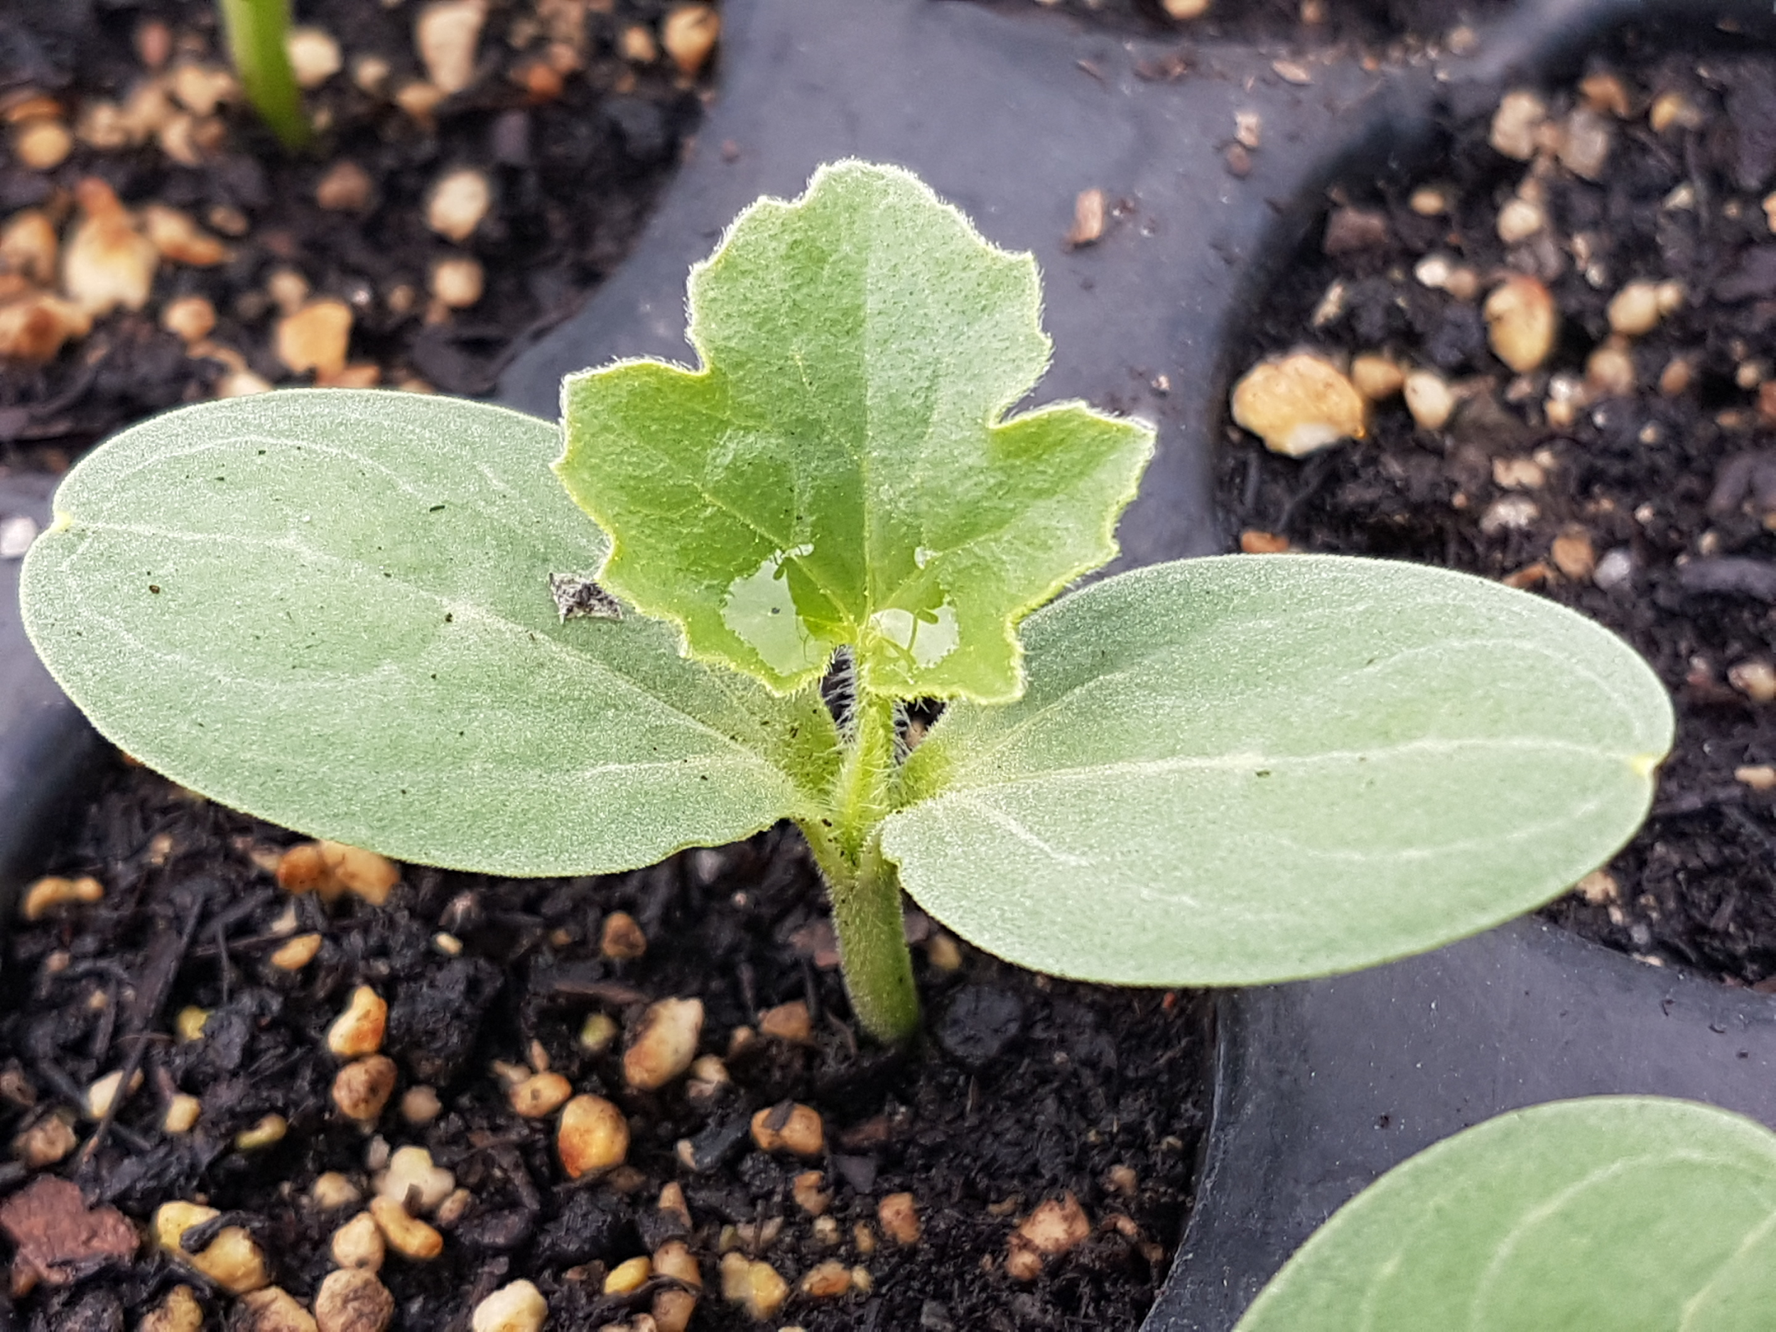
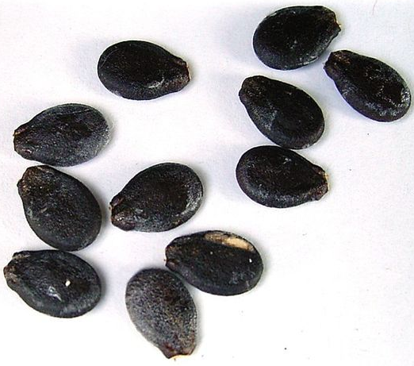
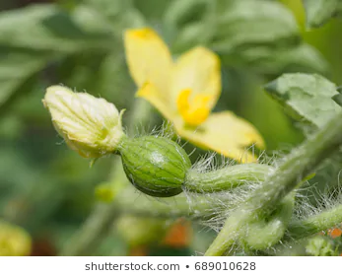
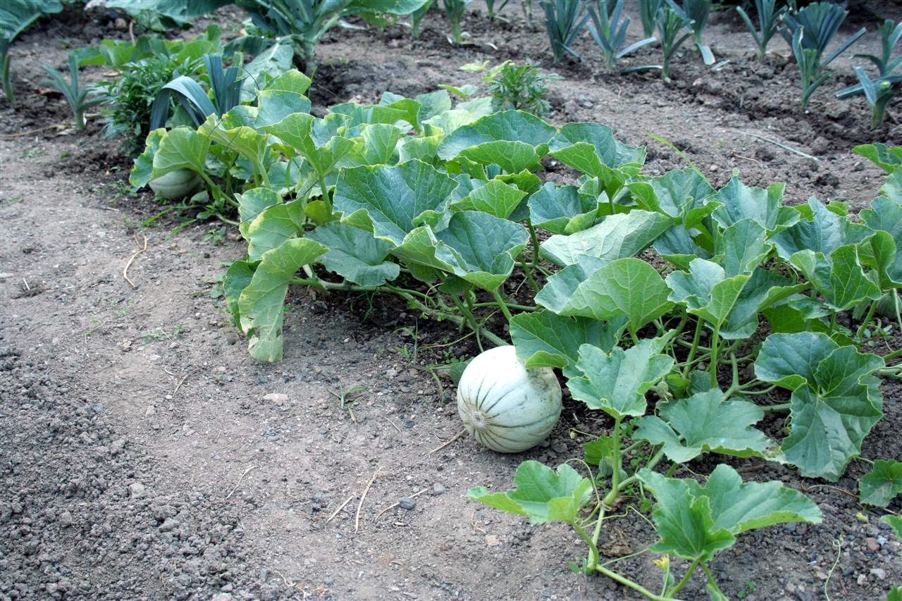
Notes:
Can find a moving GIF? Something moving?

Slide 19
What is Seed to Plate?
Have you ever heard of “Seed to Plate”?
What about “Farm to Table”?
What do you think those phrases mean?

Slide 20
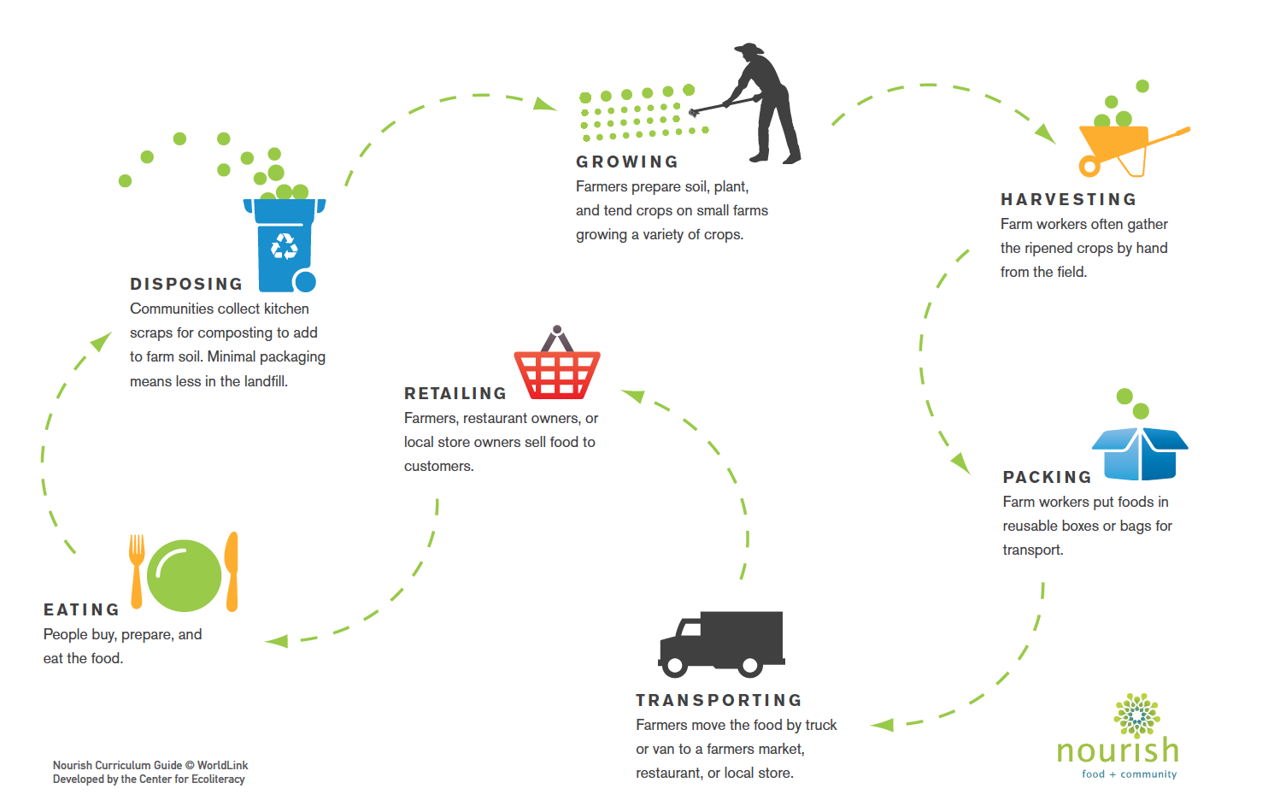
Notes:
Volunteers to read steps
What steps require people? And what is their title?

Slide 21
Hands-On Activity Explanation:
Planting a Seed!

Slide 22
Step 1: Watch the video
On ClassDojo you will find a video showing you step-by-step instructions of how to plant a seed.
Step 2: Plant your seeds
You may need adult supervision for a couple steps.
Step 3: Once you are finished, take a picture or video of your plant and upload to the Seed Planting Portfolio on ClassDojo
Notes:
Ask students to read the steps

Slide 23
Exit Ticket
Get out a piece of paper and something to write with.
In 3 minutes, write or draw something that explains what you learned today.
When you finish, hold up what you wrote/drew to your camera so we can see!
After you finish you are dismissed unless you have questions about anything.
Notes:
Who has ever done an exit ticket before?

