Slide 1
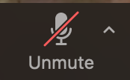
Instructions as you enter the Zoom Virtual Classroom:
01
Make sure your name in the participant list on the right-hand side of the screen shows up as your code that Mara provided you via email (example: 01 01) If your name is not your code, please leave the Zoom virtual classroom and re-enter after you have updated your listed name.
02
Mute yourself by clicking on the microphone icon at the bottom of your screen. Click the button until it has a red slash through it. You are muted if the microphone icon looks like this:
03
Make sure your camera is on by clicking on the camera button at the bottom of the screen. If it has a red slash through it, your camera is not on. Click the button until it is DOES NOT have a slash. Your camera is on if the icon looks like this:
Your settings are correct if the bottom of your screen looks something like this and you should see a small picture of yourself in the top or bottom corner:

Slide 2
Welcome!
Lesson 12 of Grow. Prepare. Eat.
Thursday August 13th, 2020

Slide 3
Table of Contents
04
01
02
03
#1
Share about Hands-On Activity
#2
Go. Slow. Woah Game
#3
Explanation of Last Hands-on Activity
#4
Wrap Up of Class

Slide 4
Hands-On Activity
Did you like the activity?
How did your answers compare to your adult’s answers?
Did you learn anything new? If so, what did you learn?
How is your compost and/or plant doing? Has it changed since the beginning?
Notes:
Abbey

Slide 5
Go, Slow, Whoa
Whoa
Slow
Go
Eat on special occasions, or once in a while
These foods do not help our bodies
Eat sometimes, or a few times a week
These foods are in the middle/kind of helpful
Eat almost anytime
These foods help our bodies to “go”!
Notes:
Gabby

Slide 6
Go. Slow. Whoa!
When a food shows up on the screen, decide if it is a Go, Slow, or Whoa food.
Go: Dance!
Slow: Move in slow motion
Whoa: Freeze!

Slide 7
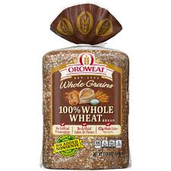
Whole Wheat Bread
GO

Slide 8
Ice Cream
WHOA

Slide 9
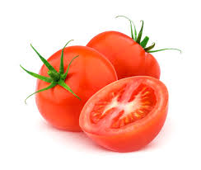
Tomato
GO

Slide 10
Juice
SLOW

Slide 11
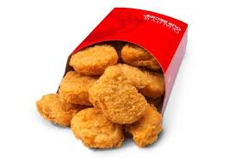
Chicken Nuggets
WHOA

Slide 12
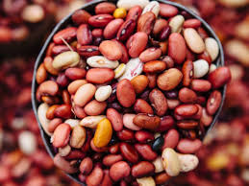
Beans
GO

Slide 13
Our Final Hands-On Activity: Overnight Oats
Step 1
Step 2
Step 3
Watch the two videos! One is about different baking techniques. The other is how to make the recipe.
Make the recipe!
Upload a picture/video to ClassDojo!
Notes:
Abbey to present
Abbey to update
Find/make video for whisking/folding/other mixing type techniques
Or overview of common terms in baking/cooking

Slide 14
Final Thoughts!
Notes:
Gabby

Slide 15
#1 Complete the final surveys!
There’s a new one!
Notes:
Gabby

Slide 16
Final Thoughts:
What did you like about the class?
What were some of your favorite parts of the live class?
What were some of your favorite hands-on activities?
Notes:
Abbey

Slide 17
Final Thoughts:
Was there anything you didn’t like about this class?
Were there any hands-on activities you didn’t like very much?
What did you think about using ClassDojo?
Were there any activities that were too hard?
Did you like having live class and things to try on your own at home?
Notes:
Gabby

Slide 18
Is there anything else you want to tell us about this class?
Notes:
Abbey

