Slide 1
Instructions as you enter the WebEx Virtual Classroom:
01
Make sure your name in the participant list on the right-hand side of the screen shows up as your code that Mara provided you via email (example: 01 01) If your name is not your code, please leave the WebEx virtual classroom and re-enter after you have updated your listed name.
02
Mute yourself by clicking on the microphone icon at the bottom of your screen. Click the button until it is red. You are muted if the microphone icon looks like this:
03
Make sure your camera is on by clicking on the camera button at the bottom of the screen. If it is red, your camera is not on. Click the button until it is NOT red. Your camera is on if the icon looks like this:
Your settings are correct if the bottom of your screen looks something like this and you should see a small picture of yourself in the top or bottom corner:

Slide 2
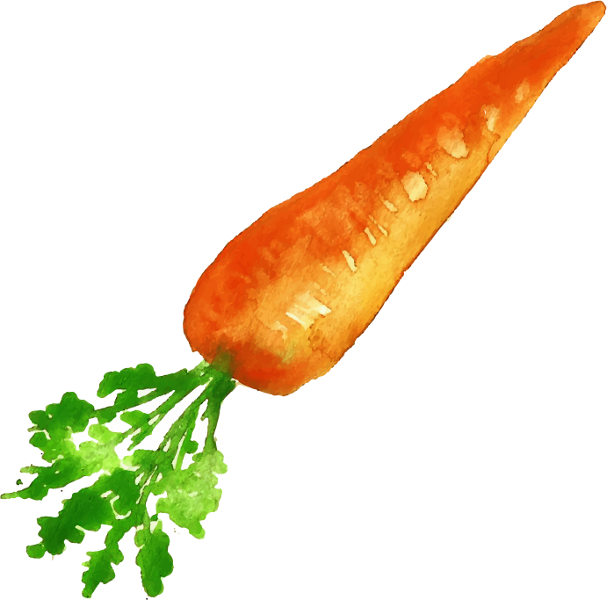
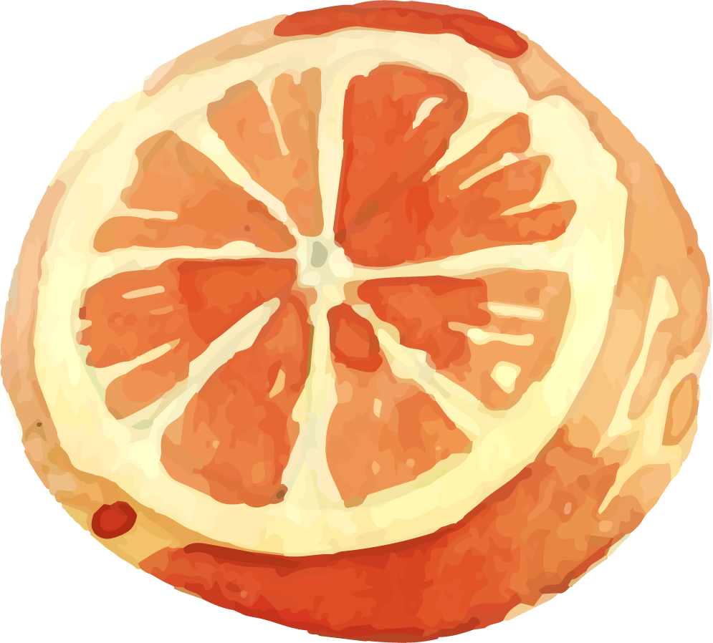
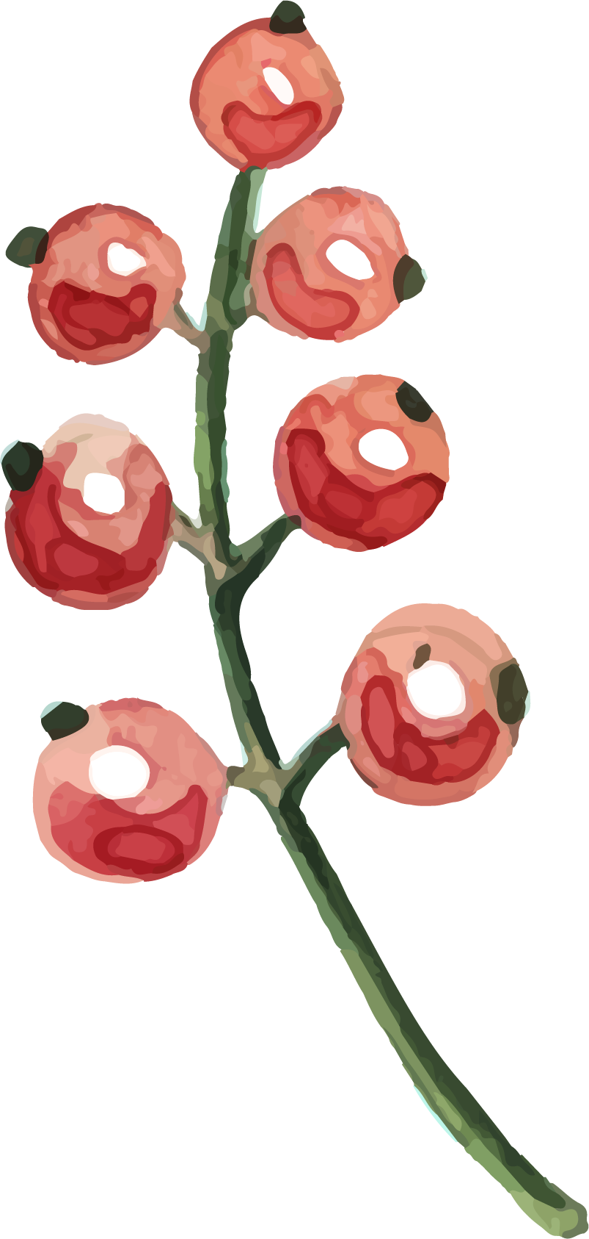
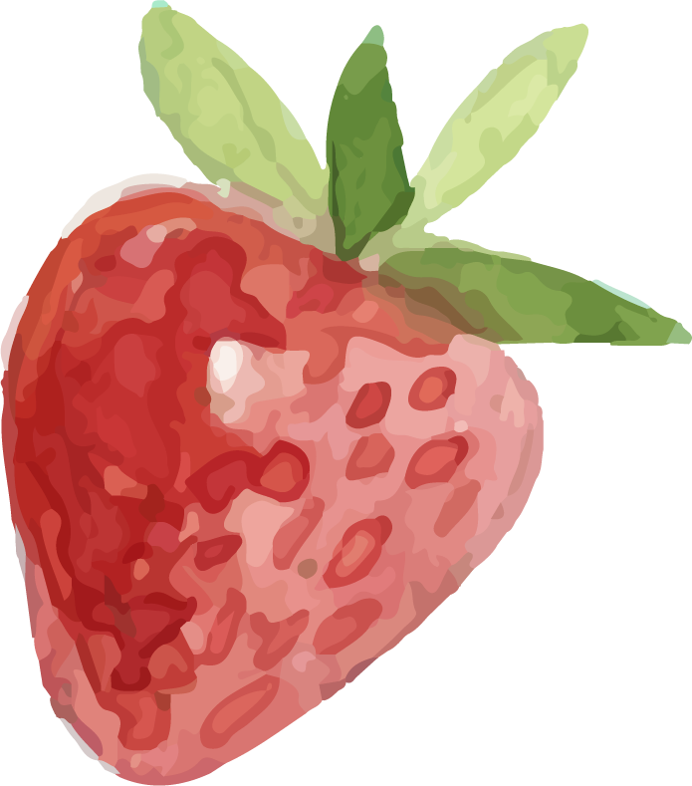
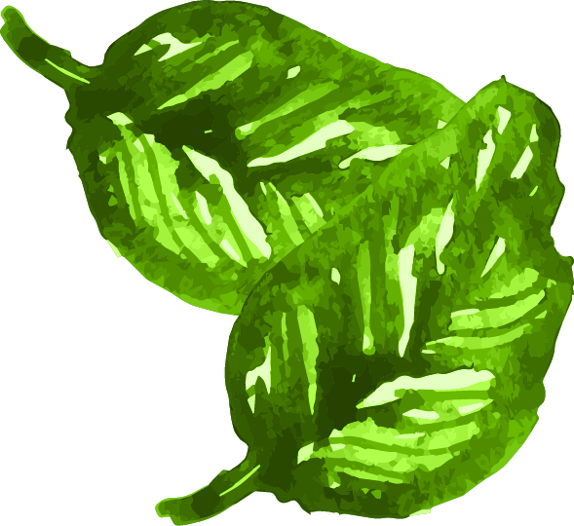
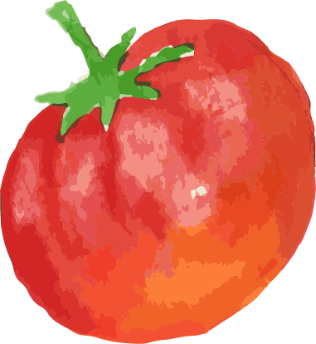
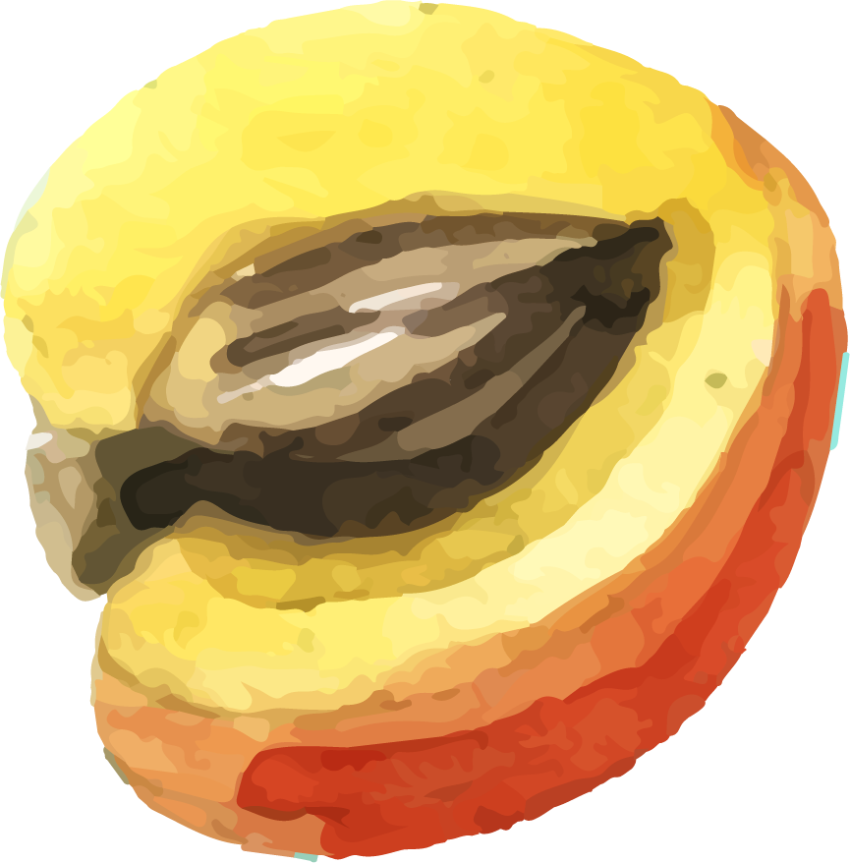
Welcome
Lesson 2 Grow. Prepare. Eat.
Thursday July 9th, 2020

Slide 3
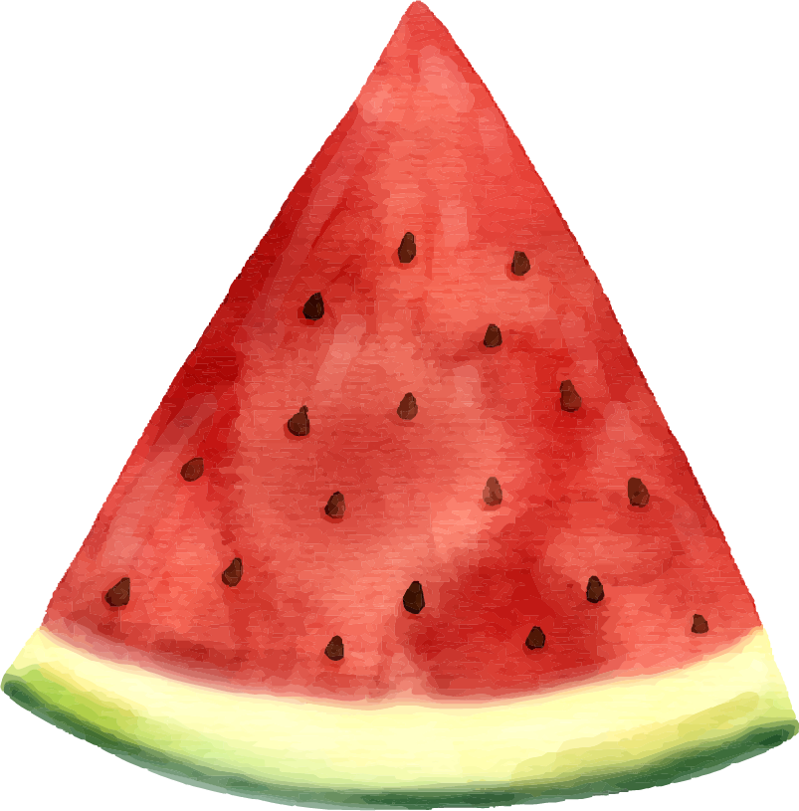
Today’s Lesson Overview:
01
WebEx Etiquette and ClassDojo
02
Share About the Hands-On Activity
03
Introduction to Flavor and Texture
04
Flavor and Texture Activity

Slide 4
HANDS-ON Activity
How did it go planting your seed(s)?
What seeds did you choose? How many seeds did you plant?
What did you use to plant your seeds? Where did you plant them?
How long do you think it will take to grow? Was it fun?
Notes:
Choose different color - yellow not good
Can the picture track with the question
Instead of grapes have doctor pain scale, instead of broccoli, have a series of counting numbers, instead of pepper have pot and shovel, instead of watermelon have calendar

Slide 5
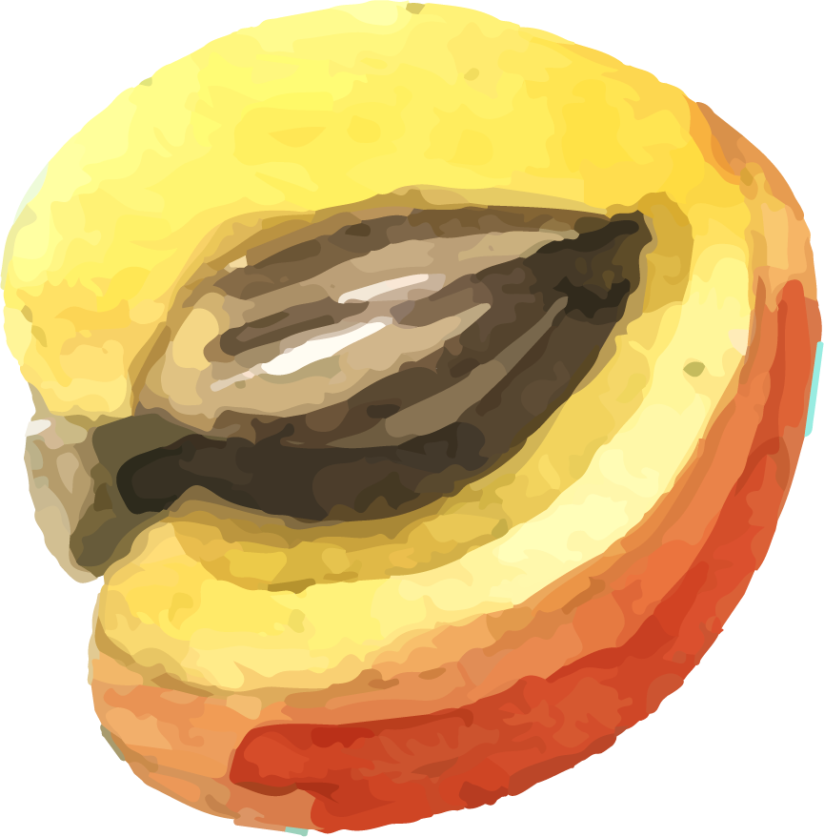
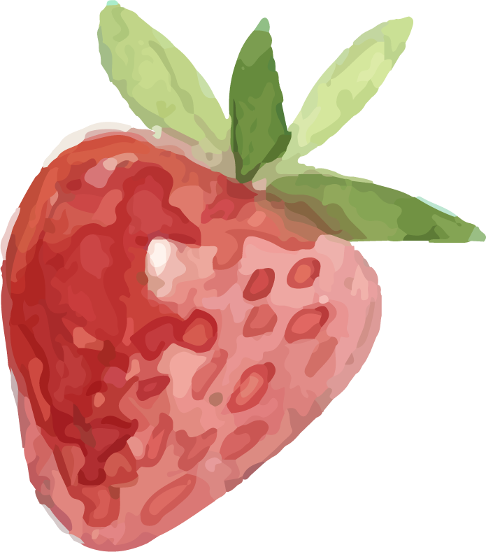
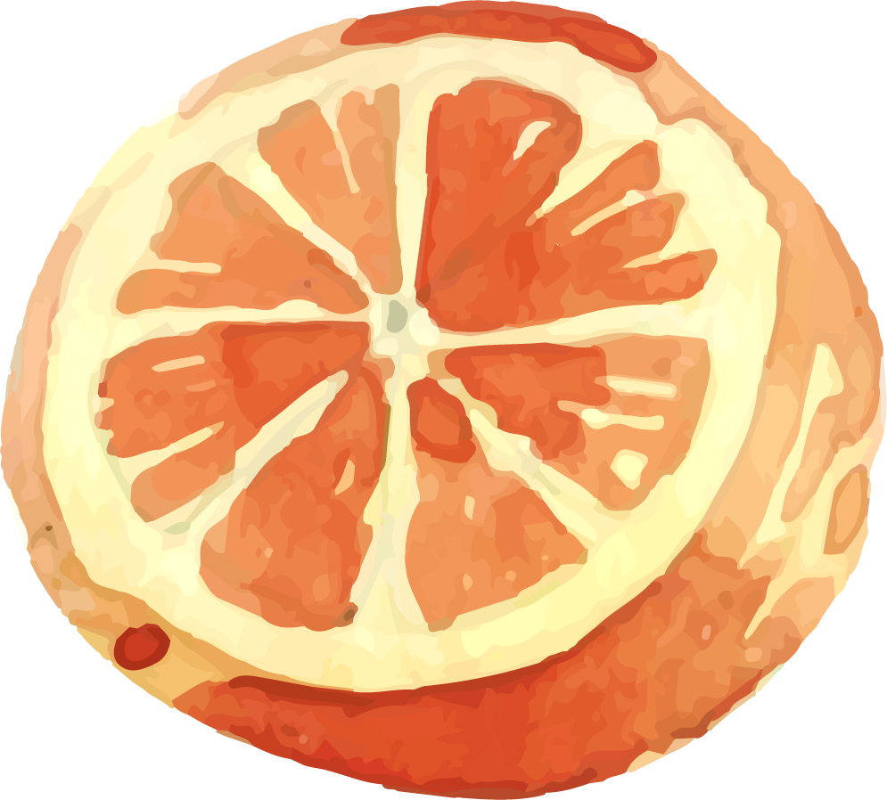
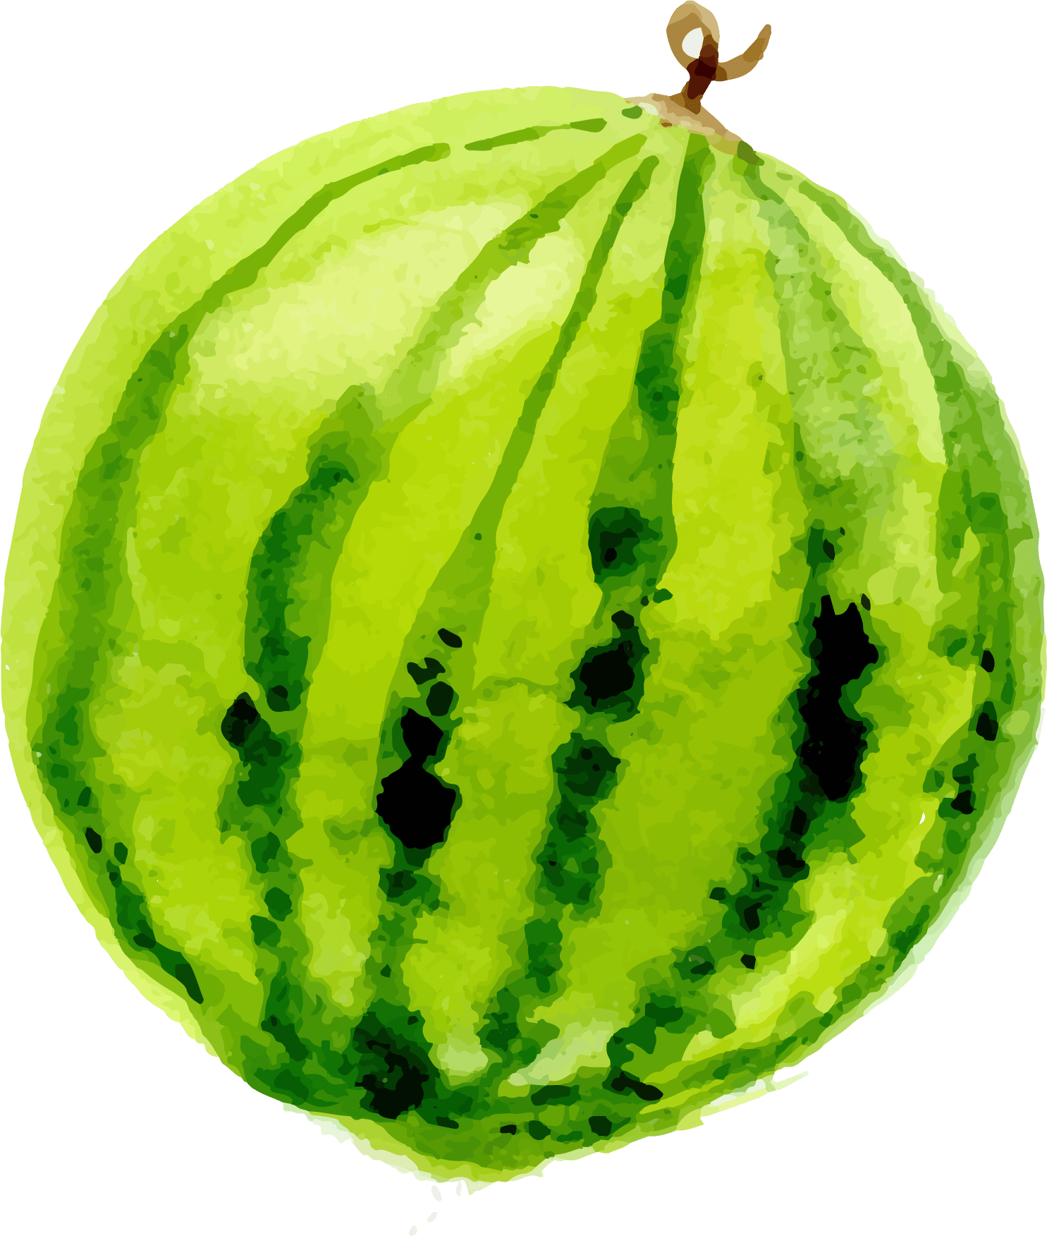
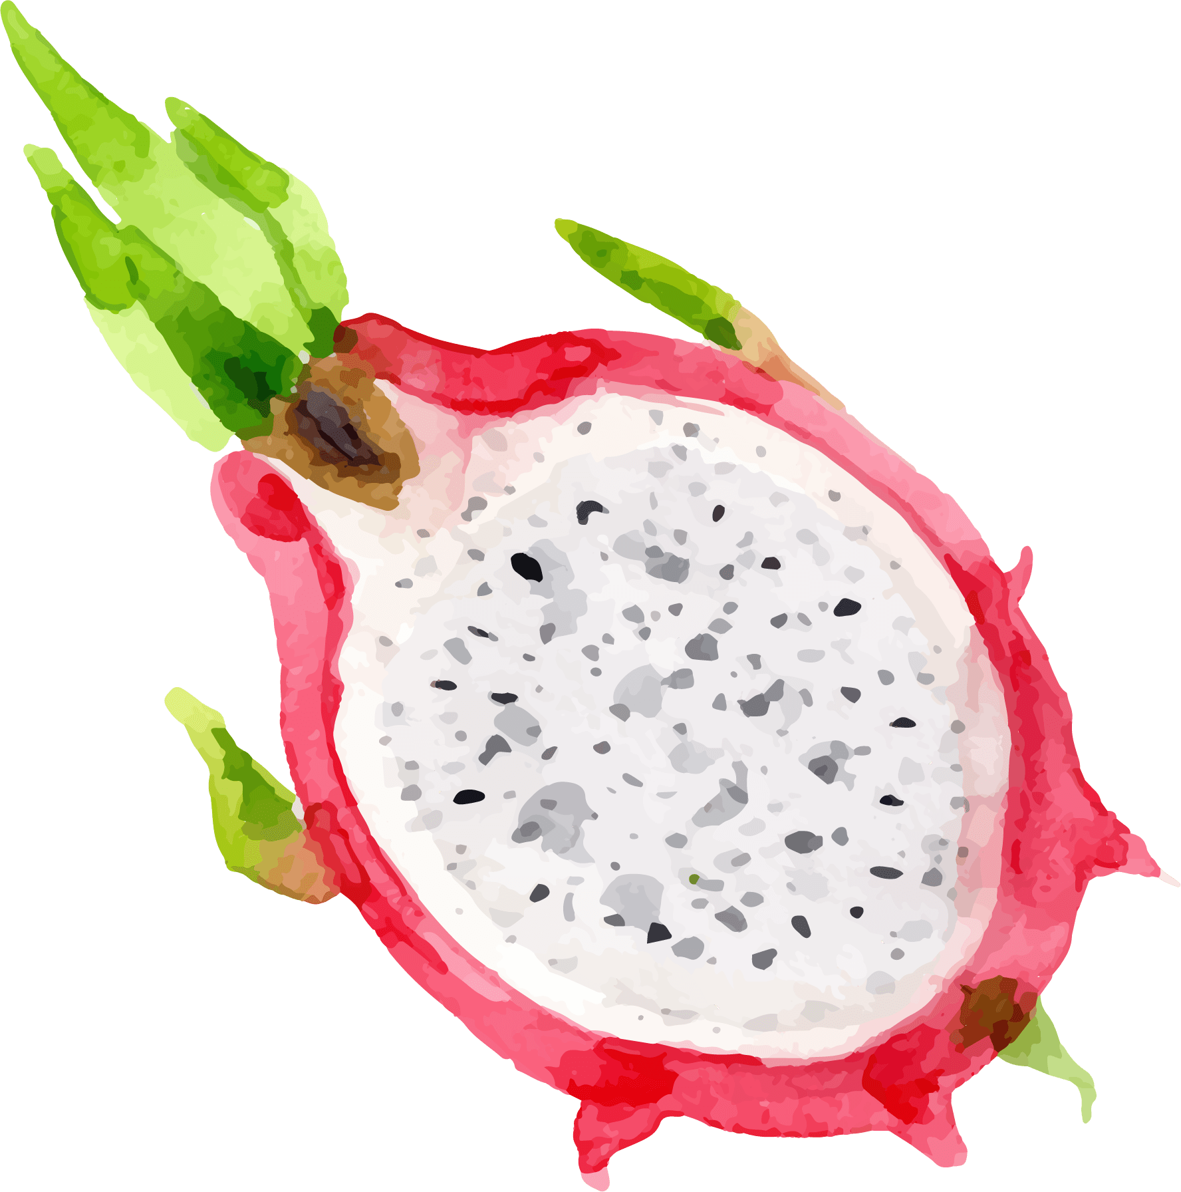
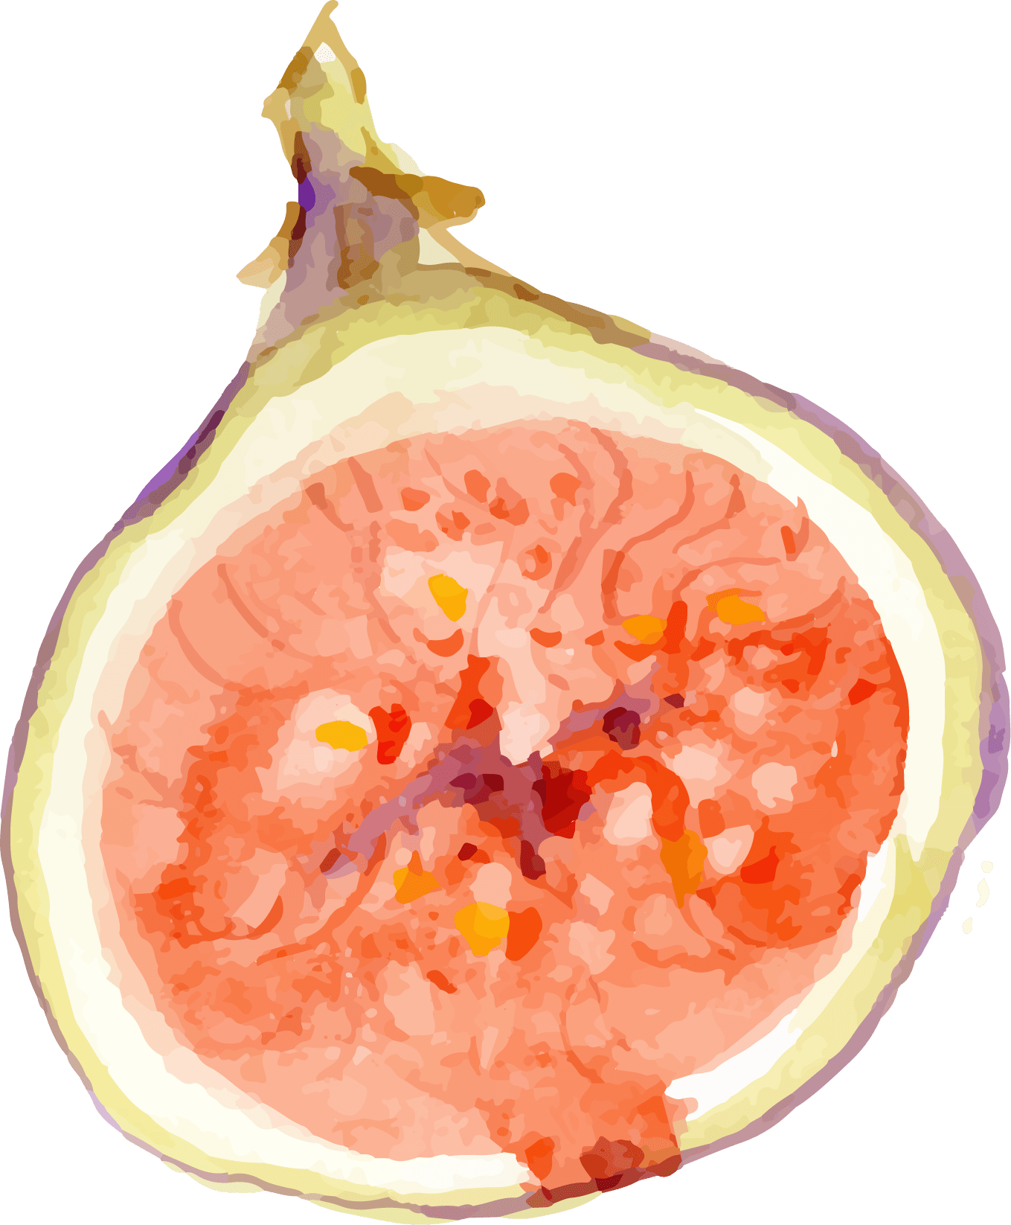
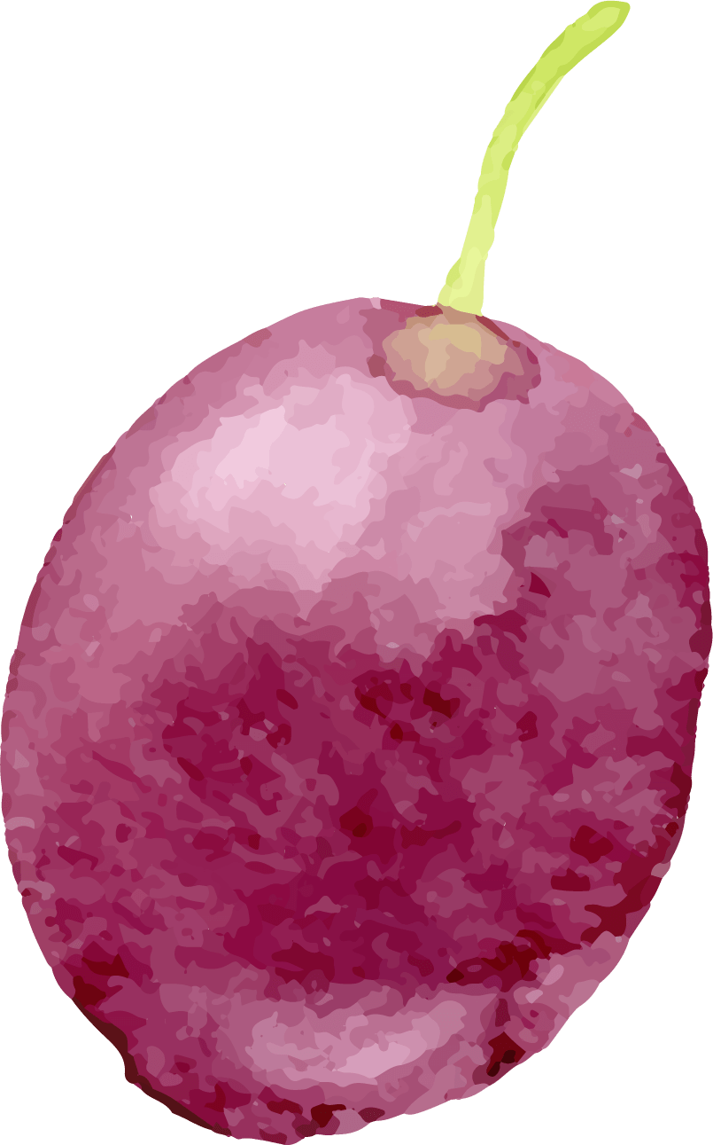
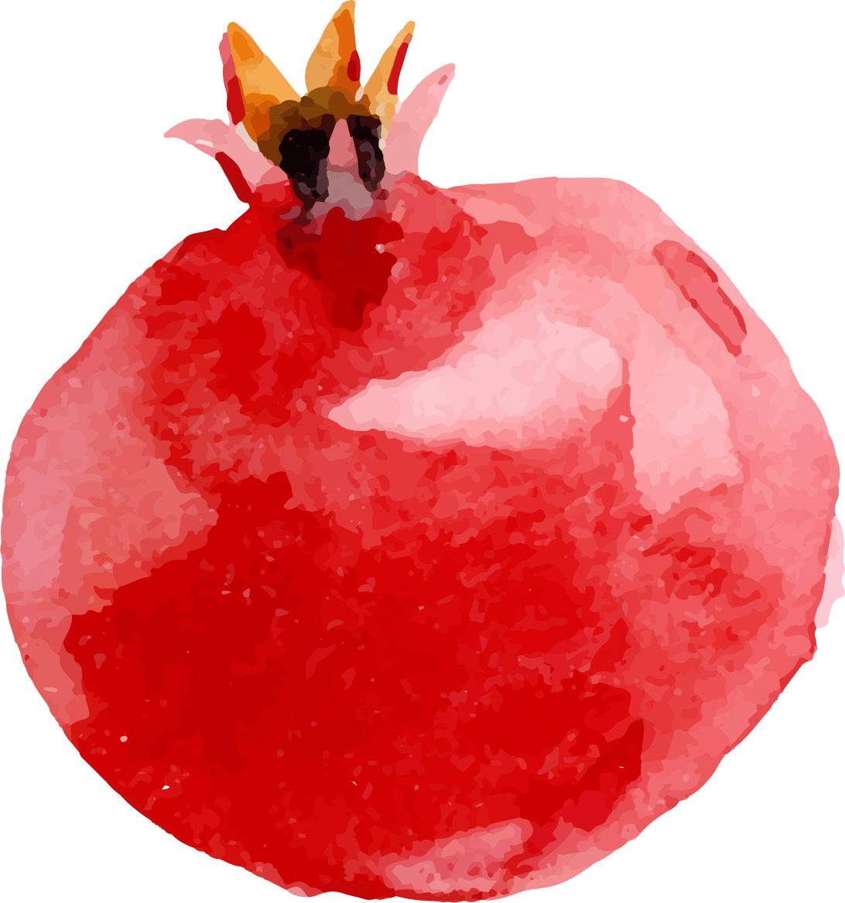
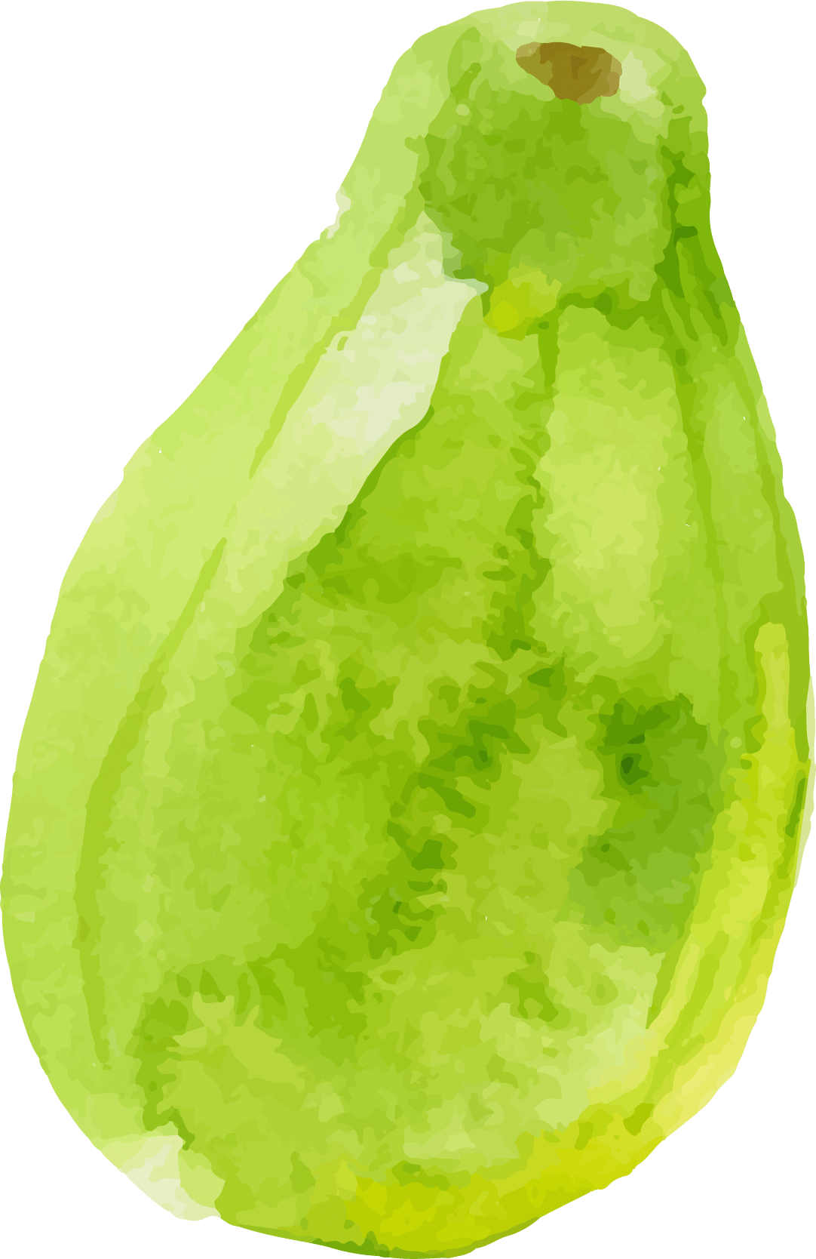
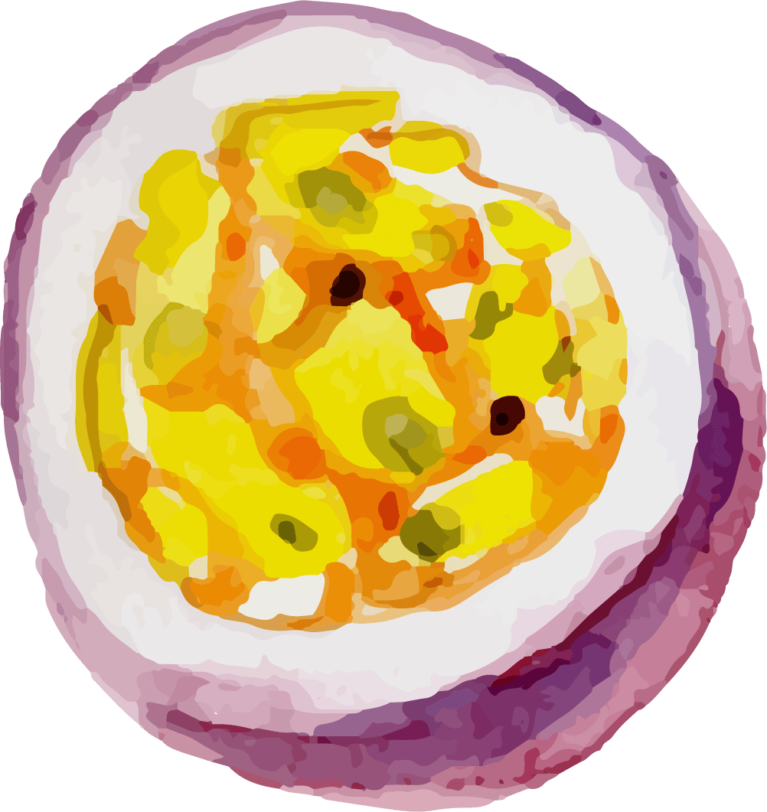
Making a Recipe is all about Flavors and Textures!
What are some of your favorite flavors?
What is a texture of a food?
What are some textures you can think of?
What foods have you had with those flavors in them?
What are some of your favorite textures of foods?
Notes:
Have funny game this;
What would it be like to combine funny textures and flavors
Are there foods that you don’t like because of texture more than it’s flavor? (mushrooms, mayonnaise, eggs, etc.)

Slide 6
Flavor and Texture Describing Words from FoodCorps:

Slide 7
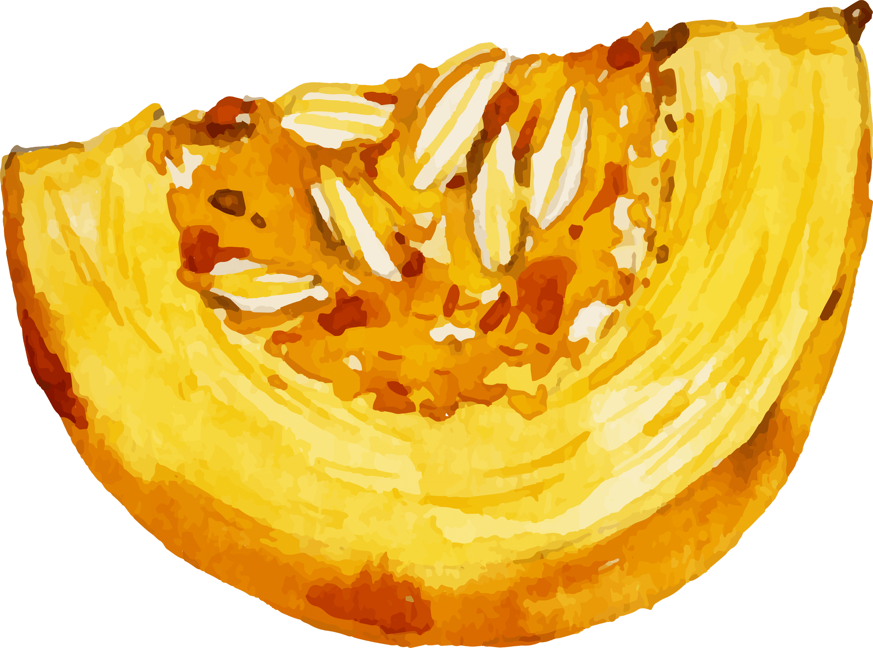
Flavor and Texture Game
I’m going to show a word that describes a texture or flavor.
Then you type into the chat box foods that come to mind when you see that word

Slide 8
SPICY

Slide 9
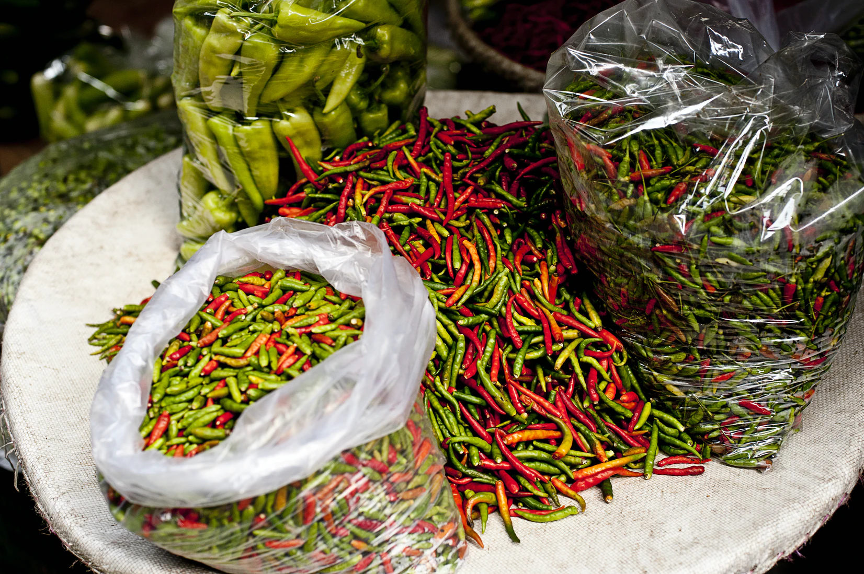
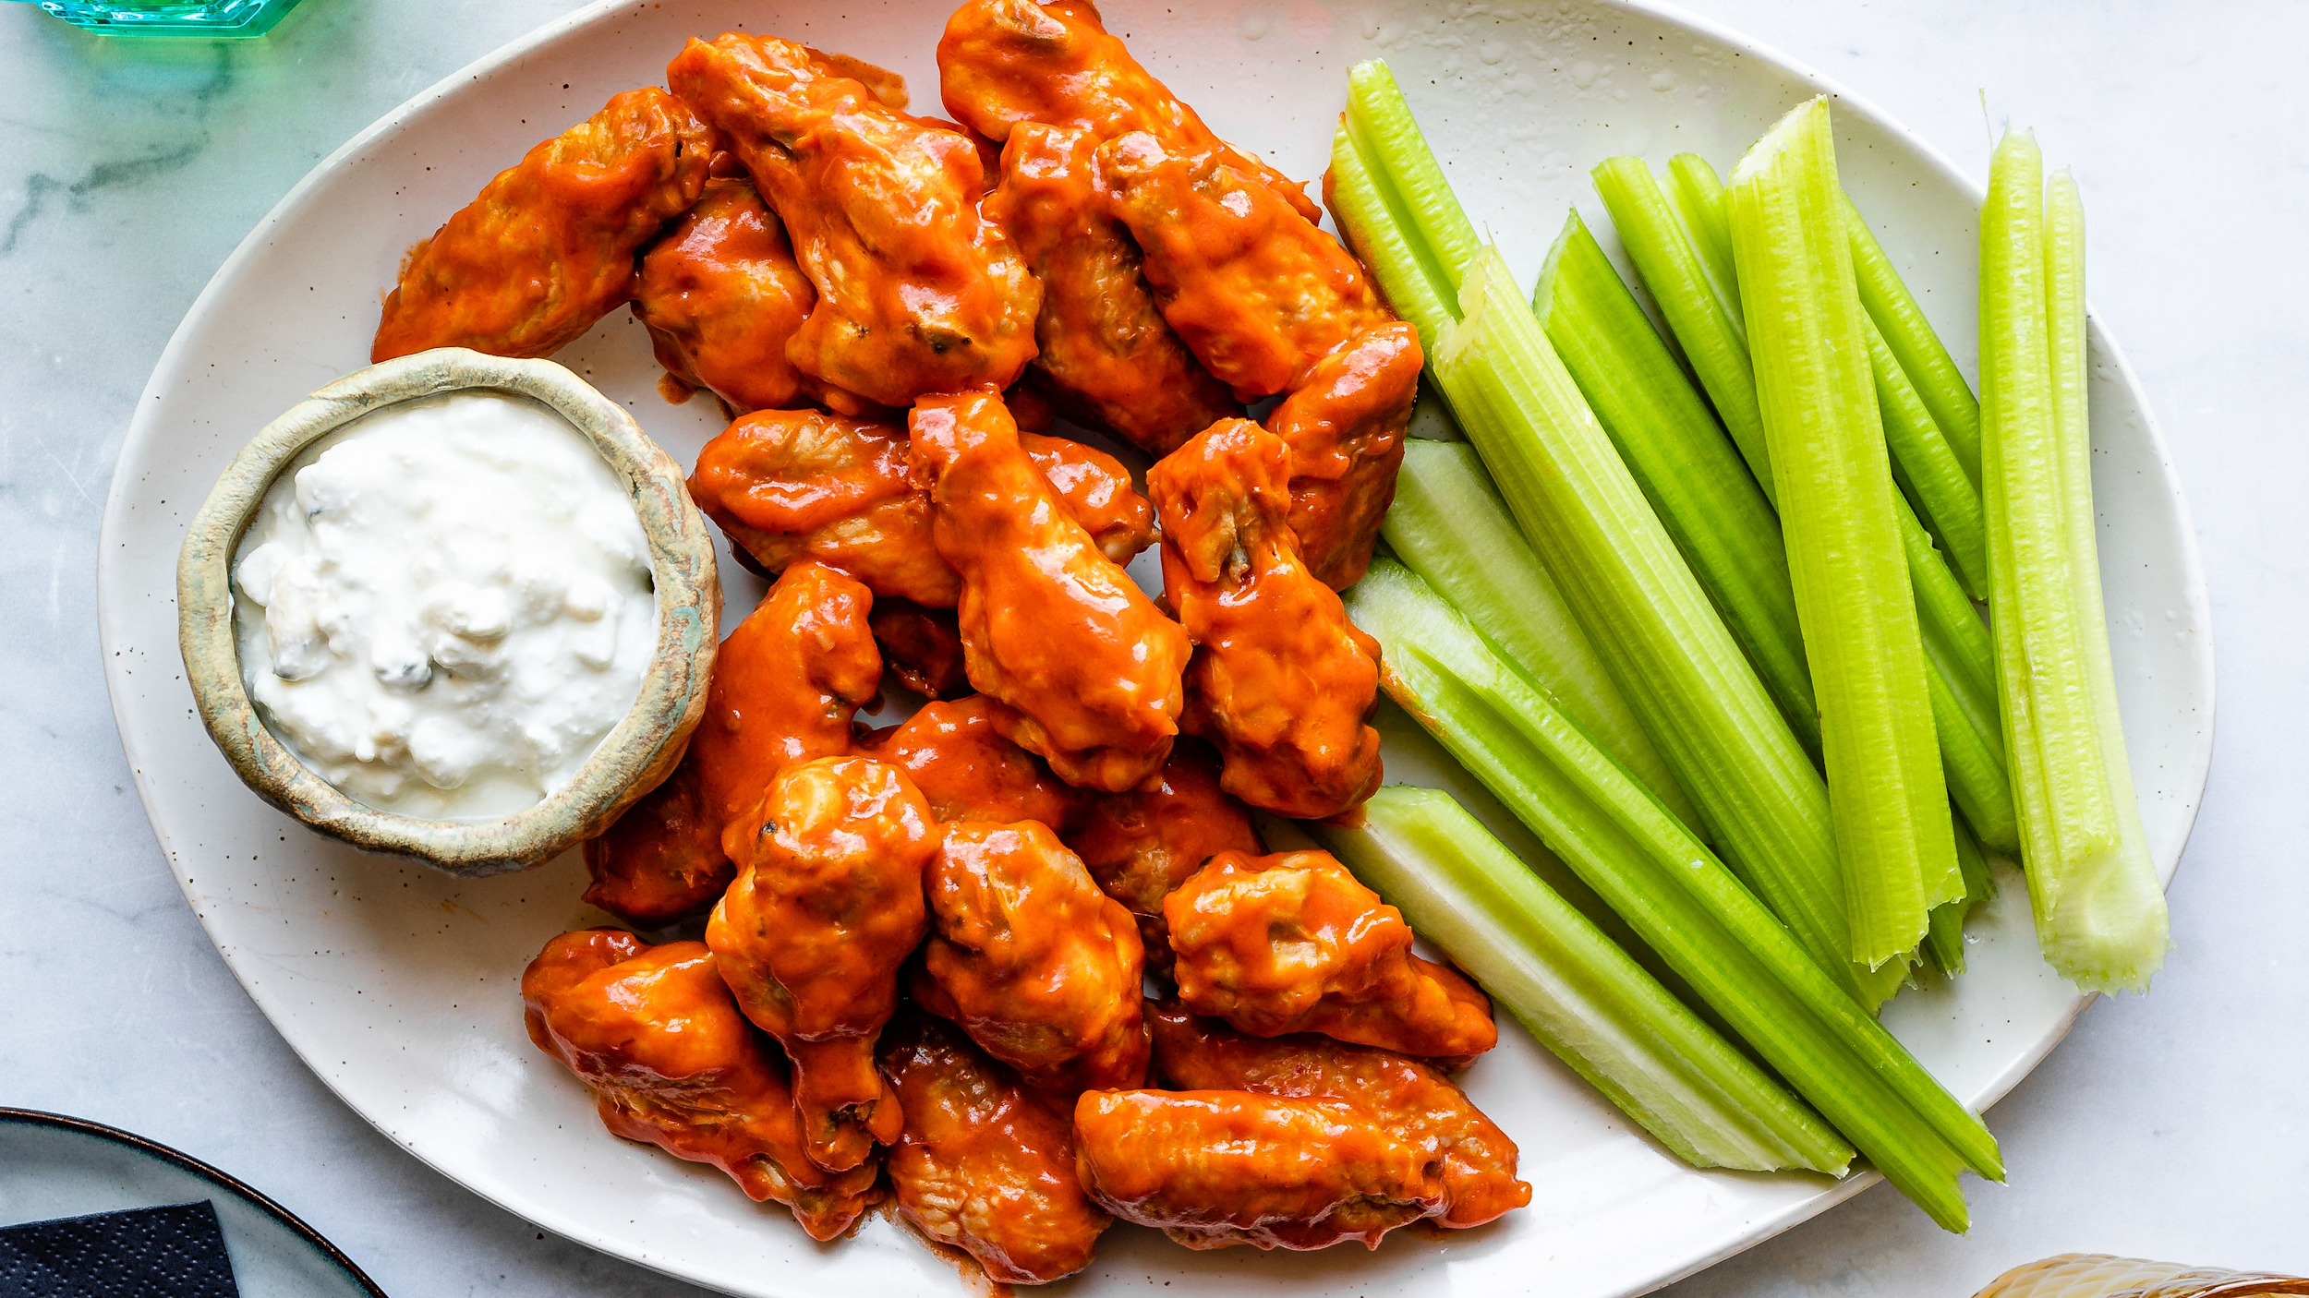
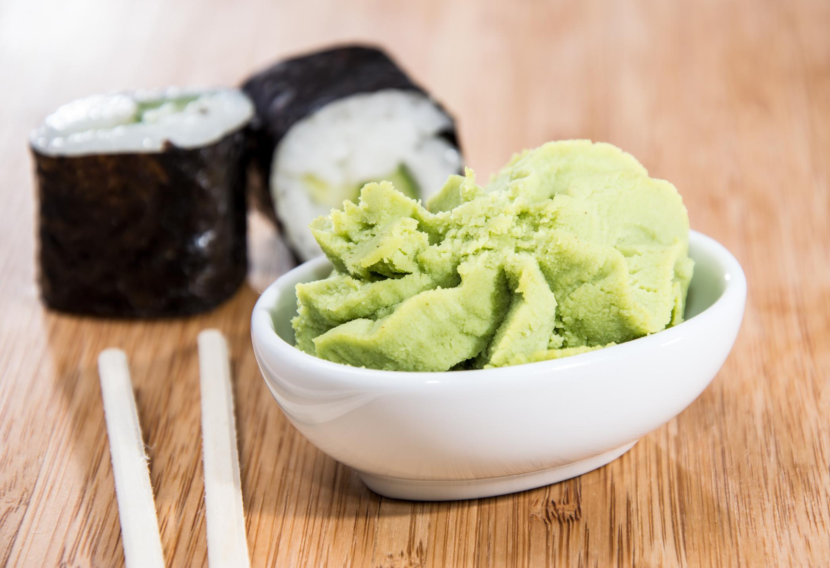
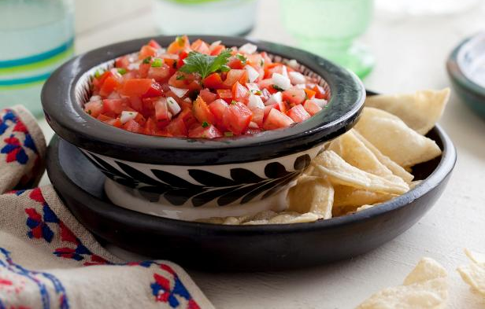

Slide 10
CREAMY

Slide 11
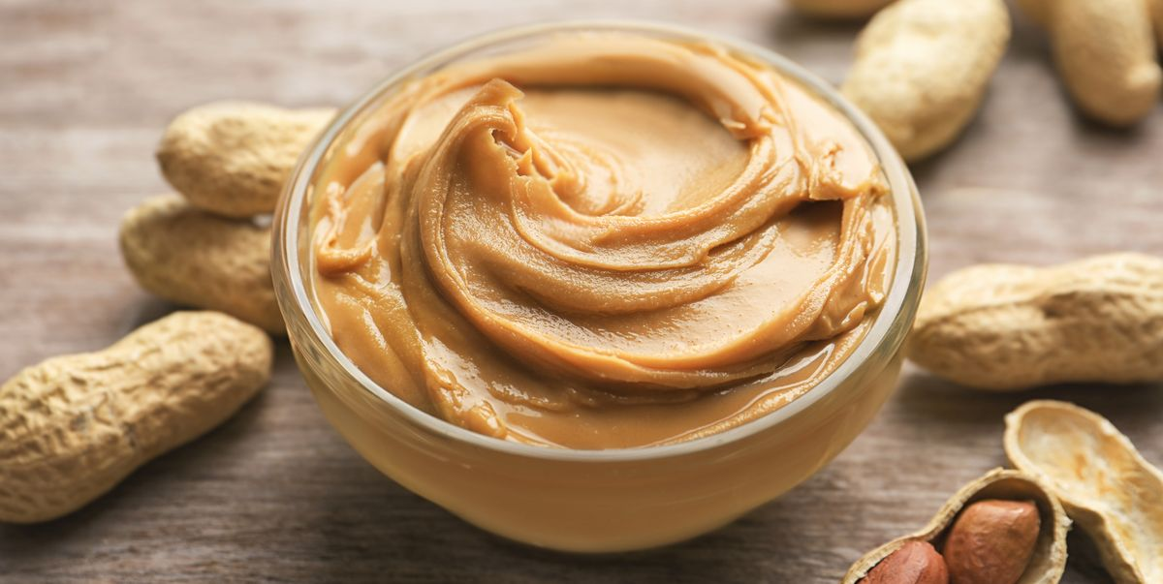
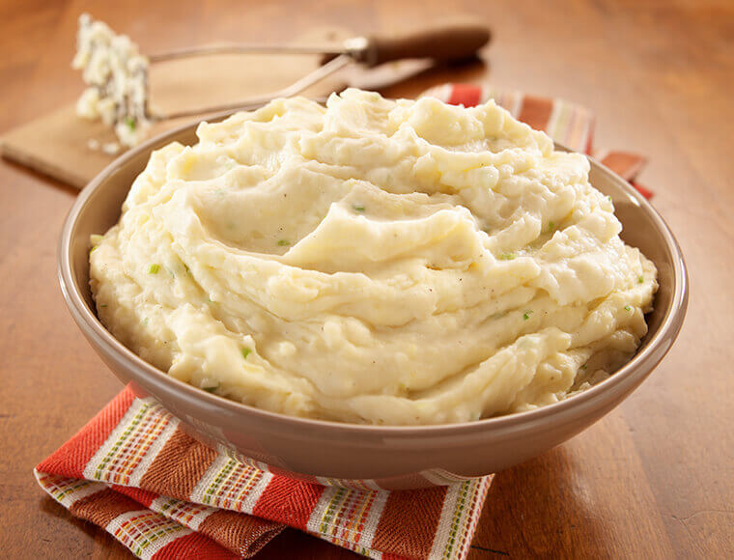
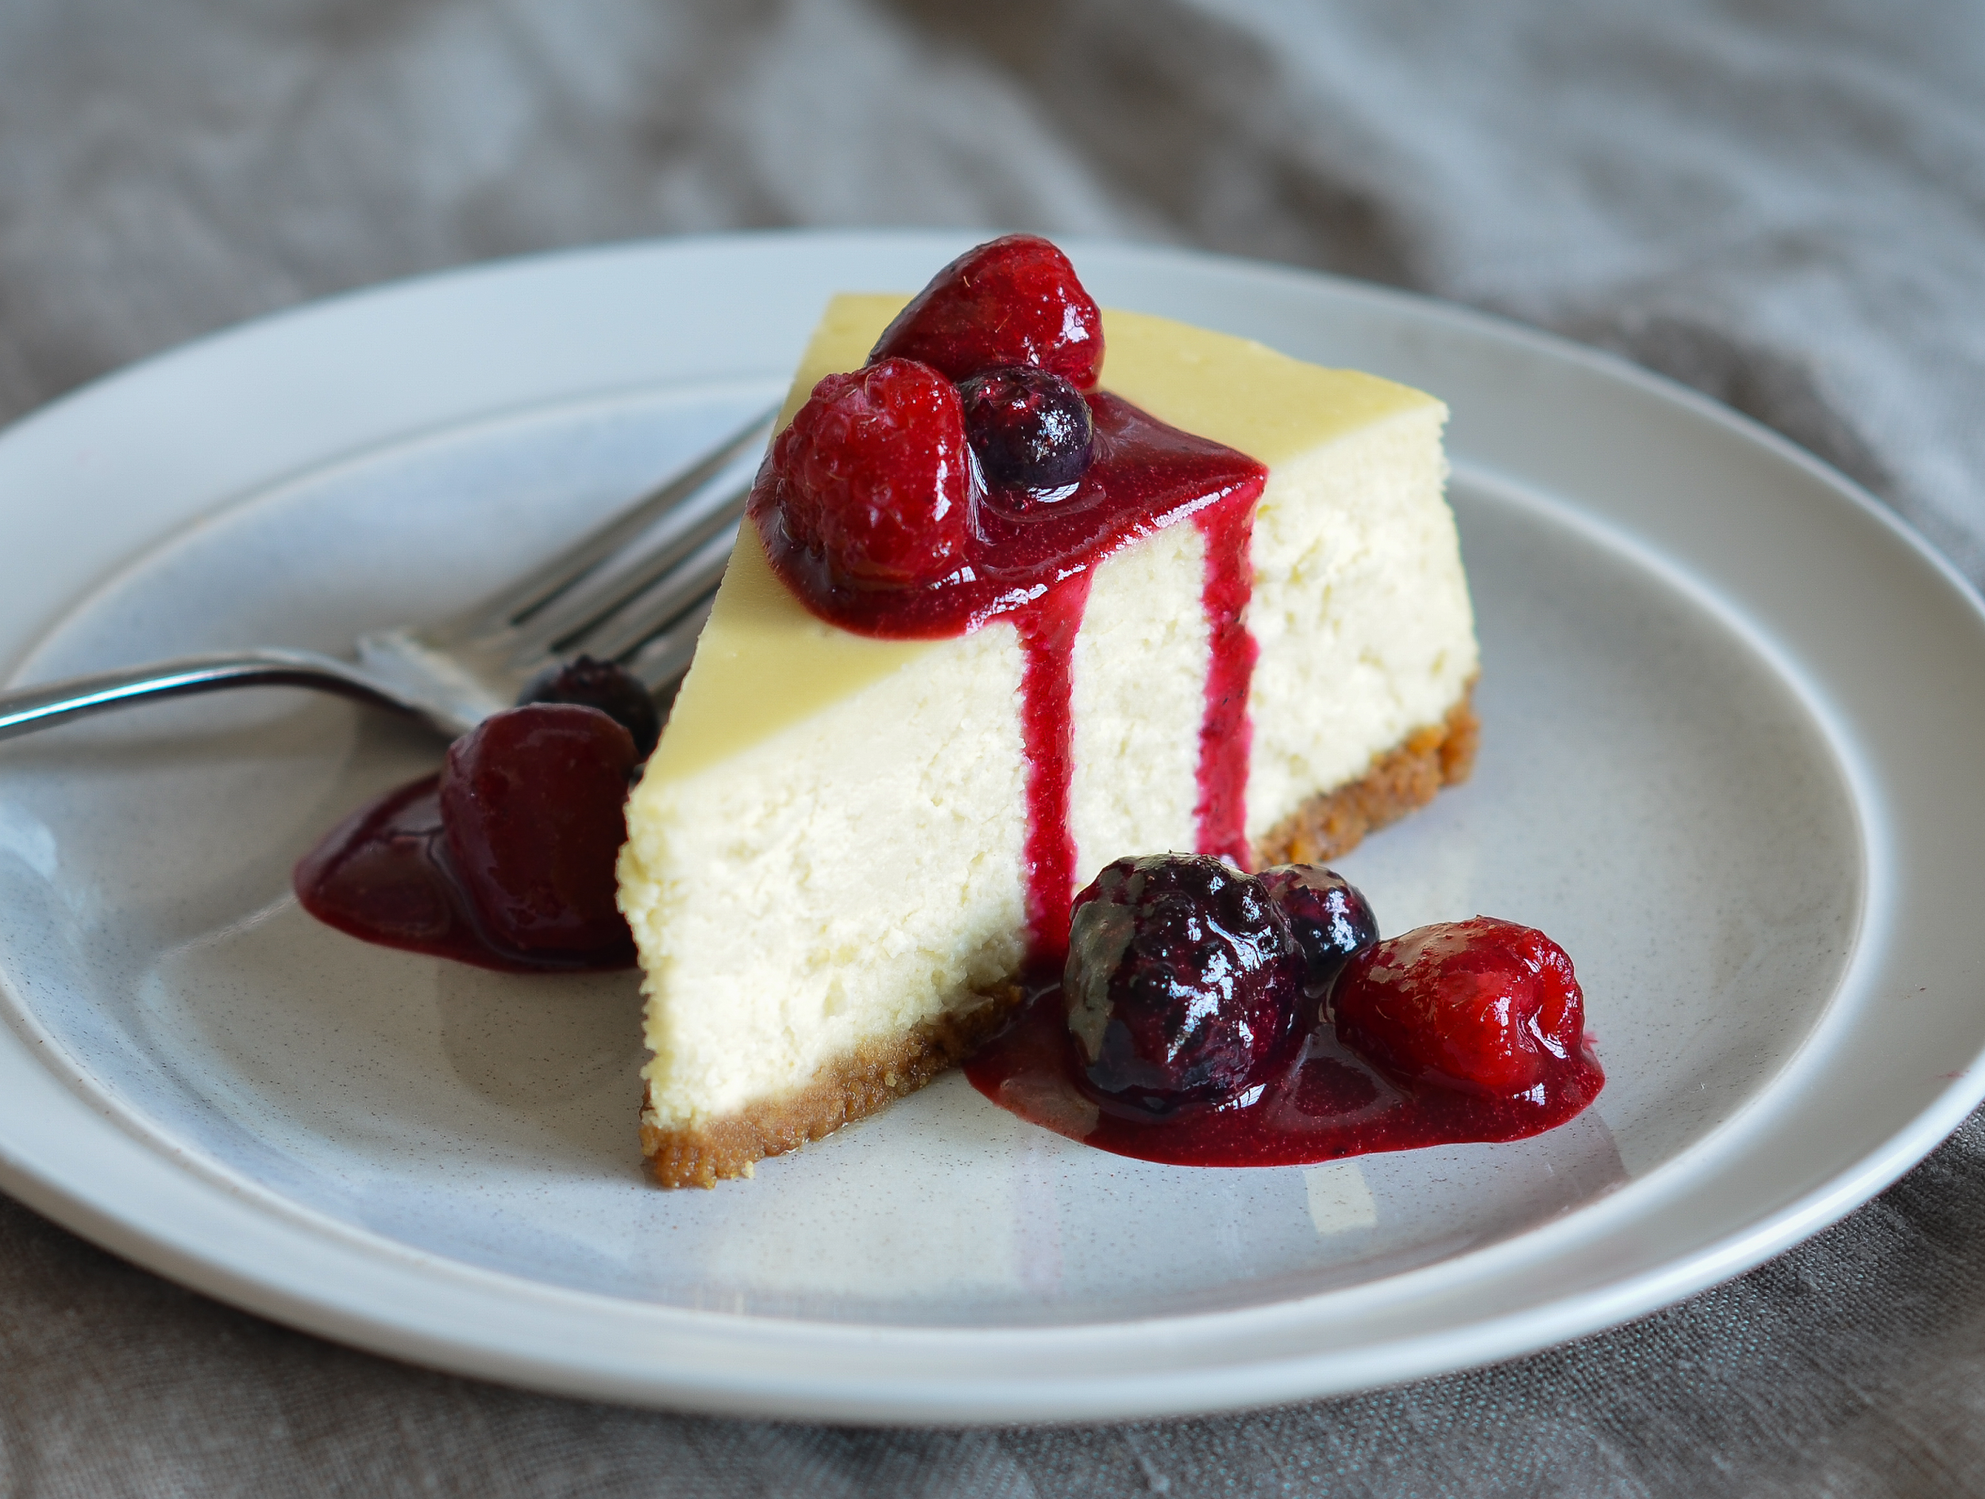
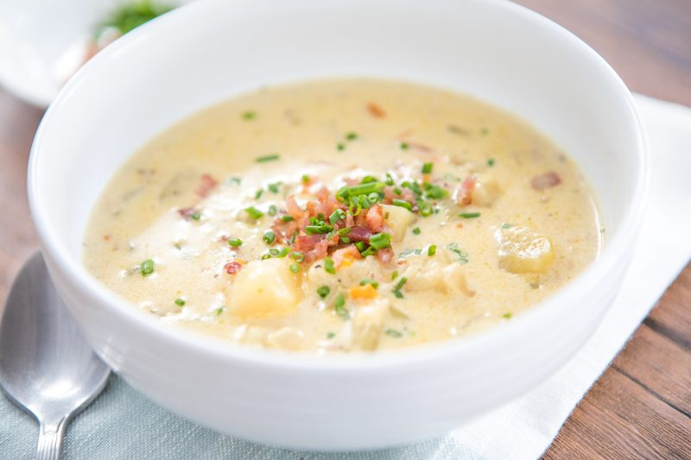

Slide 12
SALTY

Slide 13
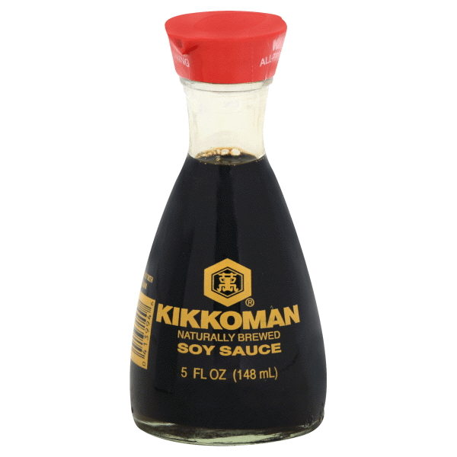
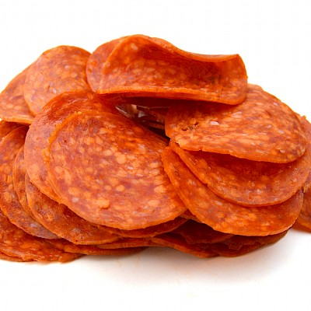

Slide 14
CRUNCHY

Slide 15
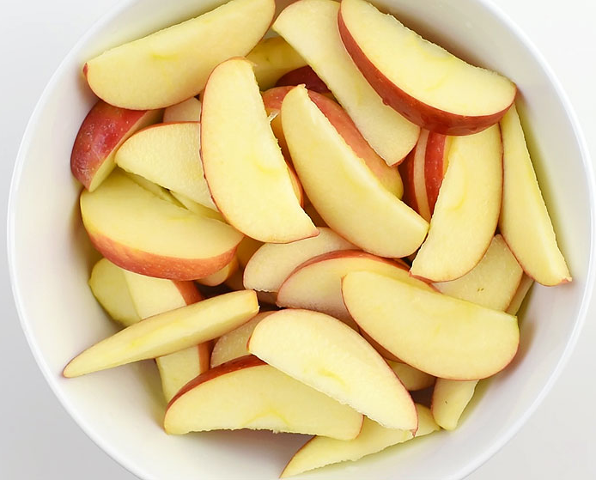
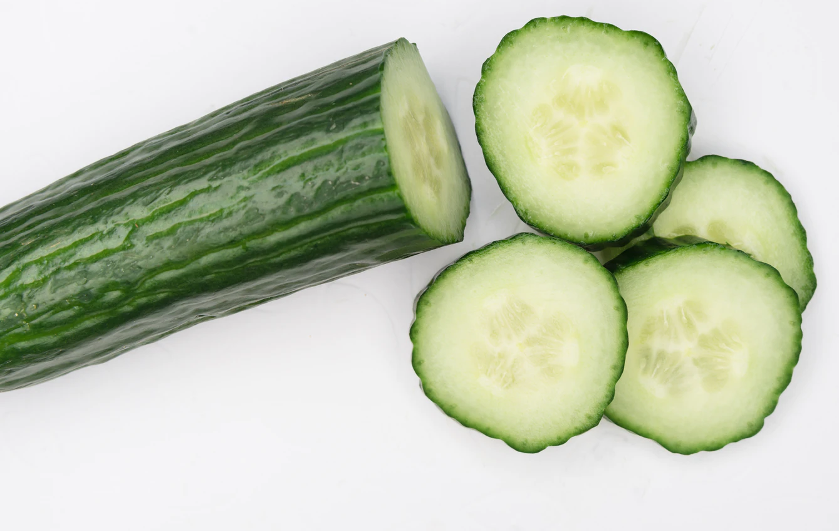
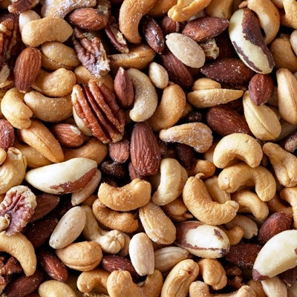

Slide 16
SOUR

Slide 17
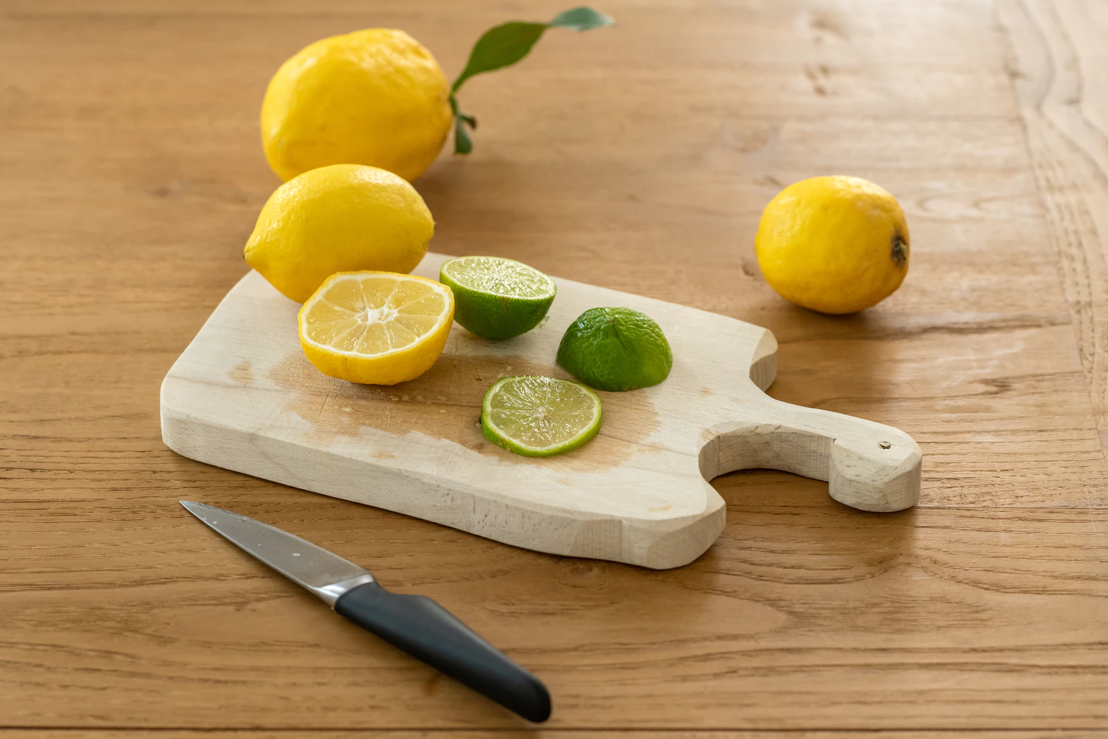
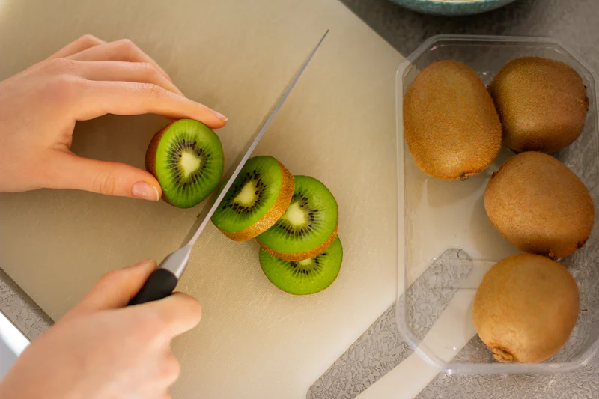

Slide 18
STICKY

Slide 19
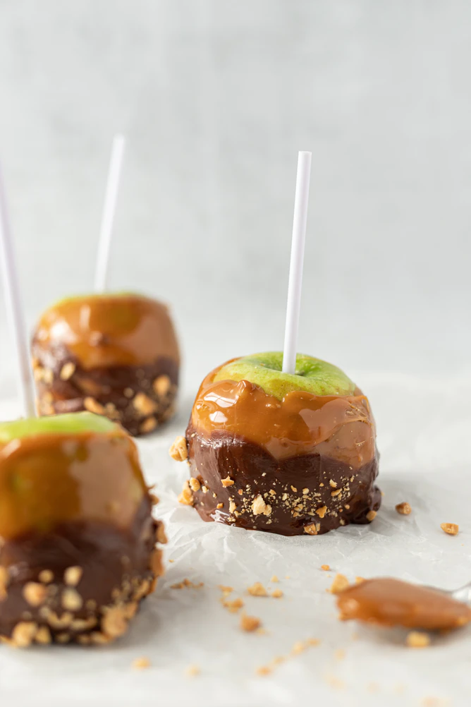
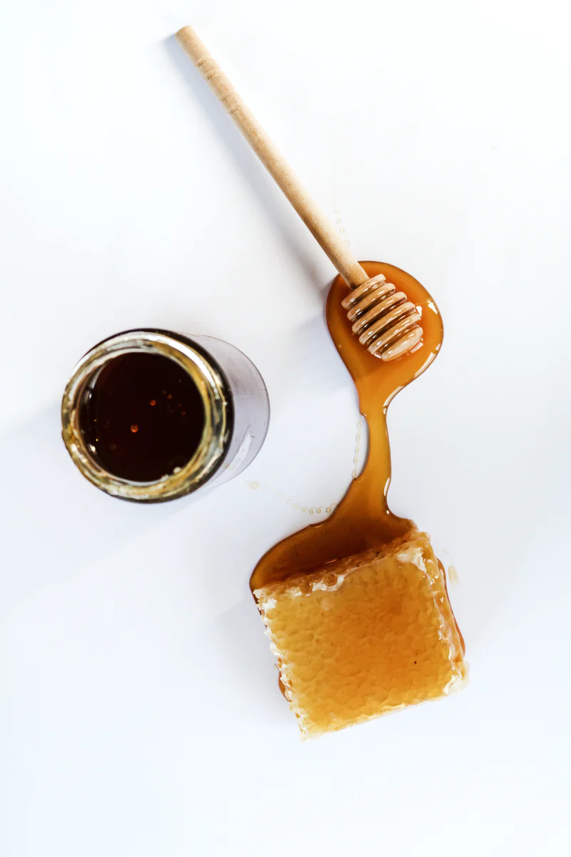

Slide 20
BITTER

Slide 21
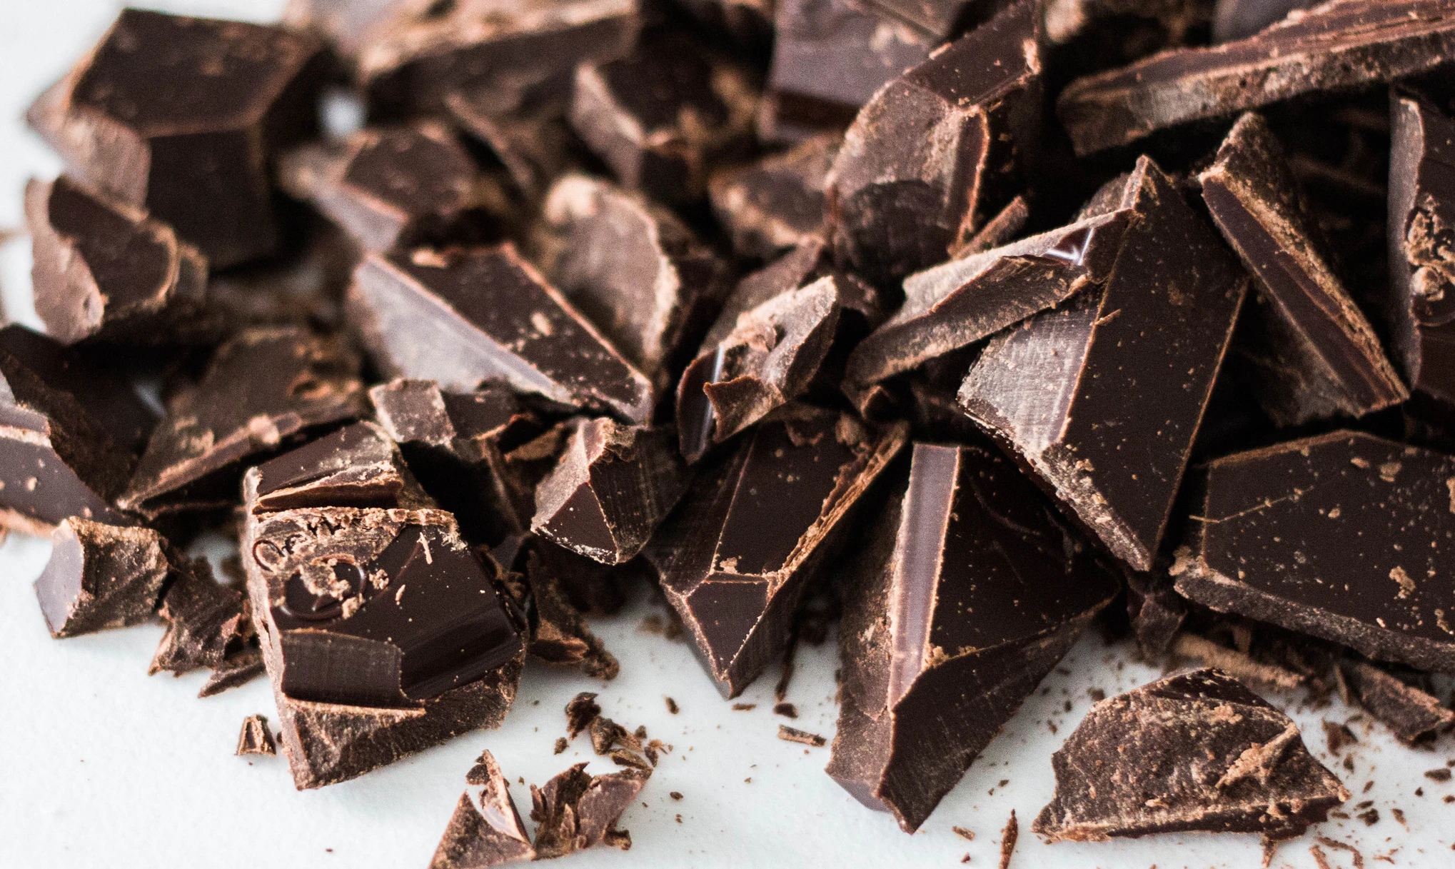
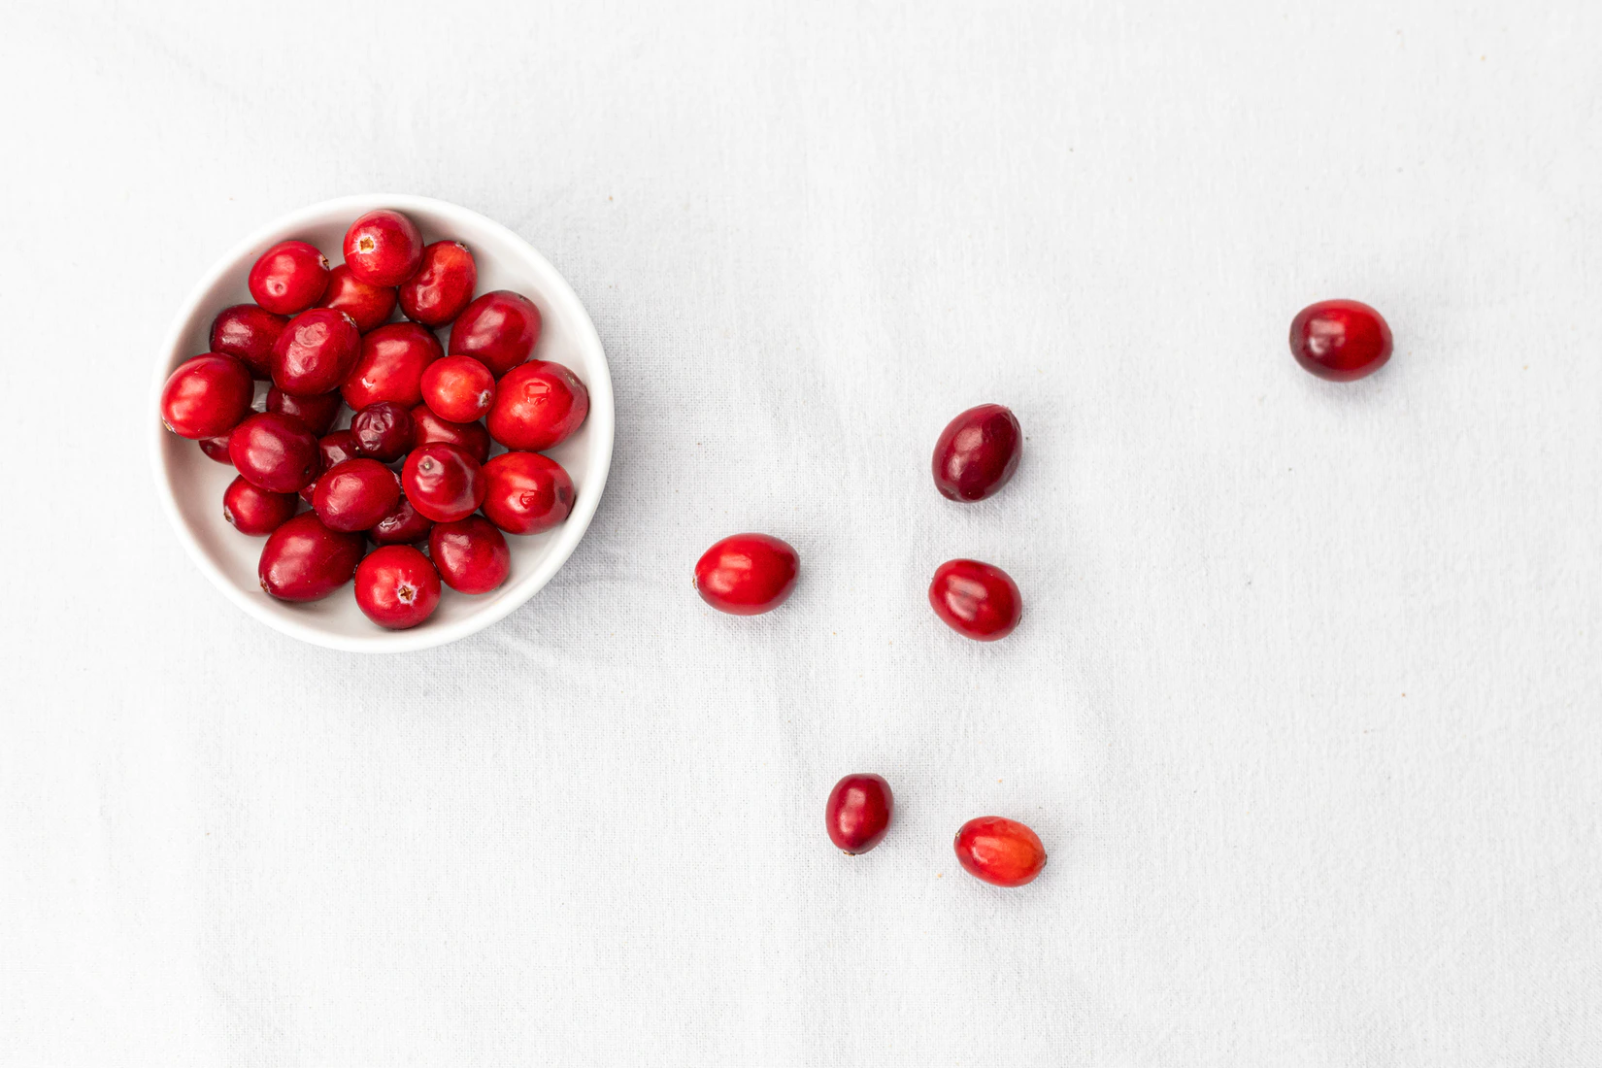
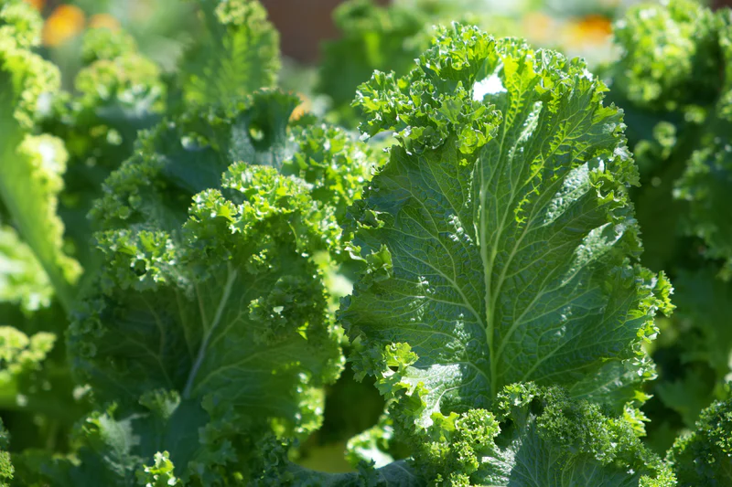

Slide 22
SMOKY

Slide 23
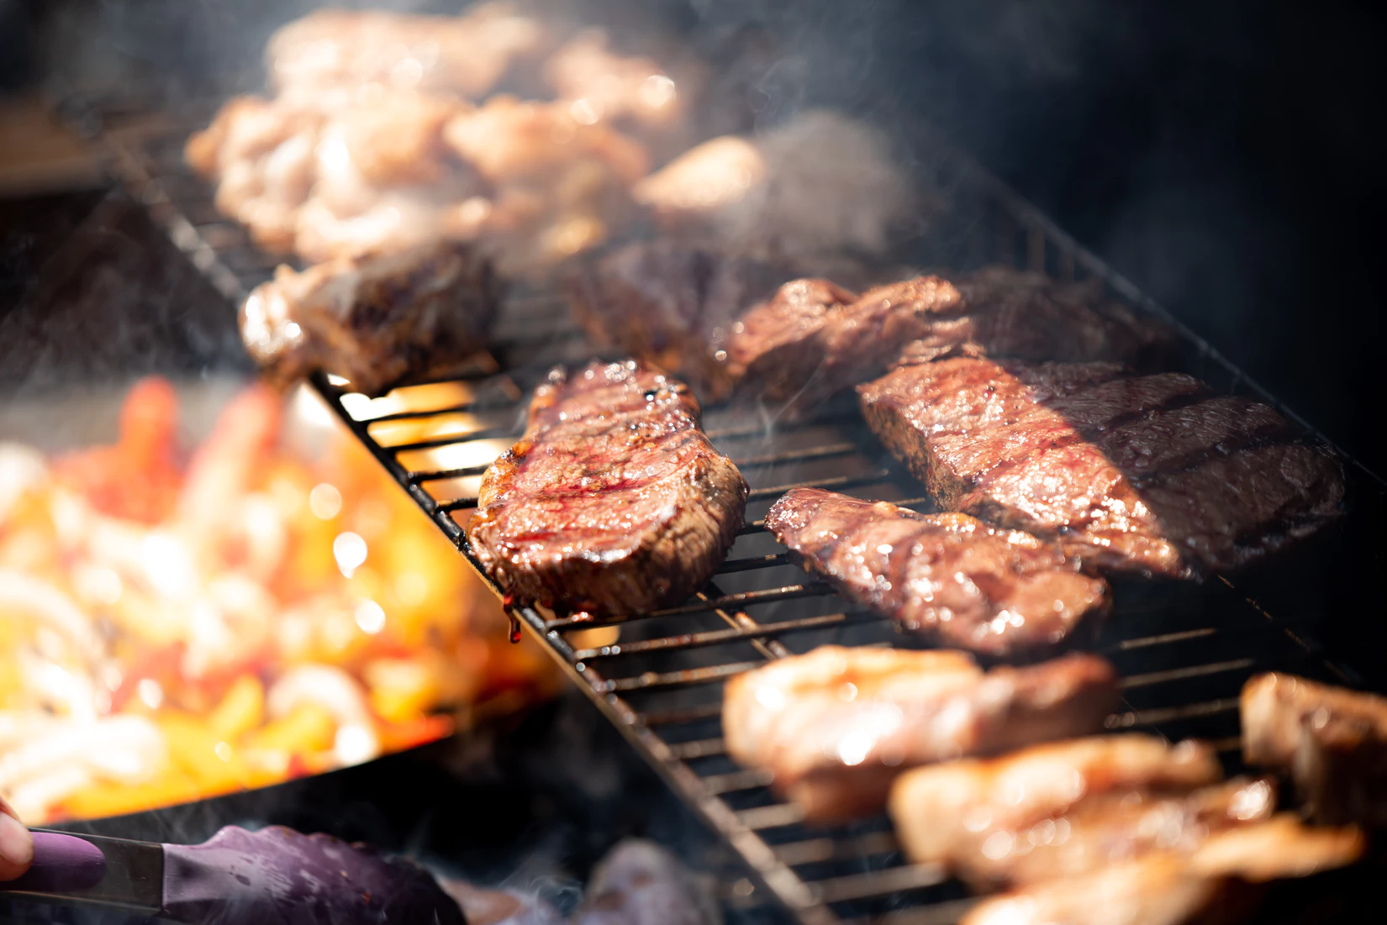

Slide 24
FATTY

Slide 25
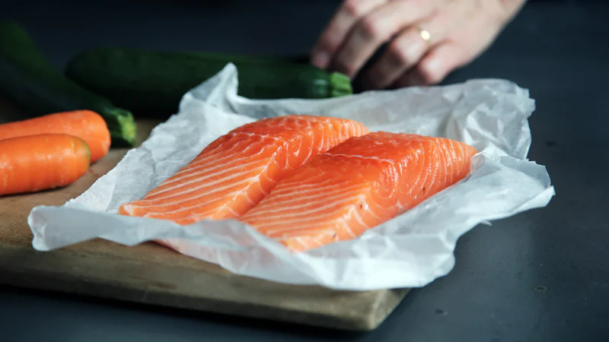
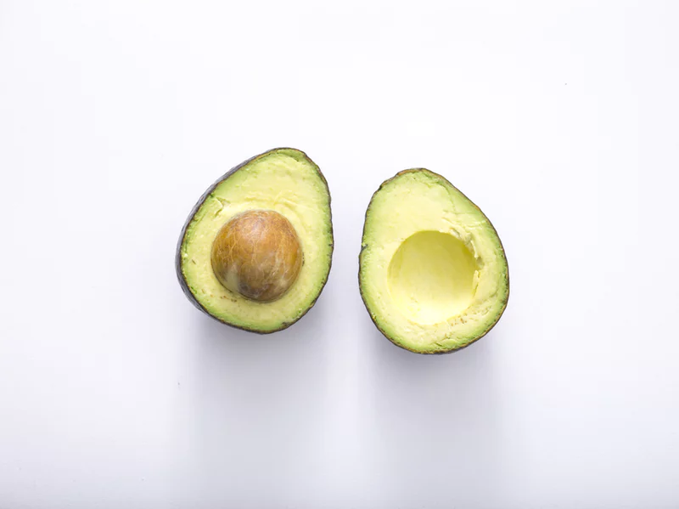

Slide 26
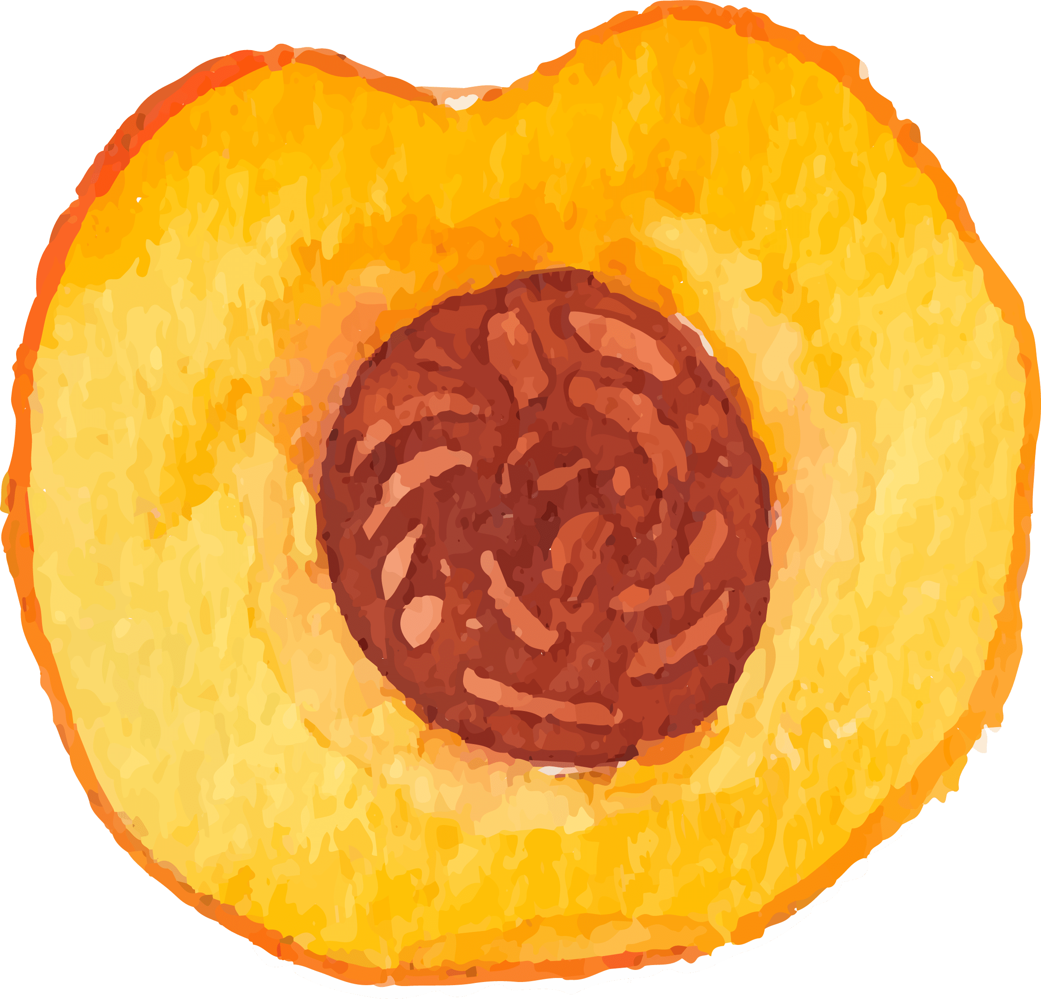
Hands-On Activity Explanation:
Explore your own flavor and texture profile

Slide 27
Flavor and Texture Profile Chart
Dipping food | Dipping flavor | Did you like it? | Describing flavor word | Describing texture word
Ex: Carrot stick | Lemon | Yes | Tart | Crunchy
Cracker | Olive oil | No | Slimy | Soggy
At the end, write in BOLD LETTERS 2 or 3 single flavors/textures or combinations of flavors/textures you liked best

Slide 28
Step 1: Watch the video for step-by-step instructions on creating your own flavor/texture profile.
Step 2: Complete the flavor/texture profile activity.
You may need adult supervision for a couple steps.
Step 3: Once you have completed your flavor/texture profile chart, take a picture and upload it to the ClassDojo profile for this activity.

Slide 29
Exit Ticket:
Type into the chat...
#1
#2
The flavor(s) or texture(s) that you are most excited to try
A flavor or texture that you’ve never had before

