Slide 1
Instructions as you enter the WebEx Virtual Classroom:
01
Make sure your name in the participant list on the right-hand side of the screen shows up as your code that Mara provided you via email (example: 01 01) If your name is not your code, please leave the WebEx virtual classroom and re-enter after you have updated your listed name.
02
Mute yourself by clicking on the microphone icon at the bottom of your screen. Click the button until it is red. You are muted if the microphone icon looks like this:
03
Make sure your camera is on by clicking on the camera button at the bottom of the screen. If it is red, your camera is not on. Click the button until it is NOT red. Your camera is on if the icon looks like this:
Your settings are correct if the bottom of your screen looks something like this and you should see a small picture of yourself in the top or bottom corner:

Slide 2
Welcome
Lesson 3 Grow. Prepare. Eat.
Monday July 13th, 2020

Slide 3
Today’s lesson outline
01
Share about the hands-on activity
02
Nutrition of fruit
intro to knife skills
make a fruit recipe
03
04

Slide 4
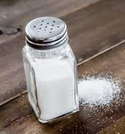
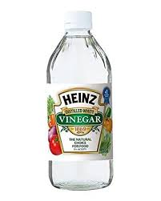
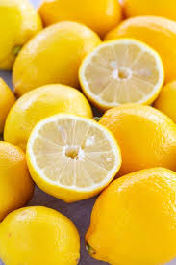
hands-on activity
How did it go trying out different flavor and texture combinations?
What were some of your favorite flavor combinations?
What foods did you use? What did you use for each flavor?
How might you use your favorite flavor combinations in recipes?

Slide 5
WHo has heard of the word “Nutrition”?

Slide 6
What do you think of when you hear the word nutrition?
What do you think it means?

Slide 7
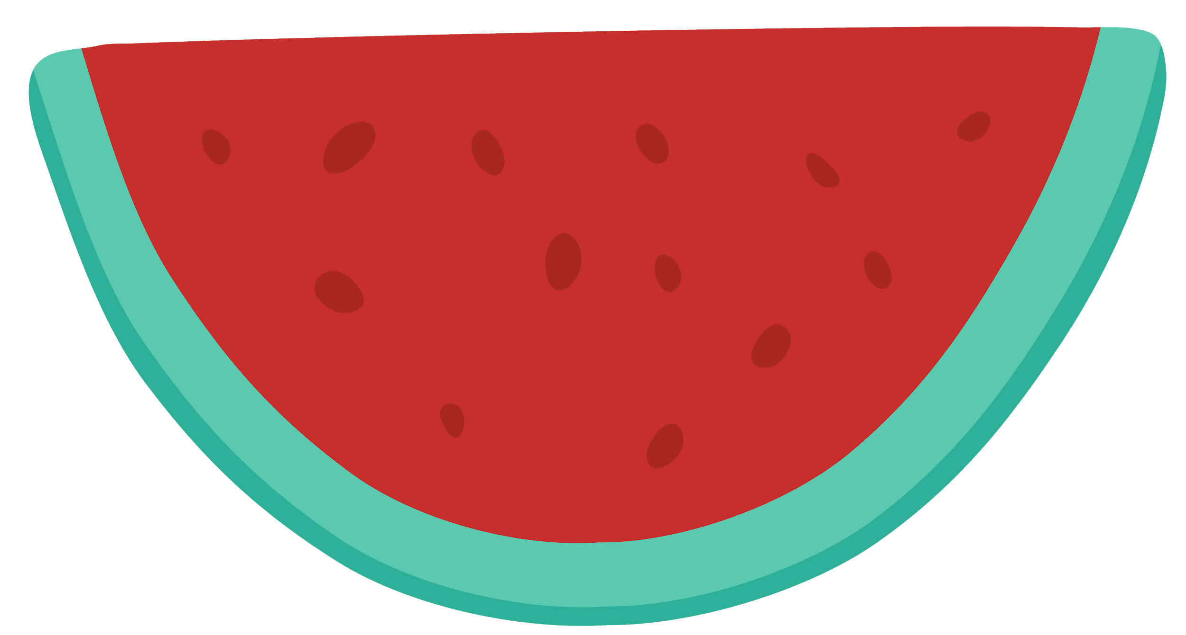
Nutrition is...
All about different foods and what they do for our bodies!

Slide 8
What nutrients are in fruits?
Fiber
Vitamins
water
Carbohydrates
Fiber comes from plants and helps to keep our digestive system and heart healthy.
There are lots of different vitamins, and each one does a special job in your body.
For example, vitamin C helps your body to heal from cuts and scrapes.
Have you ever taken a big bite of fruit and had juice run down your chin? That’s because fruit is full of water!
Carbohydrates provide your body with energy to move around and exercise.

Slide 9
What Nutrients are in Melons?
Vitamin A
Water
Melons, especially cantaloupe and honeydew contain lots of vitamin A.
Vitamin A maintains the health of skin, eyes, and the immune system.
Watermelons are 92% water!
Drinking enough water is important to avoid getting dehydrated, especially when you exercise and sweat.
Potassium
Vitamin C
Potassium is super important for our muscles, heart, and fluid regulation.
Cantaloupe and honeydew contain more potassium than watermelon.
Vitamin C helps our bodies to heal cuts and scrapes, and also helps with immune function.
Cantaloupe and honeydew contain more vitamin C than watermelon.

Slide 10
who has used a knife in the kitchen before?

Slide 11
tips for knife safety in the kitchen
do the bear claw!
always have adult supervision
cut on a stable and smooth surface like a cutting board

Slide 12
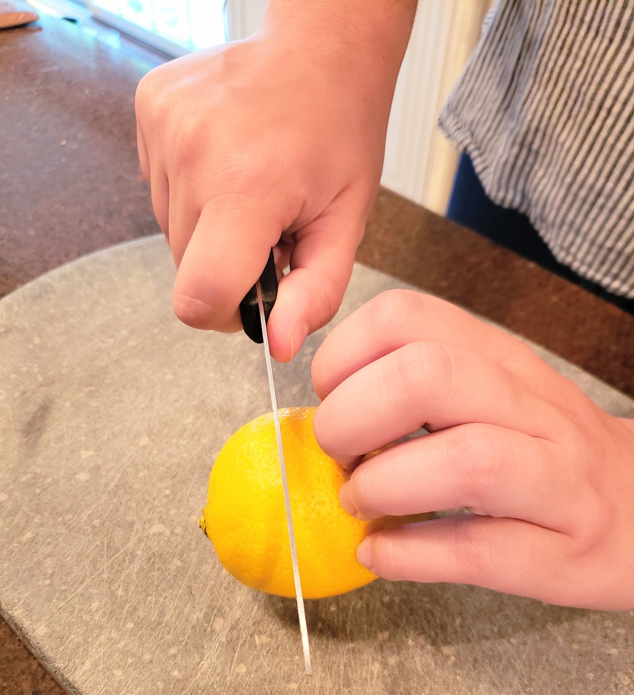
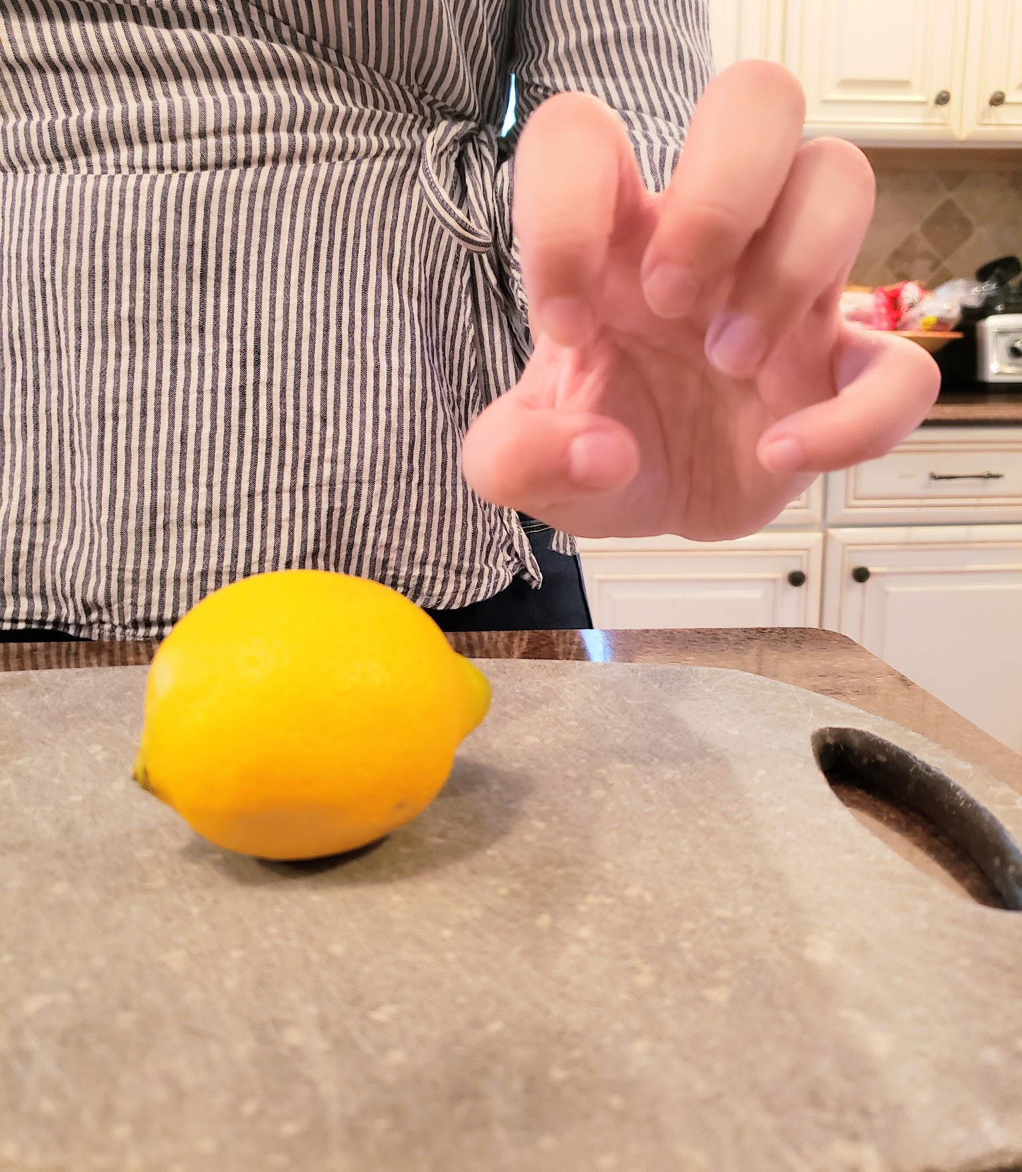
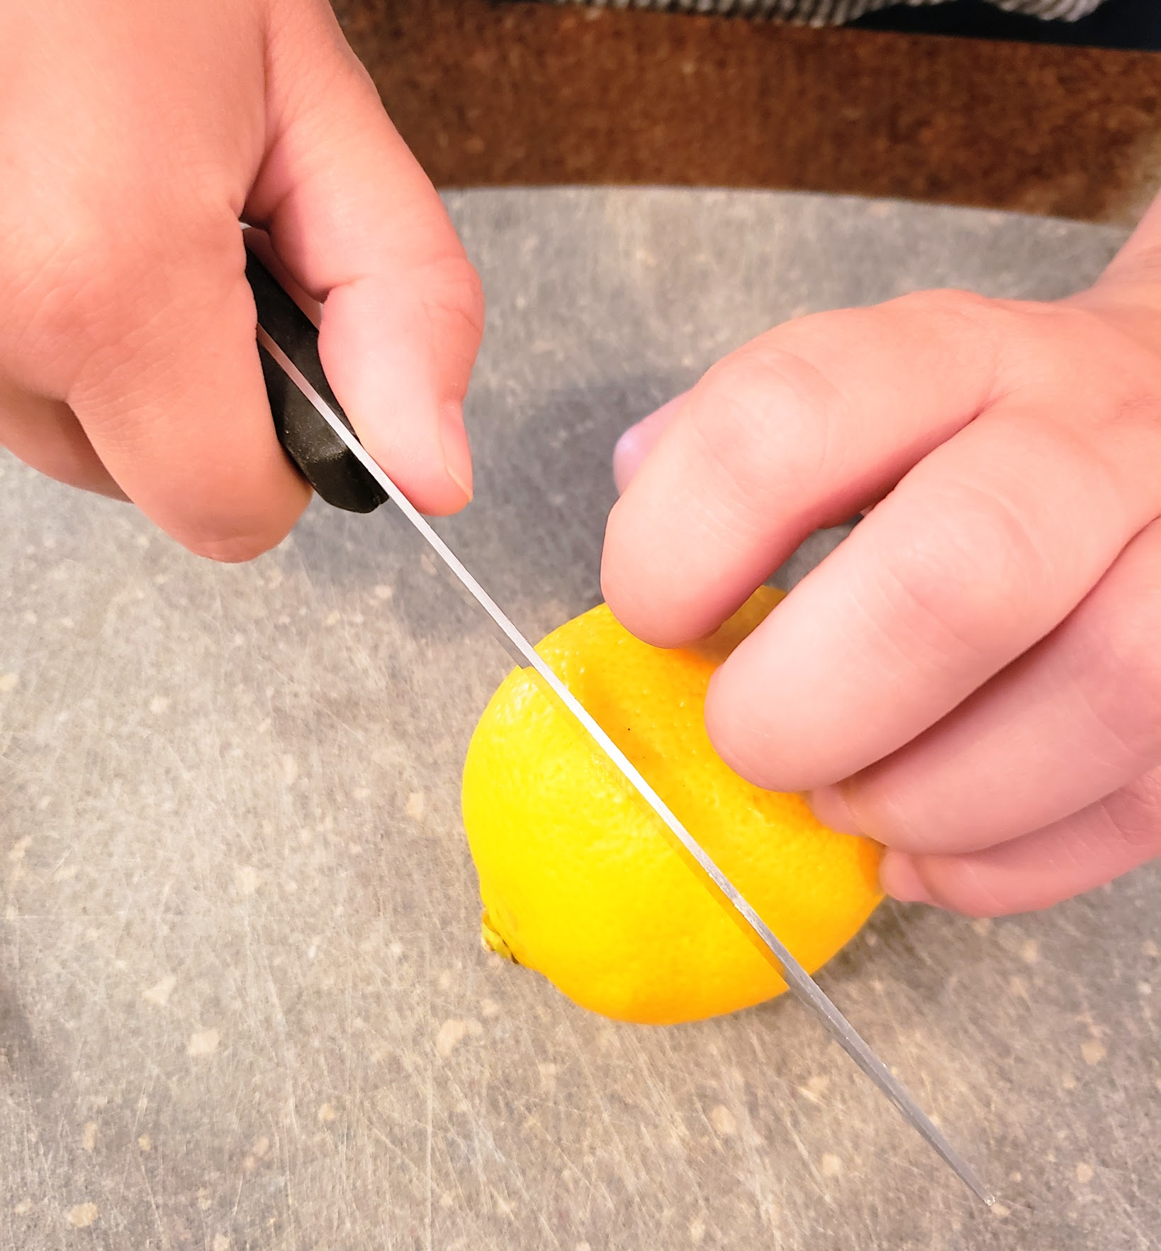
bear claw technique
make a claw shape with your non dominant hand (the one not holding the knife)
this keeps your fingers away from the knife. In case of an accident, the knife would just hit the front of your nails!
30%
use your claw to hold whatever you are chopping

Slide 13
hands-on activity explanation:
Making a fruit recipe

Slide 14
step 1: Watch the videos
videos to watch:
Knife skills video
Watch the video about how to practice safe knife skills in the kitchen using the bear claw technique.
Recipe video
Choose to make either the Baked Apples recipe or the Fruit 2 Ways recipe, and watch the corresponding video for instructions.

Slide 15
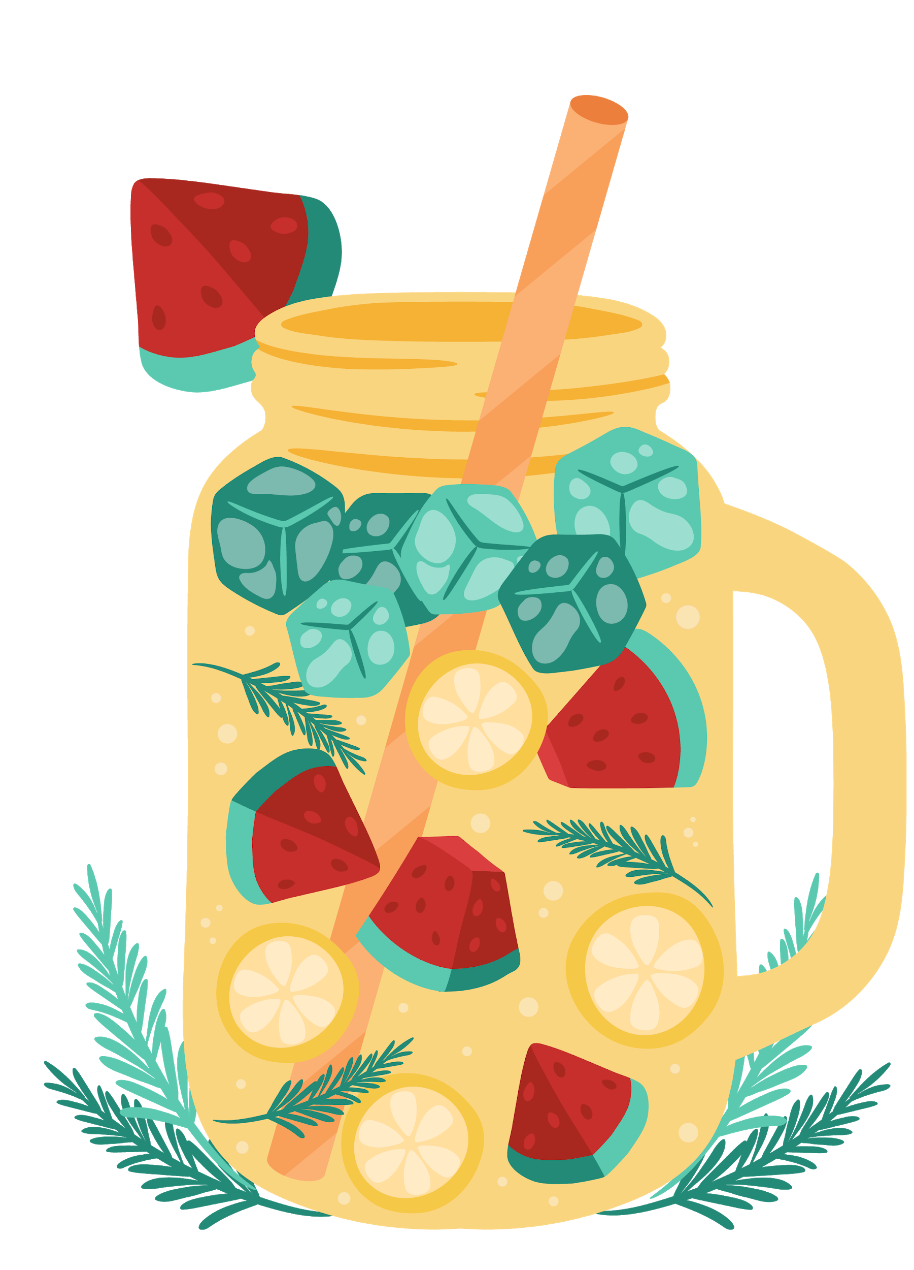
Step 2: make the recipe
Next, make the recipe!
Remember to have adult supervision while preparing the recipe and refer back to the videos for instructions
Once you are finished, take a picture or video of your creation and upload it to ClassDojo!

Slide 16
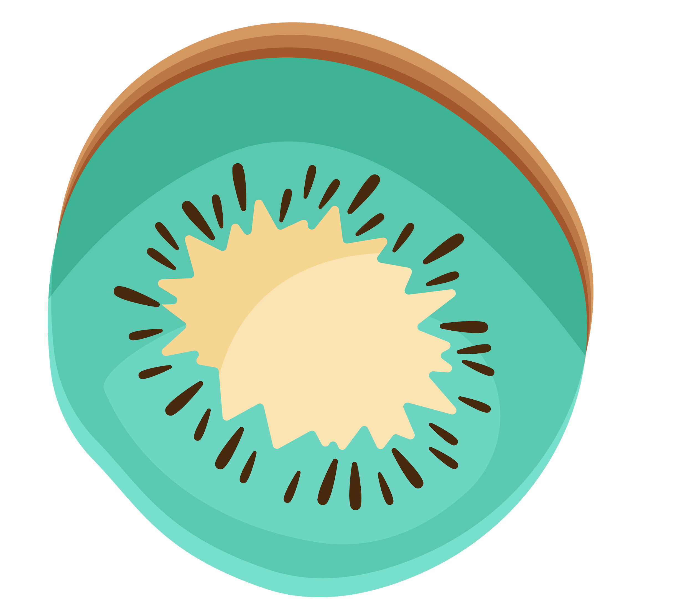
exit ticket:
Please…
Share 1 new idea you learned about today
Show us how you use the bear claw technique

