Slide 1
Instructions as you enter the WebEx Virtual Classroom:
01
Make sure your name in the participant list on the right-hand side of the screen shows up as your code that Mara provided you via email (example: 01 01) If your name is not your code, please leave the WebEx virtual classroom and re-enter after you have updated your listed name.
02
Mute yourself by clicking on the microphone icon at the bottom of your screen. Click the button until it is red. You are muted if the microphone icon looks like this:
03
Make sure your camera is on by clicking on the camera button at the bottom of the screen. If it is red, your camera is not on. Click the button until it is NOT red. Your camera is on if the icon looks like this:
Your settings are correct if the bottom of your screen looks something like this and you should see a small picture of yourself in the top or bottom corner:

Slide 2
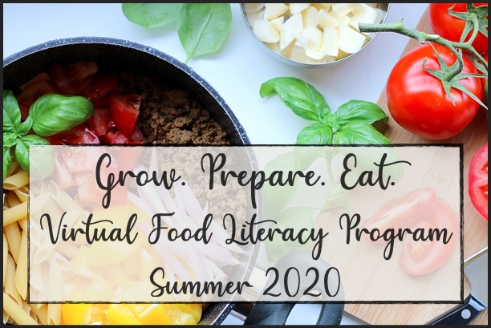
Welcome
Lesson 5 Grow. Prepare. Eat
Monday July 20th, 2020

Slide 3
Share About the Hands-On Activity
Today’s Lesson Outline
Intro to Servings
Nutrition Label Hunt

Slide 4
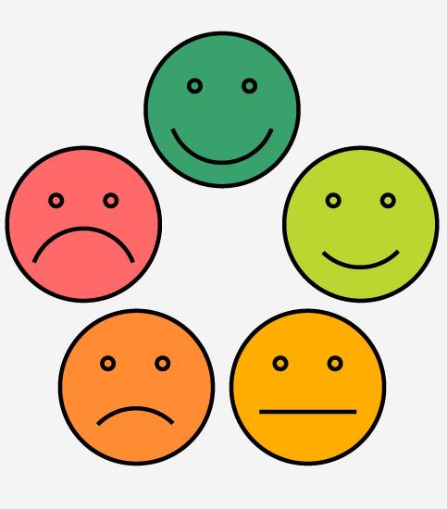
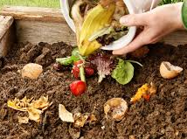
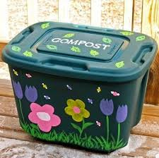
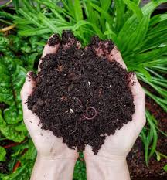
Hands-On Activity
How did it go making your own compost?
What did you add to your compost?
What container did you use to hold your compost?
What do you predict will happen to your compost? How will you use it?

Slide 5
What is a serving of food?

Slide 6
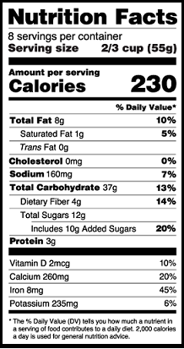
A serving size is...
The amount of food listed on a nutrition facts label
Measured with cups, ounces, tablespoons etc.

Slide 7
How do we decide how much to eat?
When are you hungriest?
Do you eat the same amount of food as….
Your parents?
4 year old you?
An older sibling or cousin?
Notes:
Series of questions to prompt discussion, animate separately
Do you eat the same amount of food as your parents, siblings, do you eat the same amount of food now vs. when you were 4 years old
Lead into discussion about portion sizes, how do we decide how much to eat, scenario examples, let kids choose how much to eat based on hunger, guide thru practical applications

Slide 8
How do we measure a serving?

Slide 9
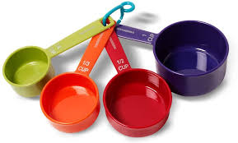
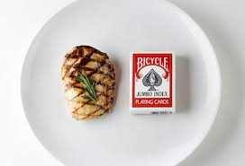

Slide 10
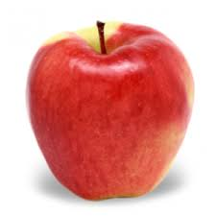
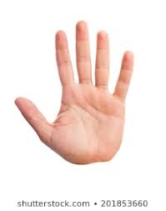
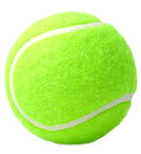
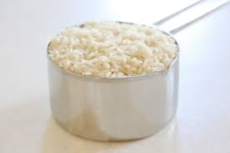
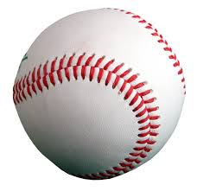
Match each food to the object/hand that shows a typical serving size
1 medium fruit
3 ounces of chicken or meat
Tennis ball or fist
Deck or cards or palm of hand
1 cup of fruits and vegetables or cooked rice and pasta
Baseball

Slide 11
Hands-On Activity Explanation:
Nutrition Label Hunt

Slide 12
Nutrition Label Hunt
Step 2
Step 3
Step 4
Step 5
Step 1
Watch the video that shows how to read a nutrition facts label.
Find 6-10 foods in your home. Make sure at least some of them have a nutrition facts label.
Read the label to find the serving size. Measure a serving of each food into a bowl or plate.
Take a picture of all of the foods with the labels next to them. Upload your pictures to ClassDojo.
Arrange the foods from smallest to largest amount.

Slide 13
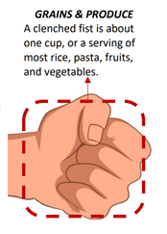
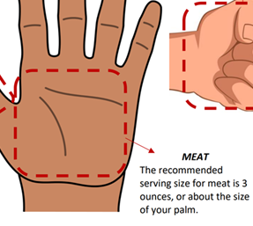
Exit Ticket
Think about a typical serving size of each food.
Type in the chat an object in your house close to that size.
Vegetables
Protein or Meat
Hint: A typical serving is 1 cup
Hint: A typical serving is 3 ounces

