Slide 1
Instructions as you enter the WebEx Virtual Classroom:
01
Make sure your name in the participant list on the right-hand side of the screen shows up as your code that Mara provided you via email (example: 01 01) If your name is not your code, please leave the WebEx virtual classroom and re-enter after you have updated your listed name.
02
Mute yourself by clicking on the microphone icon at the bottom of your screen. Click the button until it is red. You are muted if the microphone icon looks like this:
03
Make sure your camera is on by clicking on the camera button at the bottom of the screen. If it is red, your camera is not on. Click the button until it is NOT red. Your camera is on if the icon looks like this:
Your settings are correct if the bottom of your screen looks something like this and you should see a small picture of yourself in the top or bottom corner:
Notes:
Reminder: find paper and writing utensil for exit ticket while waiting to start

Slide 2
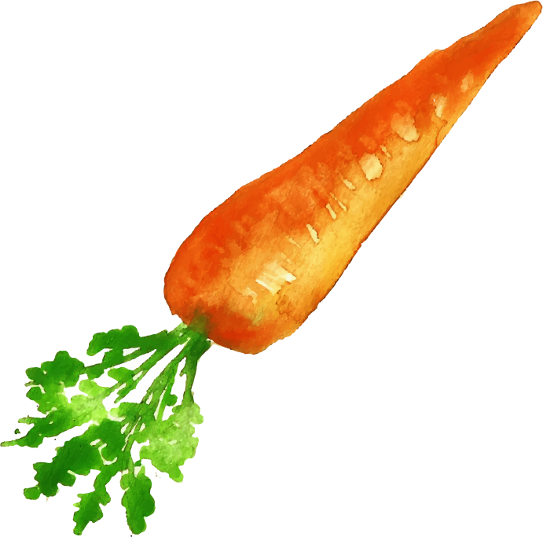
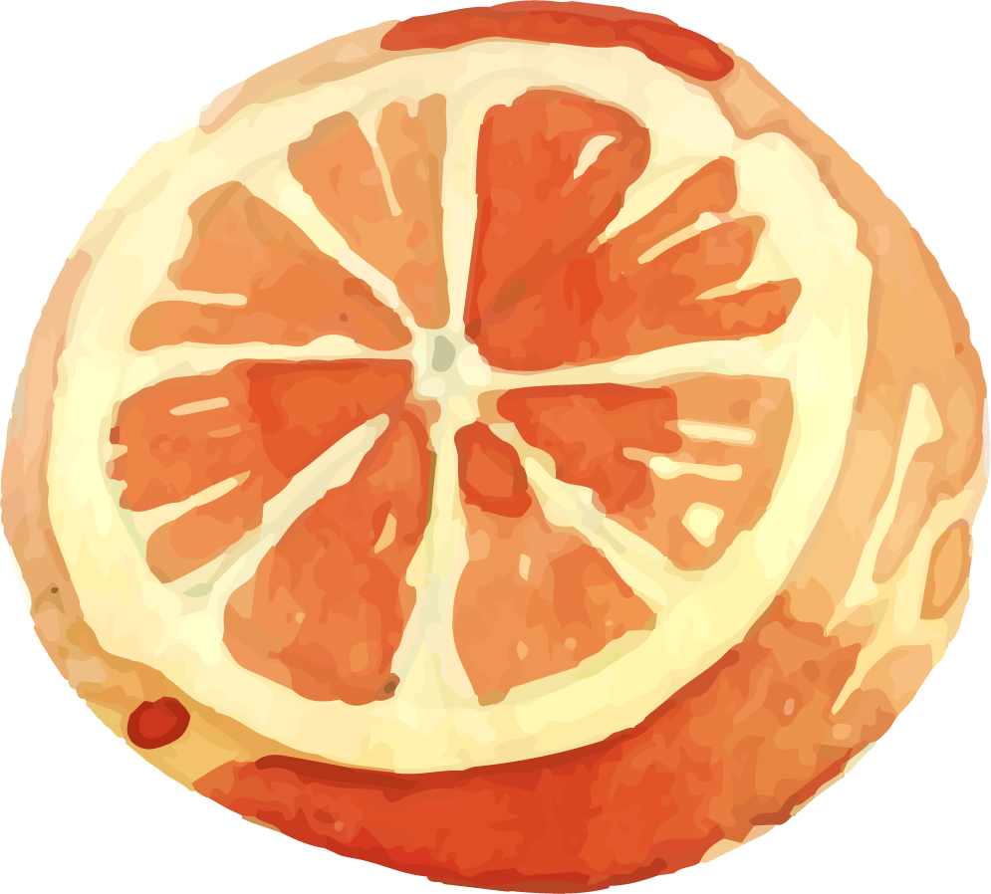
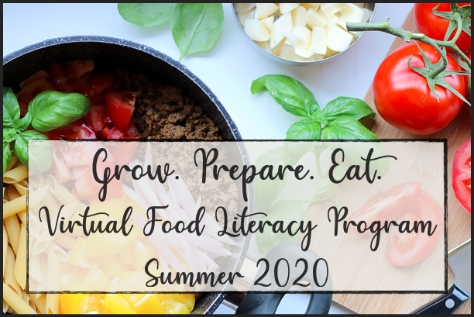
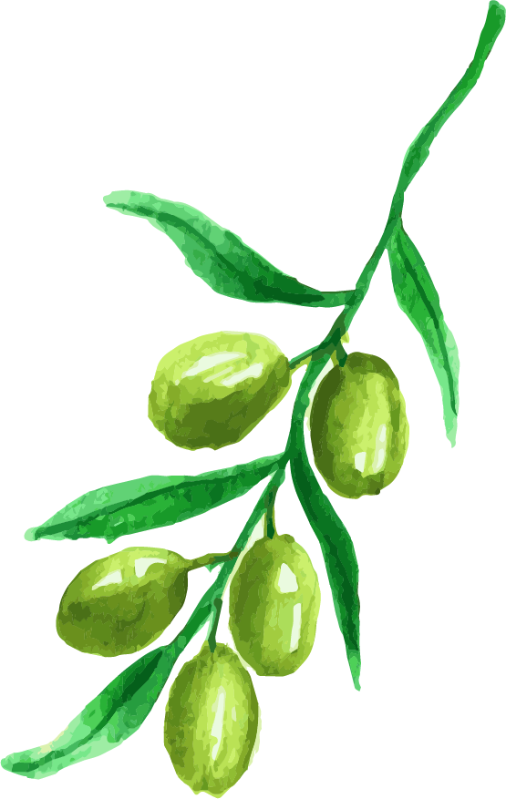
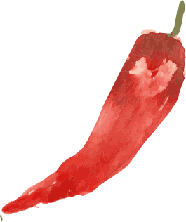
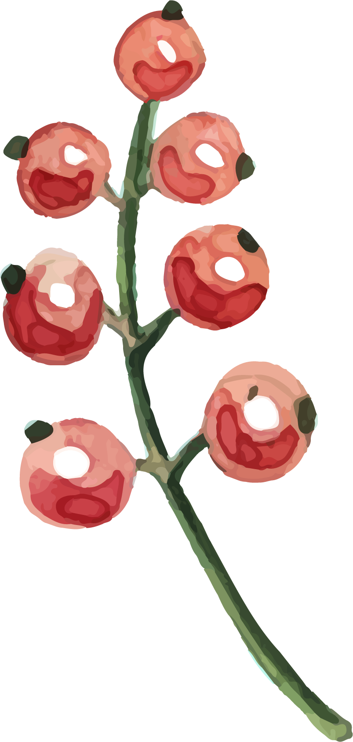
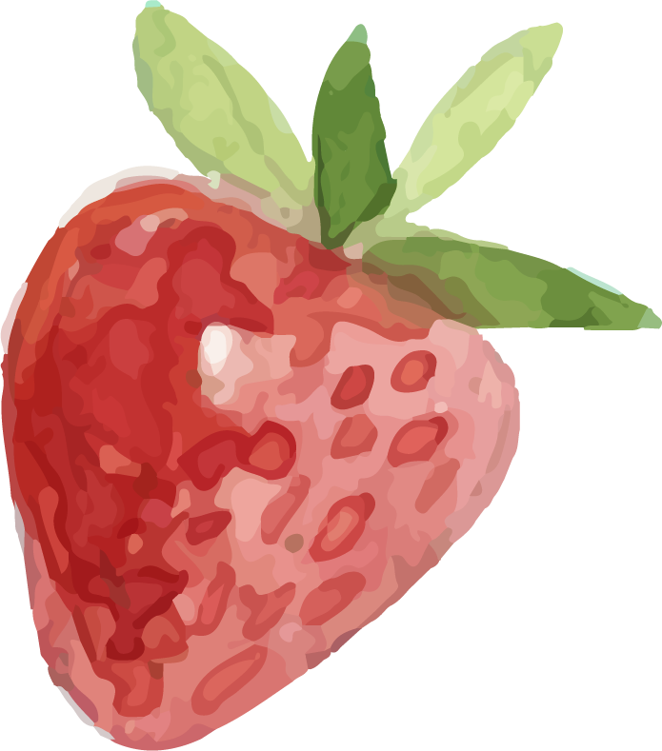
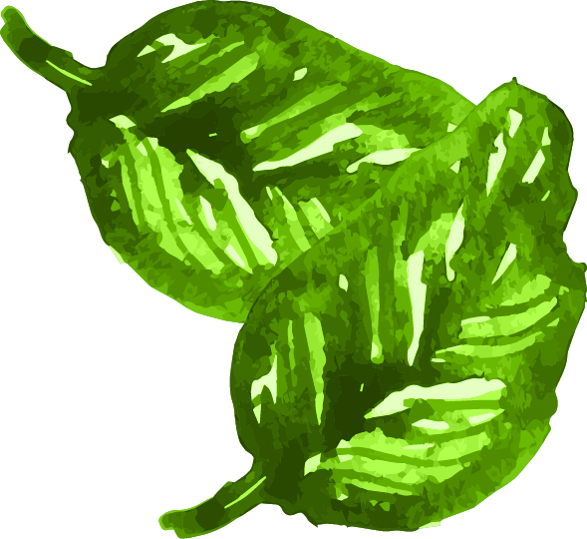
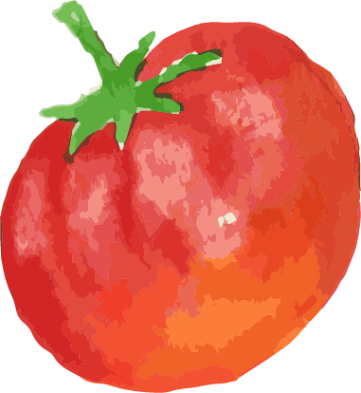
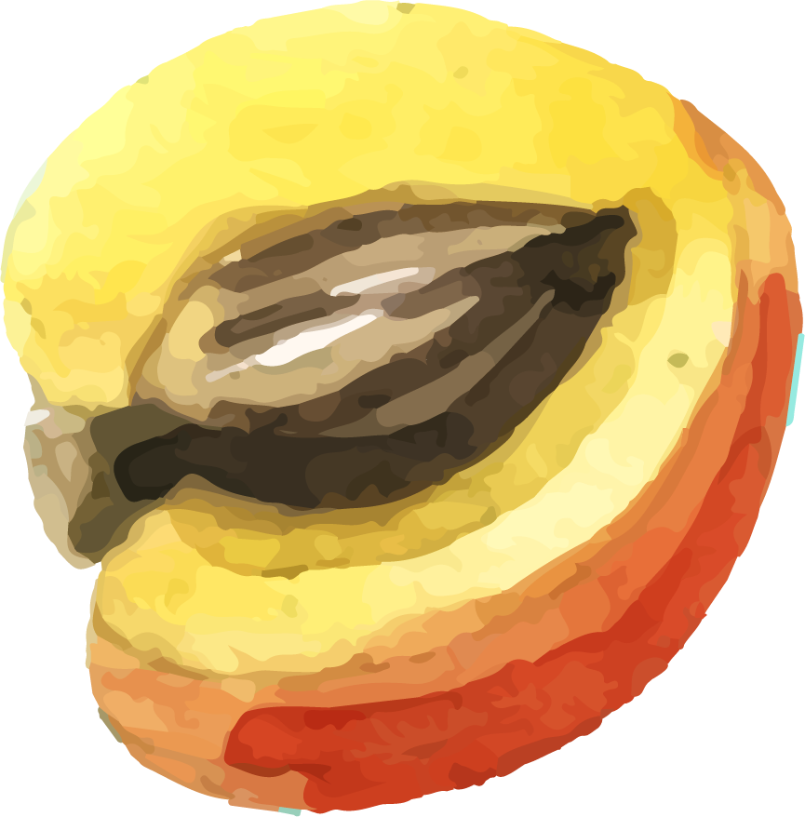
Welcome
Lesson 6 Grow. Prepare. Eat
Thursday July 23rd, 2020

Slide 3
Today’s Lesson Outline
01
02
Share About the Hands-On Activity
Nutrition of Tomatoes and Cucumbers
03
04
Go, Slow, Whoa
Make a Vegetable Recipe

Slide 4
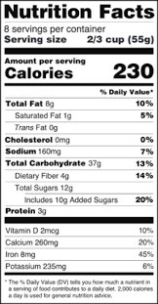
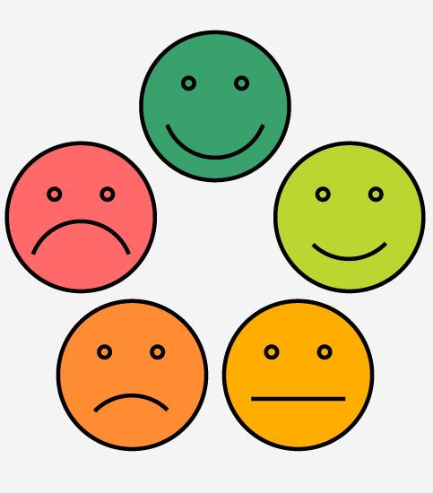
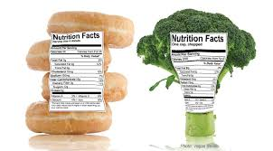
HANDS-ON Activity
How did it go doing the nutrition label hunt activity?
Was it easy or hard to read the nutrition facts labels?
What foods did you find?
Did any foods not have labels?
Did anything surprise you?
Which food had the biggest serving size?
Which food had the smallest serving size?
How do you feel about reading nutrition facts labels now?

Slide 5
Review: What is nutrition?

Slide 6
What Nutrients are in Tomatoes and Cucumbers?
Fiber
Vitamin C
Magnesium
Vitamin K
Potassium
Review
Review
Fiber helps to keep our hearts and stomachs healthy.
Vitamin C helps with healing and the immune system.
Magnesium helps keep our bodies overall healthy, especially our muscles.
Review
Vitamin K helps keep our blood, bones, and heart healthy.
Potassium contributes to healthy muscles, heart, and fluid regulation.

Slide 7
Go, Slow, Whoa
Whoa
Slow
Go
Eat on special occasions, or once in a while
These foods do not help our bodies
Eat sometimes, or a few times a week
These foods are in the middle/kind of helpful
Eat almost anytime
These foods help our bodies to “go”!

Slide 8
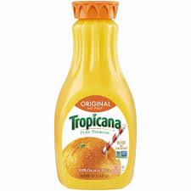
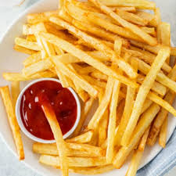
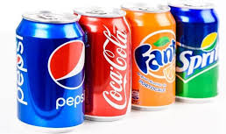
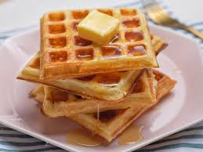
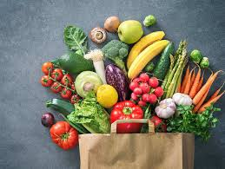
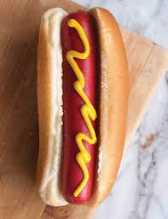
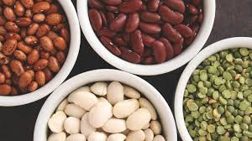
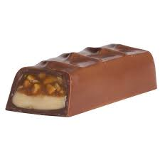
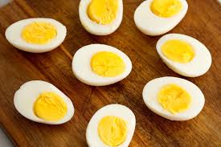
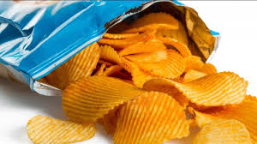
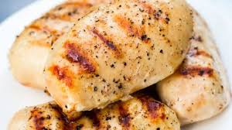
GO
SLOW
WHOA

Slide 9
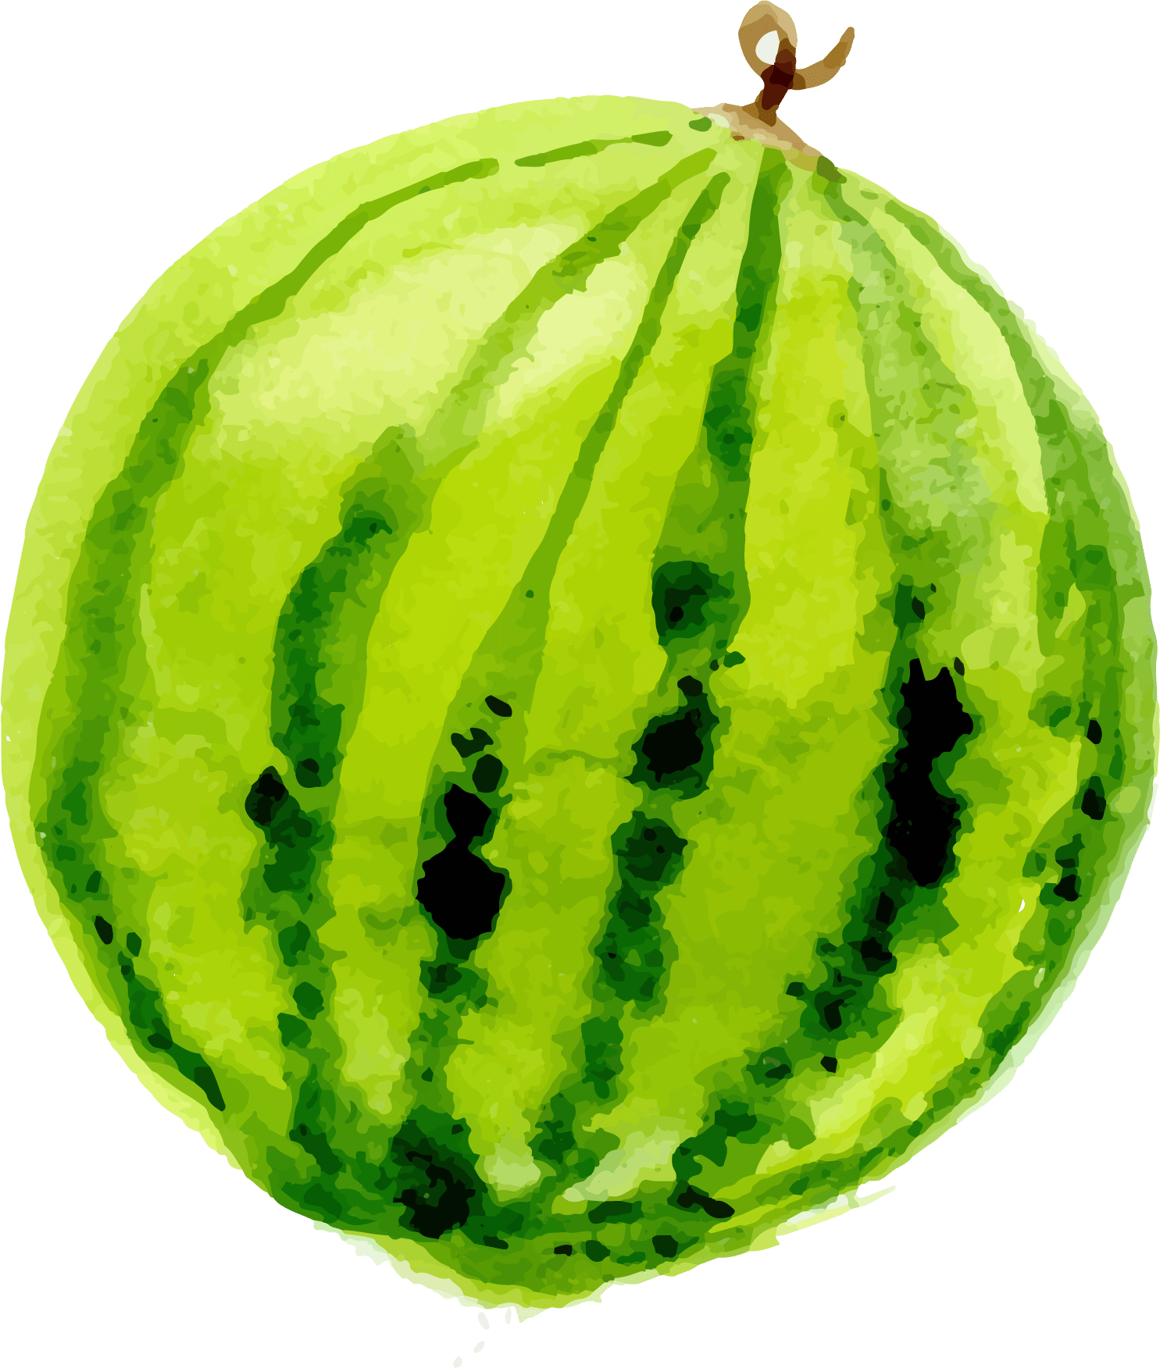
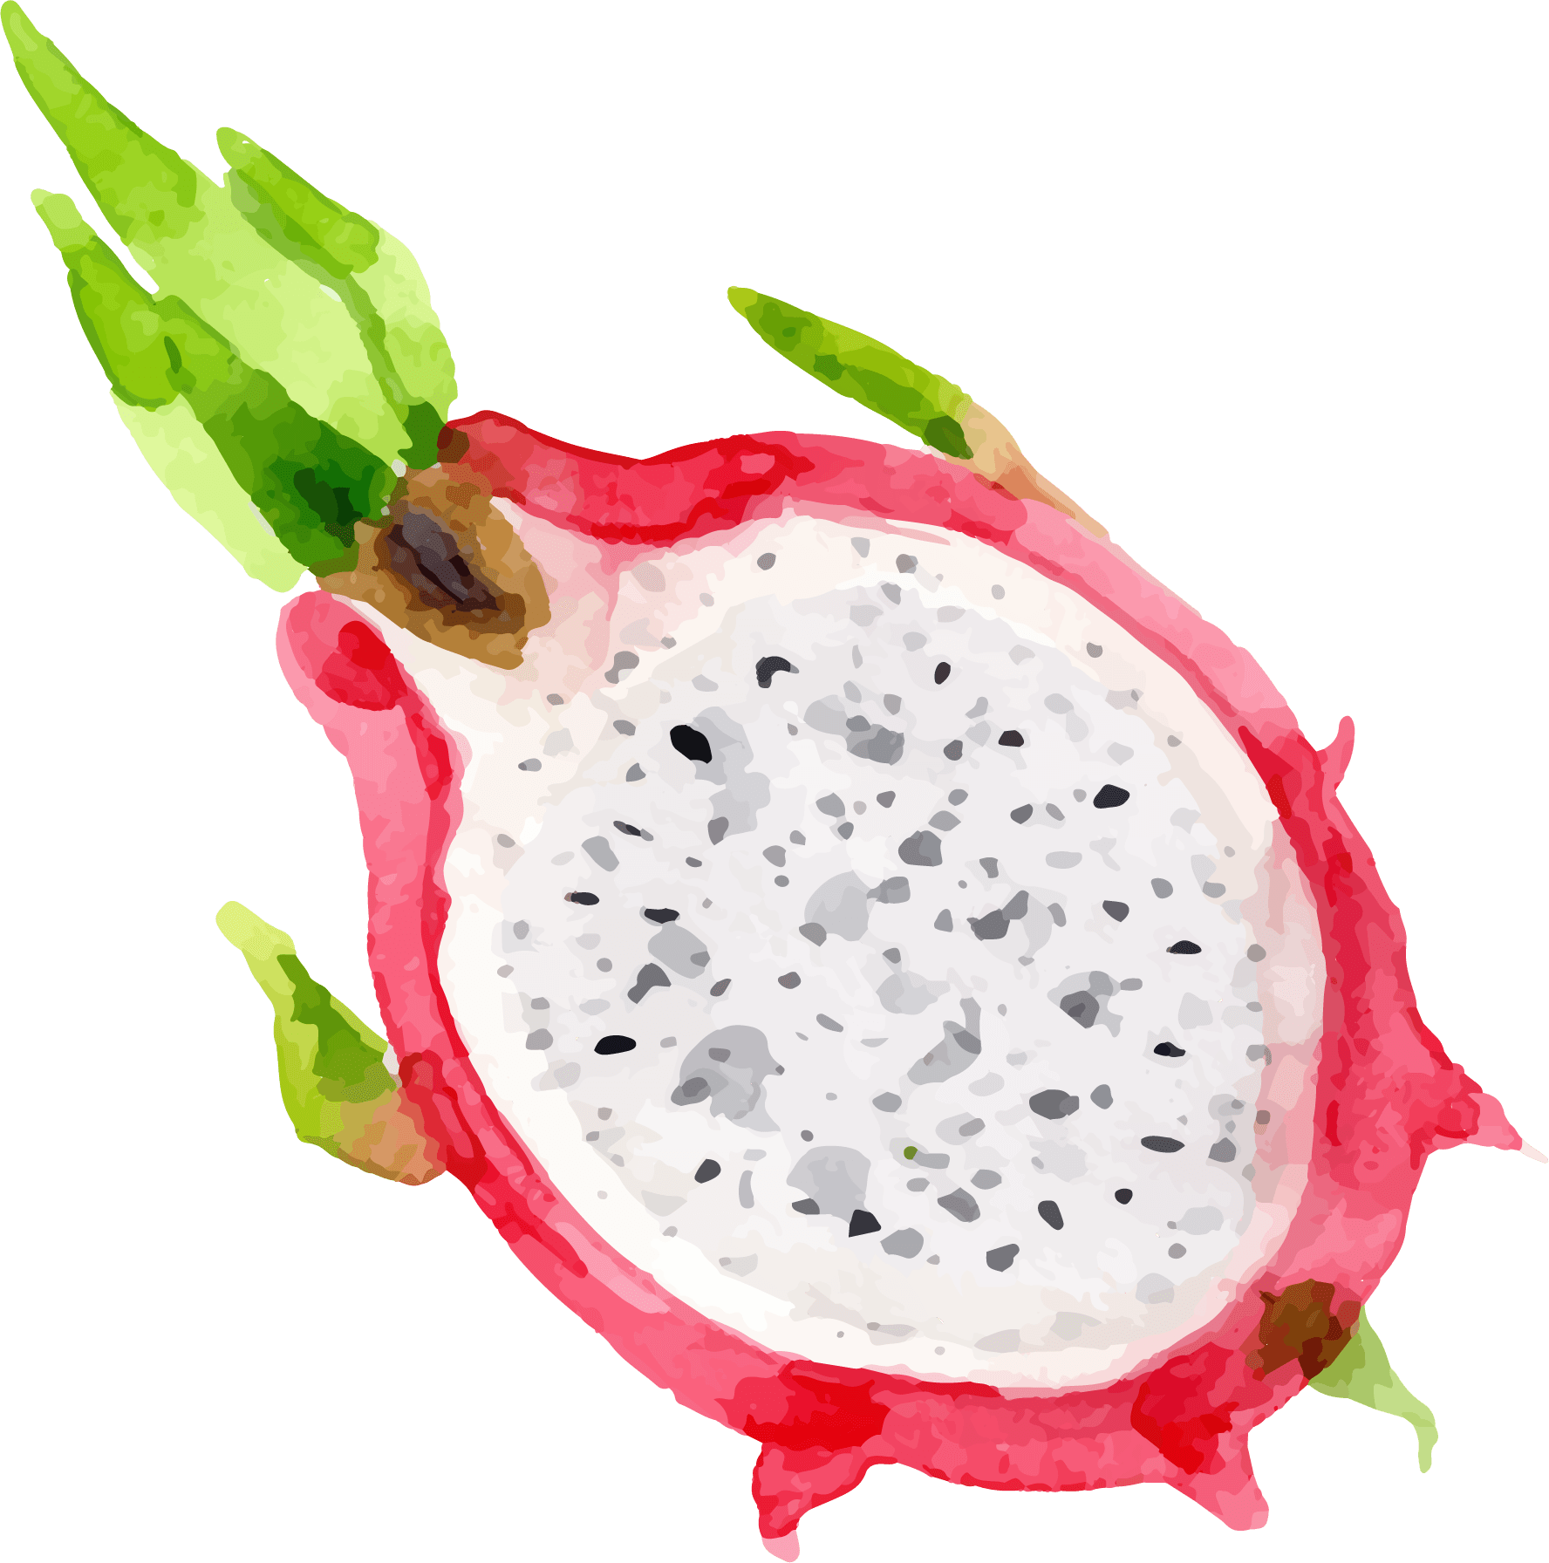
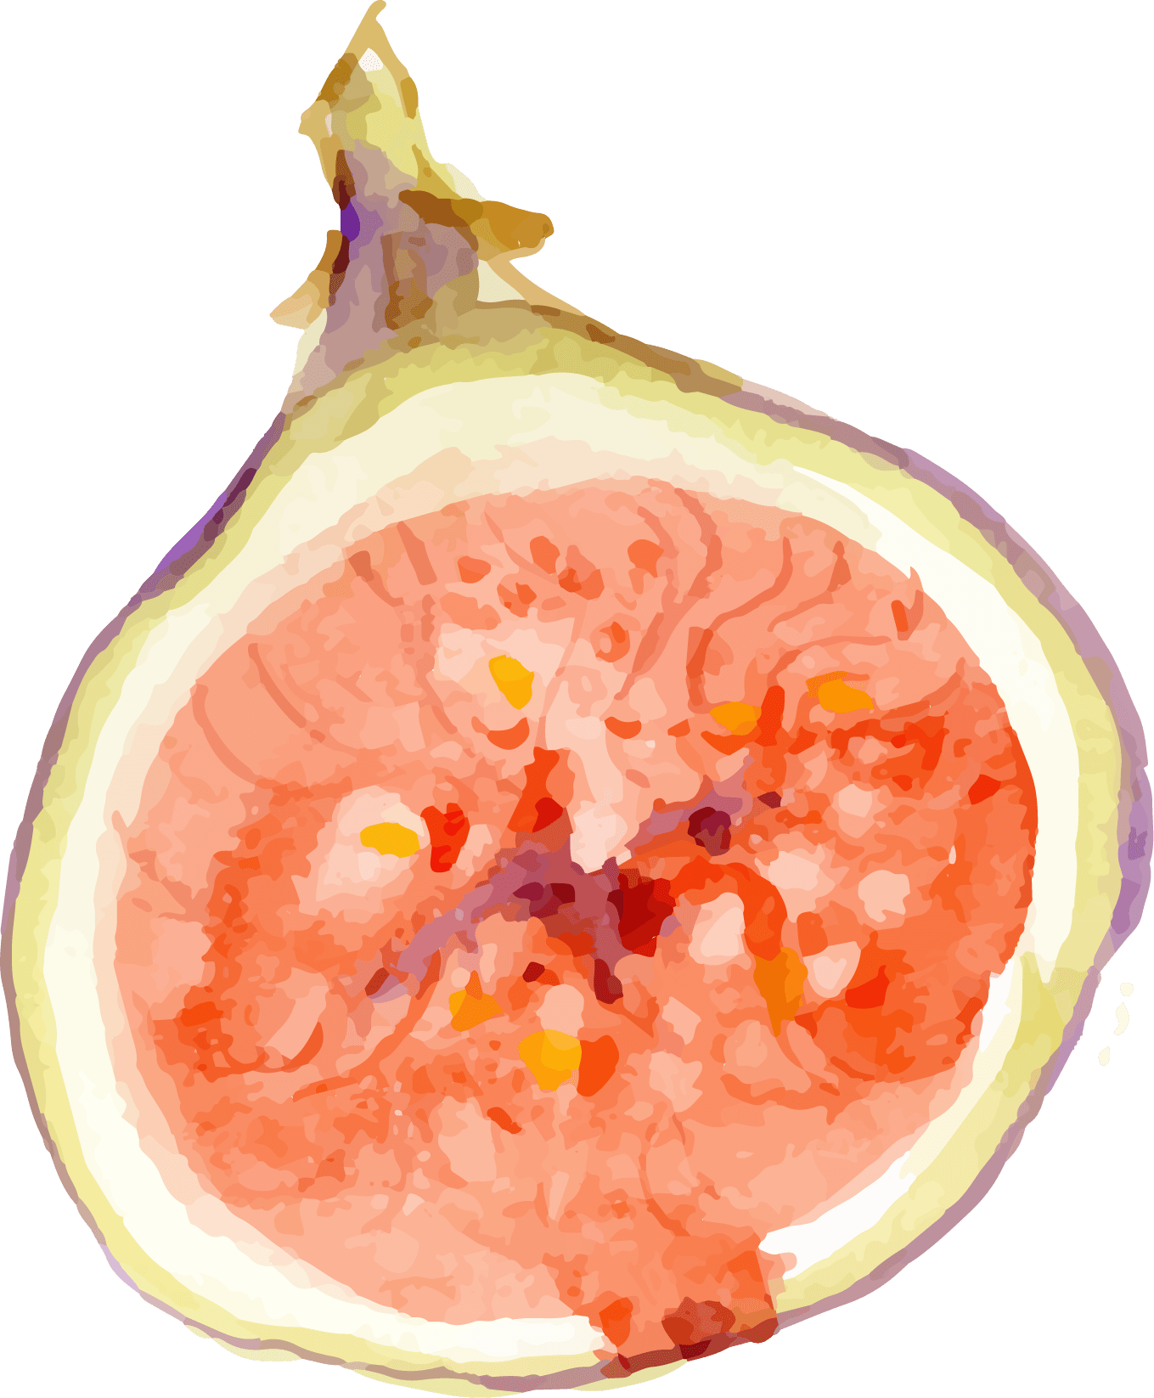
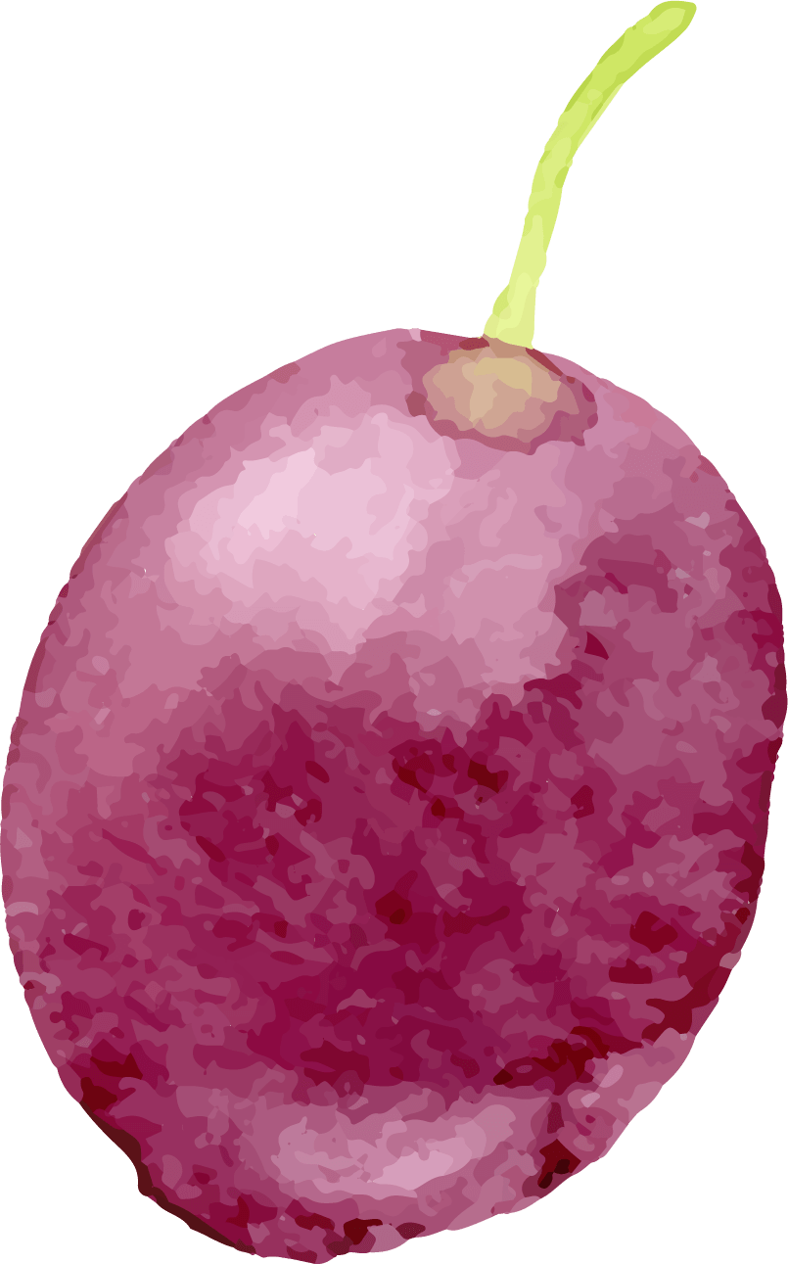
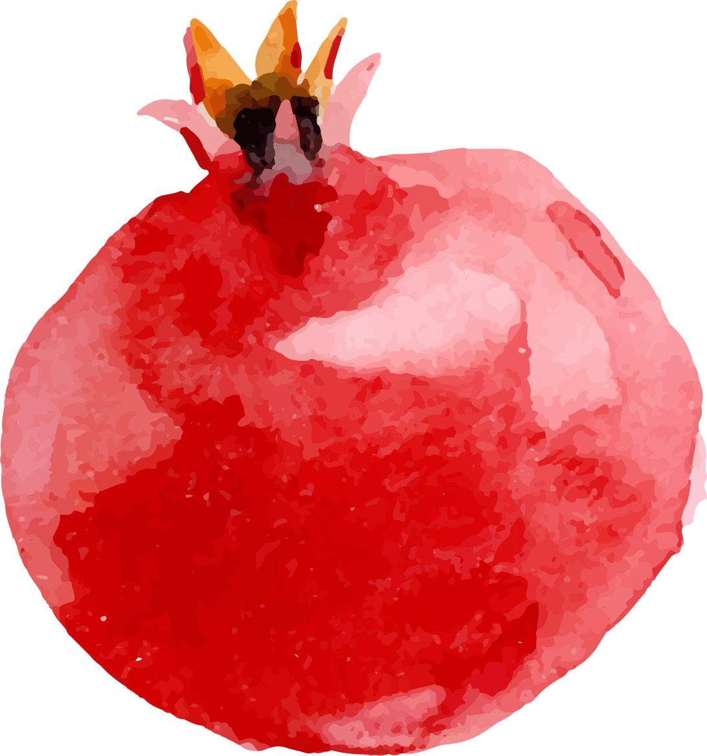
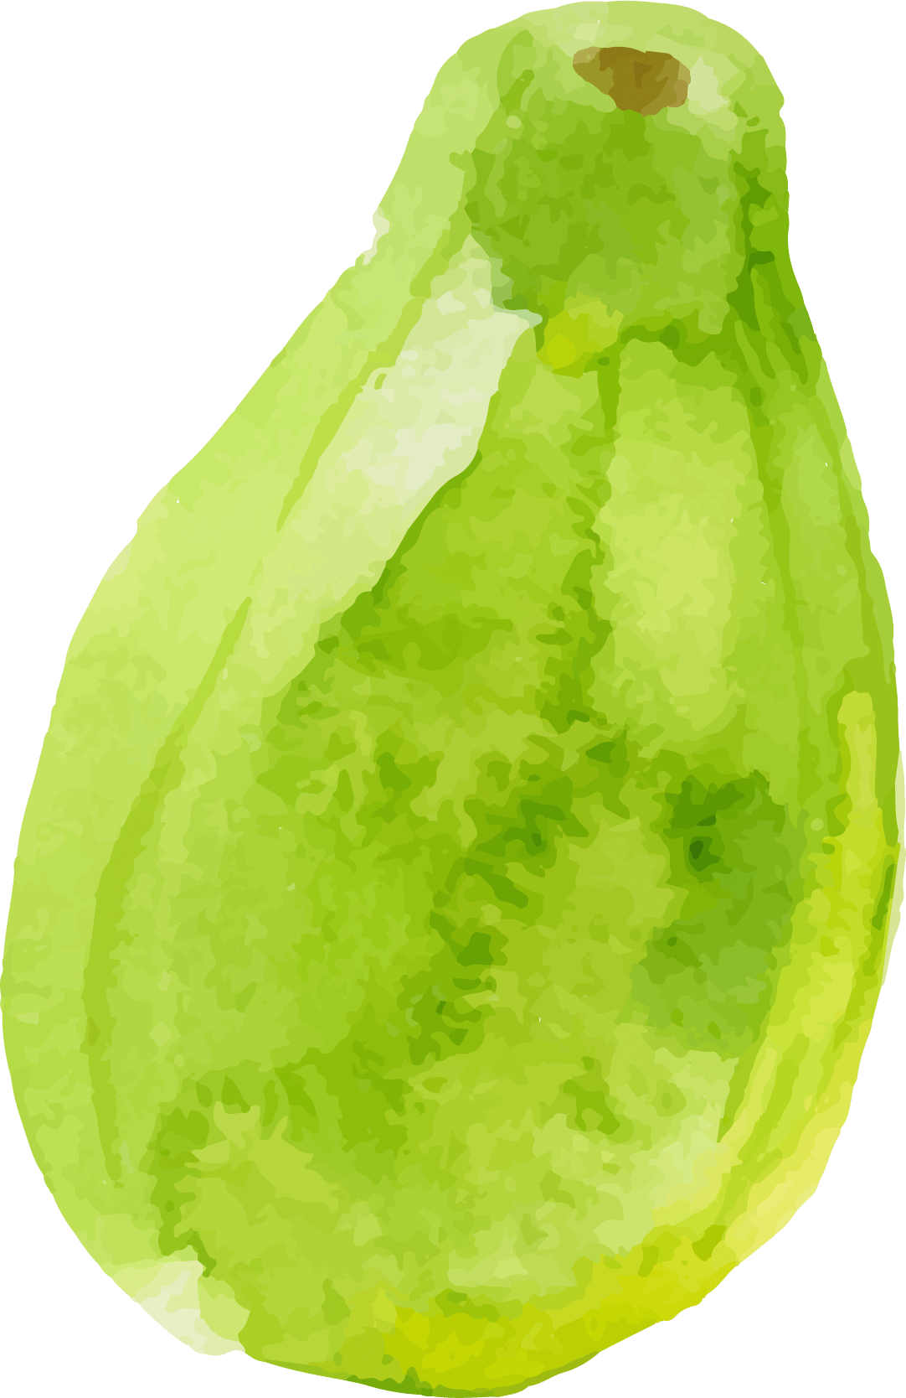
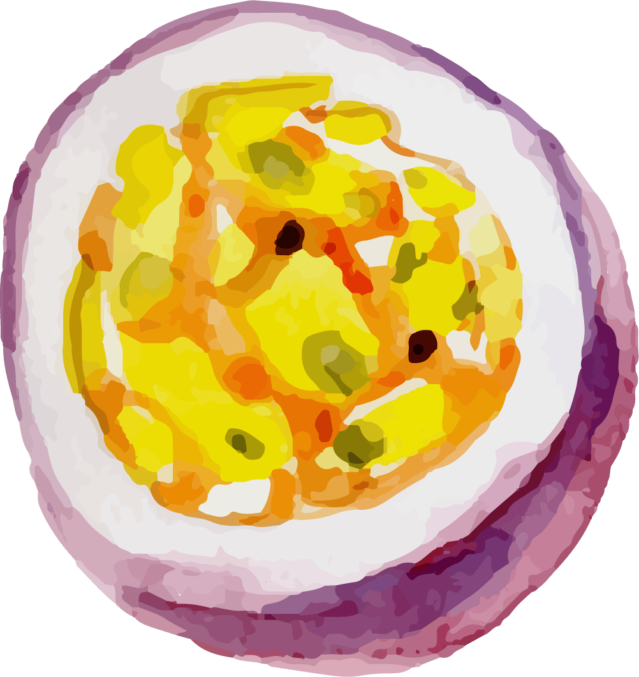
Let’s Practice!
When a food shows up on the screen, decide if it is a Go, Slow, or Whoa food.
Go: Dance!
Slow: Move in slow motion
Whoa: Freeze!

Slide 10
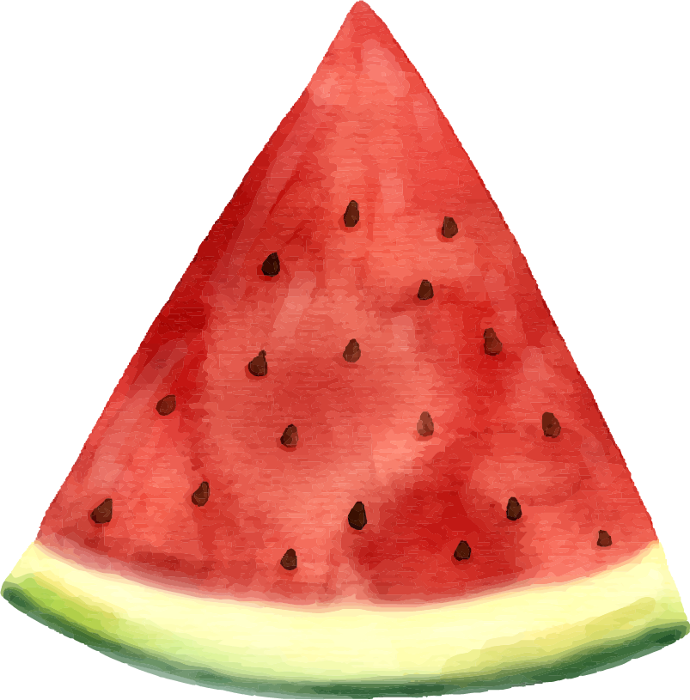
Watermelon
GO

Slide 11
Ice Cream
WHOA

Slide 12
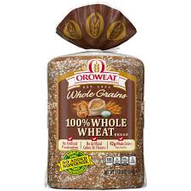
Whole Wheat Bread
GO

Slide 13
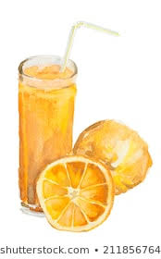
Juice
SLOW

Slide 14
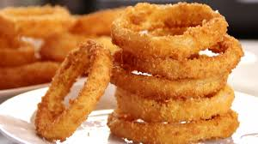
Onion Rings
WHOA

Slide 15
Low Fat Microwave Popcorn
SLOW

Slide 16
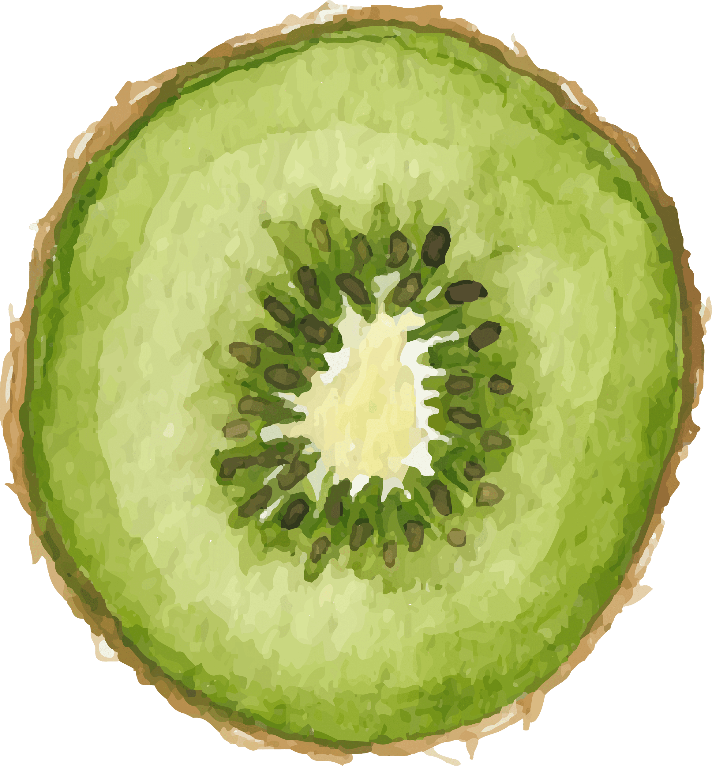
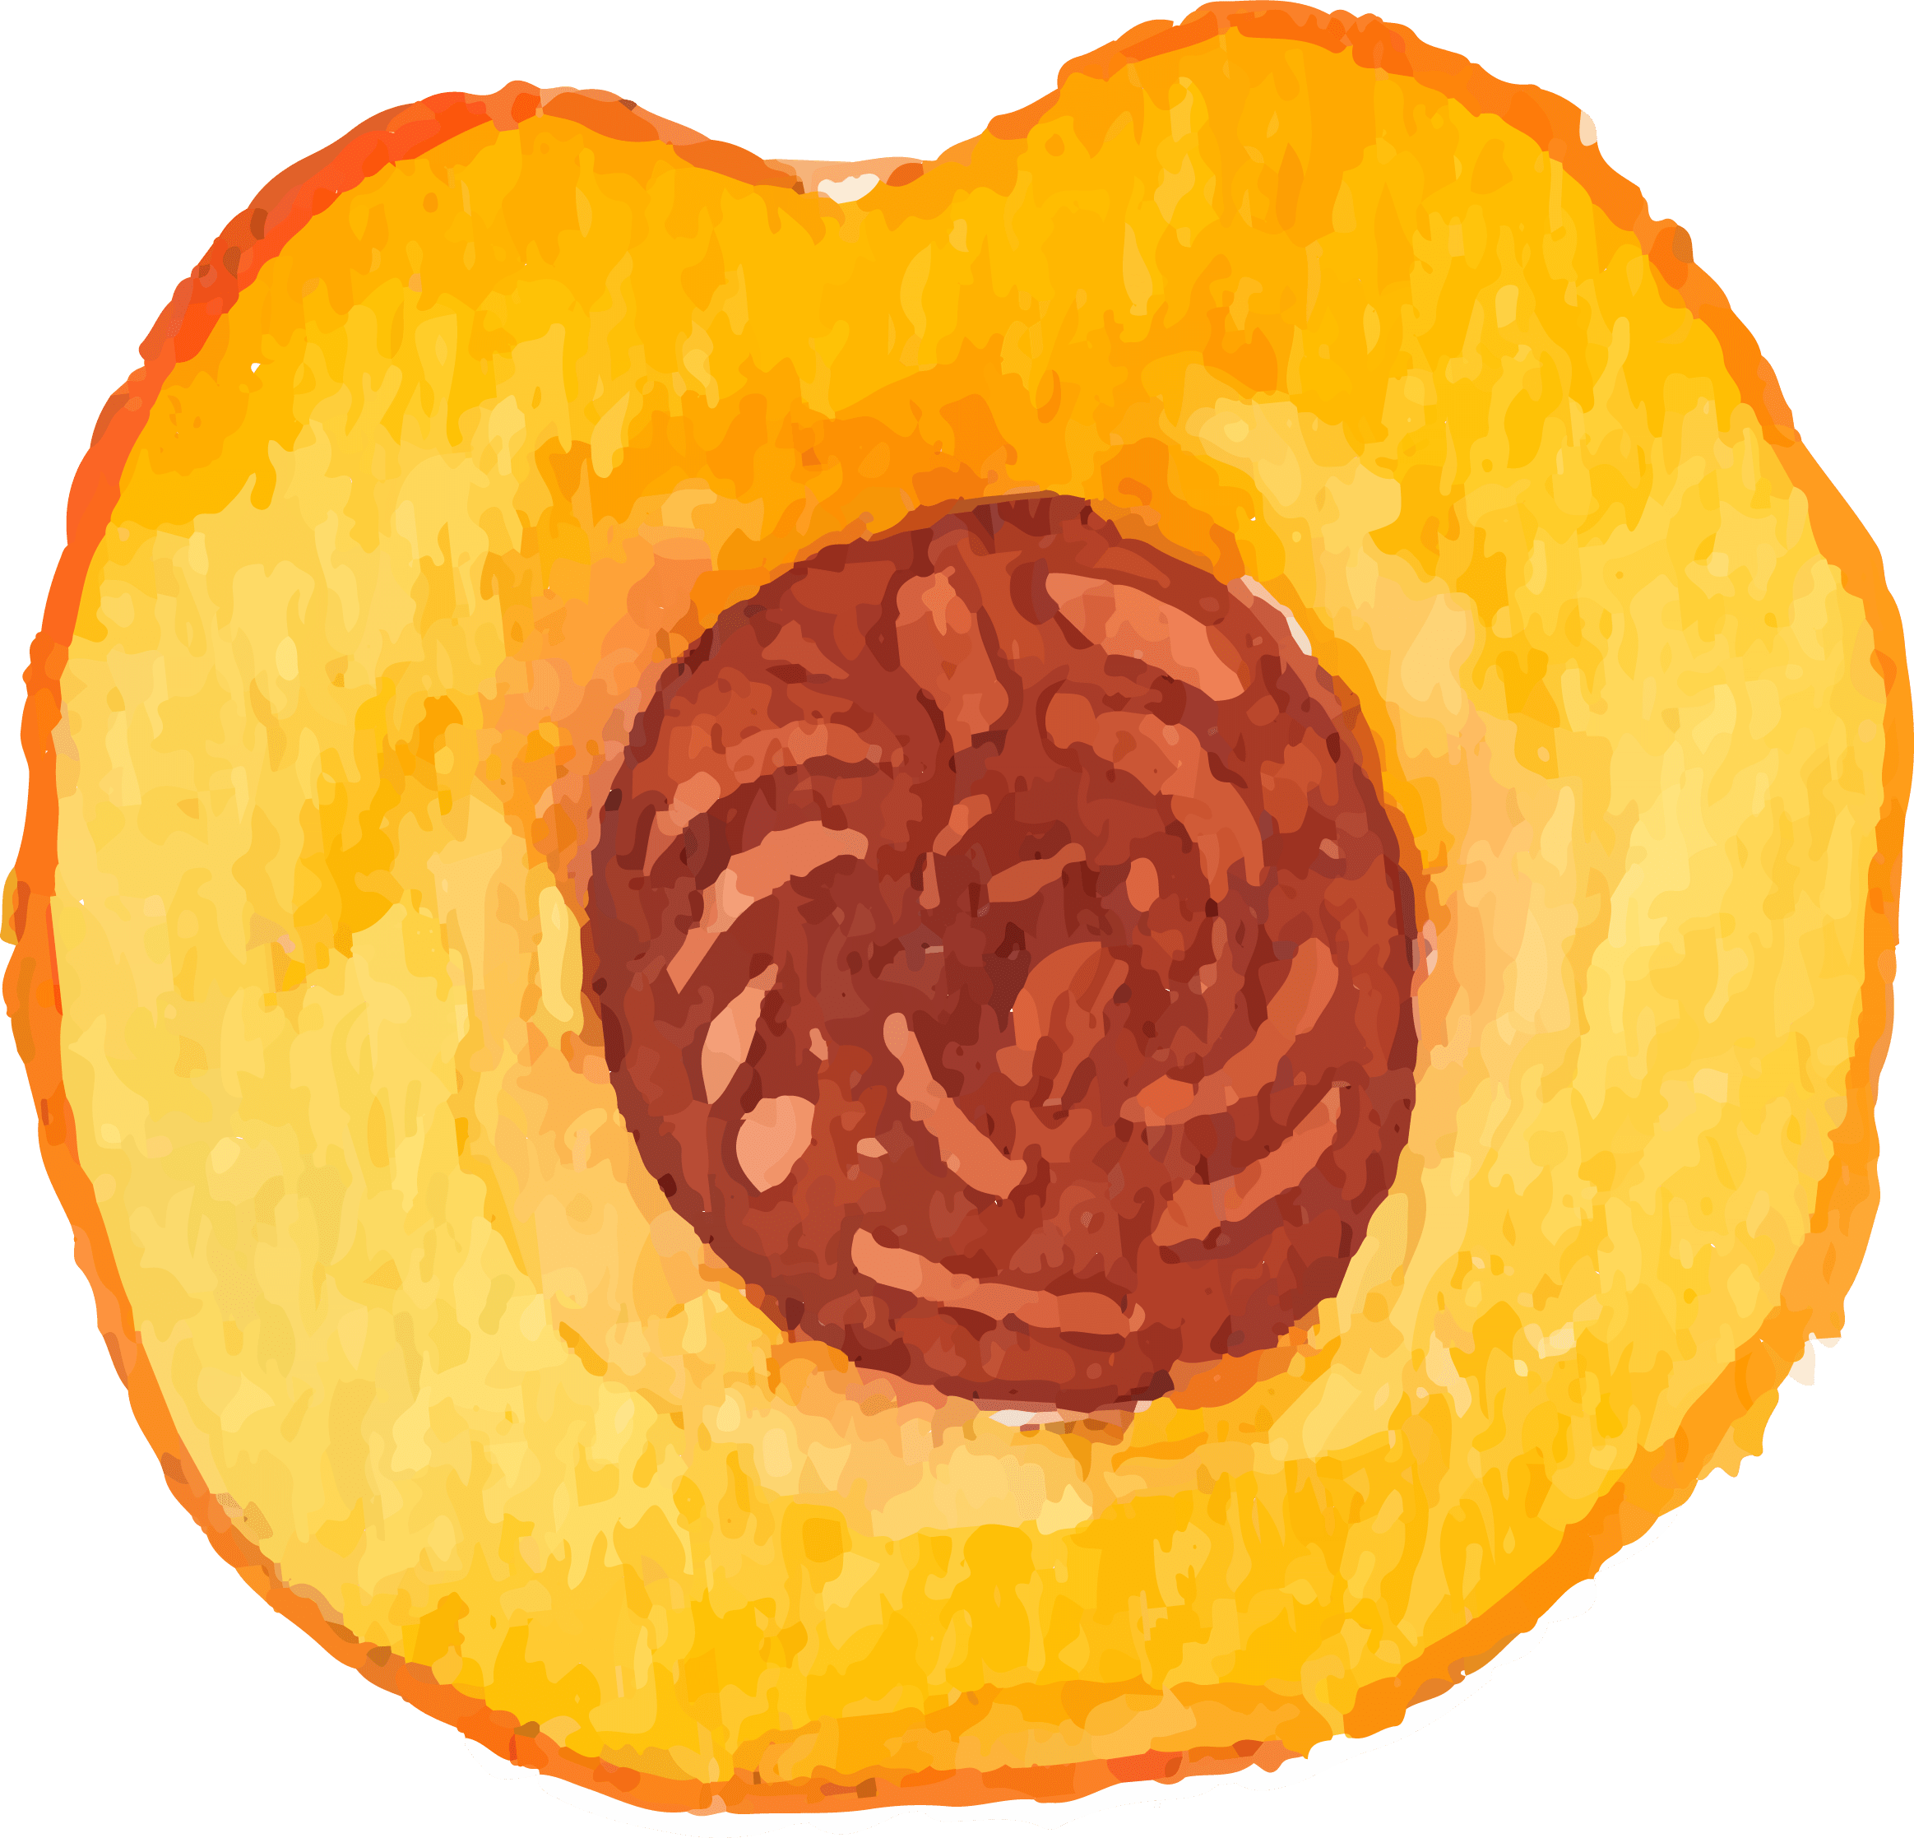
Hands-On Activity Explanation:
Make a vegetable recipe

Slide 17
Step 1
Videos to Watch
Watch the video about how to practice safe knife skills in the kitchen using the peeling technique.
Watch the video for instructions to make vegetable salsa.

Slide 18
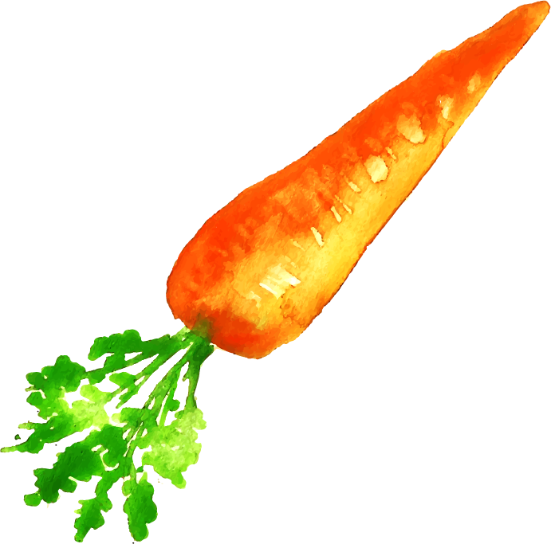
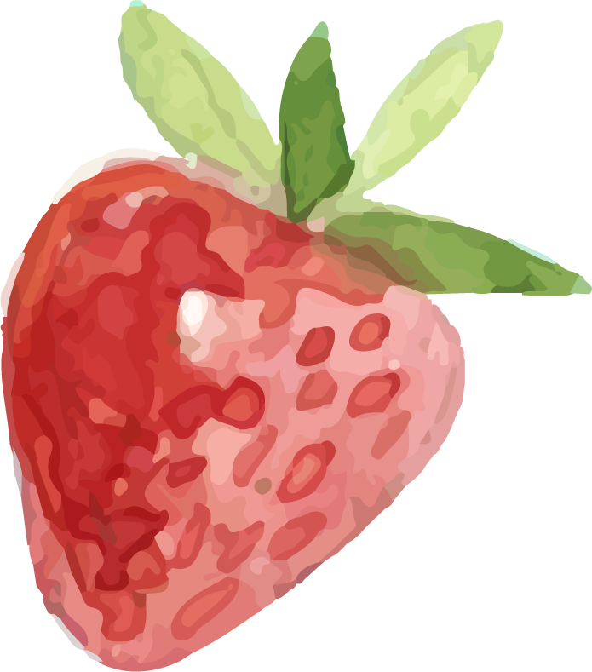
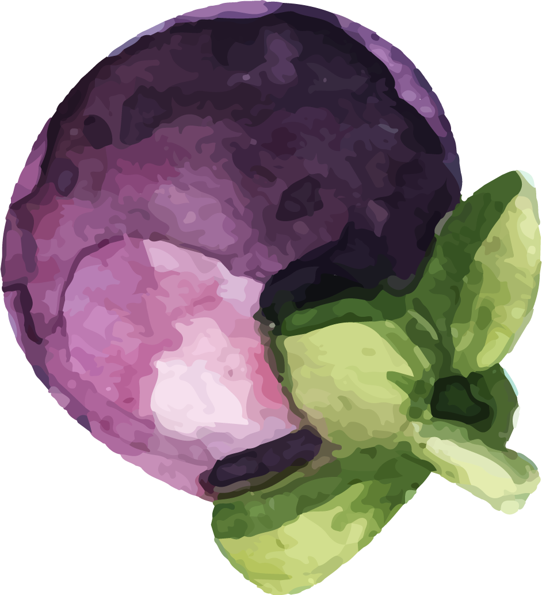
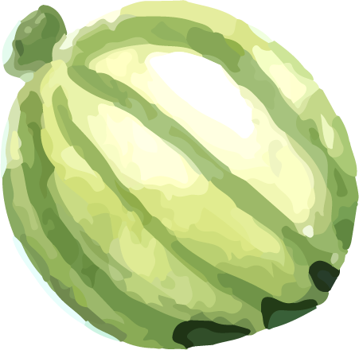
Step 2
Make the salsa recipe!
Take a picture or video of your creation and upload it to ClassDojo.

Slide 19
Exit Slip
GO
SLOW
WHOA
Find some paper and something to write with.
Draw a food from the category you are assigned to, and hold up your drawing to the camera.

