Slide 1
Instructions as you enter the WebEx Virtual Classroom:
01
Make sure your name in the participant list on the right-hand side of the screen shows up as your code that Mara provided you via email (example: 01 01) If your name is not your code, please leave the WebEx virtual classroom and re-enter after you have updated your listed name.
02
Mute yourself by clicking on the microphone icon at the bottom of your screen. Click the button until it is red. You are muted if the microphone icon looks like this:
03
Make sure your camera is on by clicking on the camera button at the bottom of the screen. If it is red, your camera is not on. Click the button until it is NOT red. Your camera is on if the icon looks like this:
Your settings are correct if the bottom of your screen looks something like this and you should see a small picture of yourself in the top or bottom corner:
Notes:
Reminder: find paper and writing utensil for exit ticket while waiting to start

Slide 2
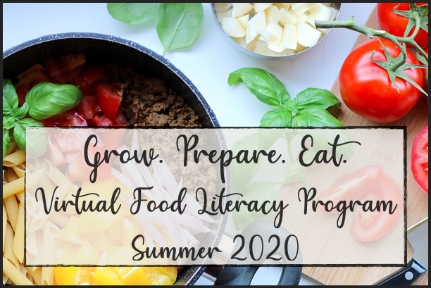
WELCOME!
Lesson 7 Grow. Prepare. Eat
Monday July 27th, 2020

Slide 3
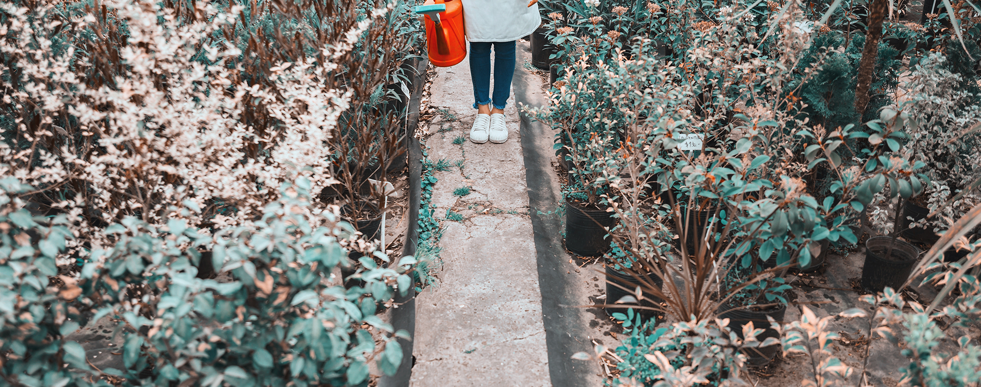
2. INTRO TO PROTEIN
4. HANDS-ON ACTIVITY EXPLANATION
1. SHARE ABOUT HANDS- ON ACTIVITY
3. COMPOSTING REVIEW

Slide 4
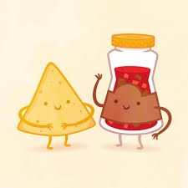
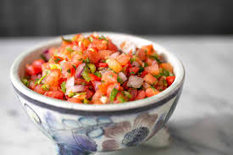
HANDS-ON Activity
How did it go making the salsa recipe?
What foods did you add to your salsa?
Did you try the salsa by itself or did you eat it with another food?
Did they taste good together?
Would you make the salsa again?
What combination might you try next time?

Slide 5
What do you know about protein?
Protein is a nutrient that's naturally found in plants and animals. It's made of tiny building blocks called amino acids. When you eat protein, it breaks down into amino acids during digestion. Then your body sends these amino acids to different parts to keep them healthy and growing.
One part of the body that needs protein are your muscles. Children grow very quickly, and protein helps your muscles keep growing to help you move, walk, run, and exercise.

Slide 6
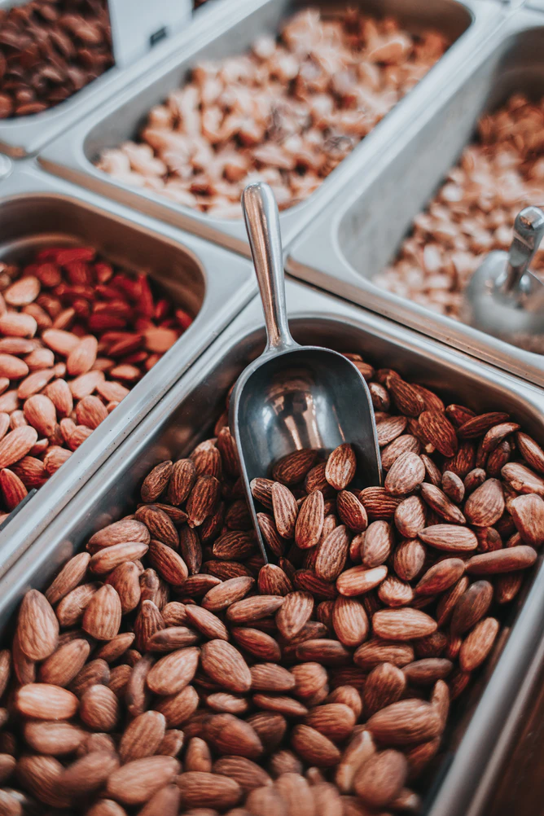
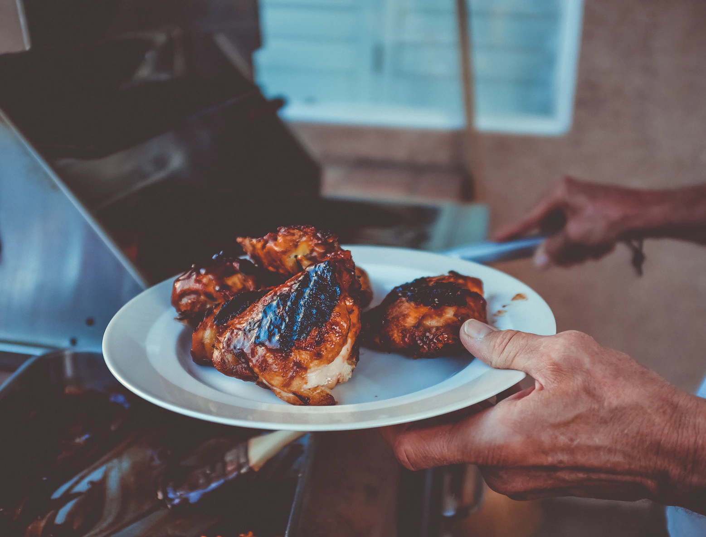
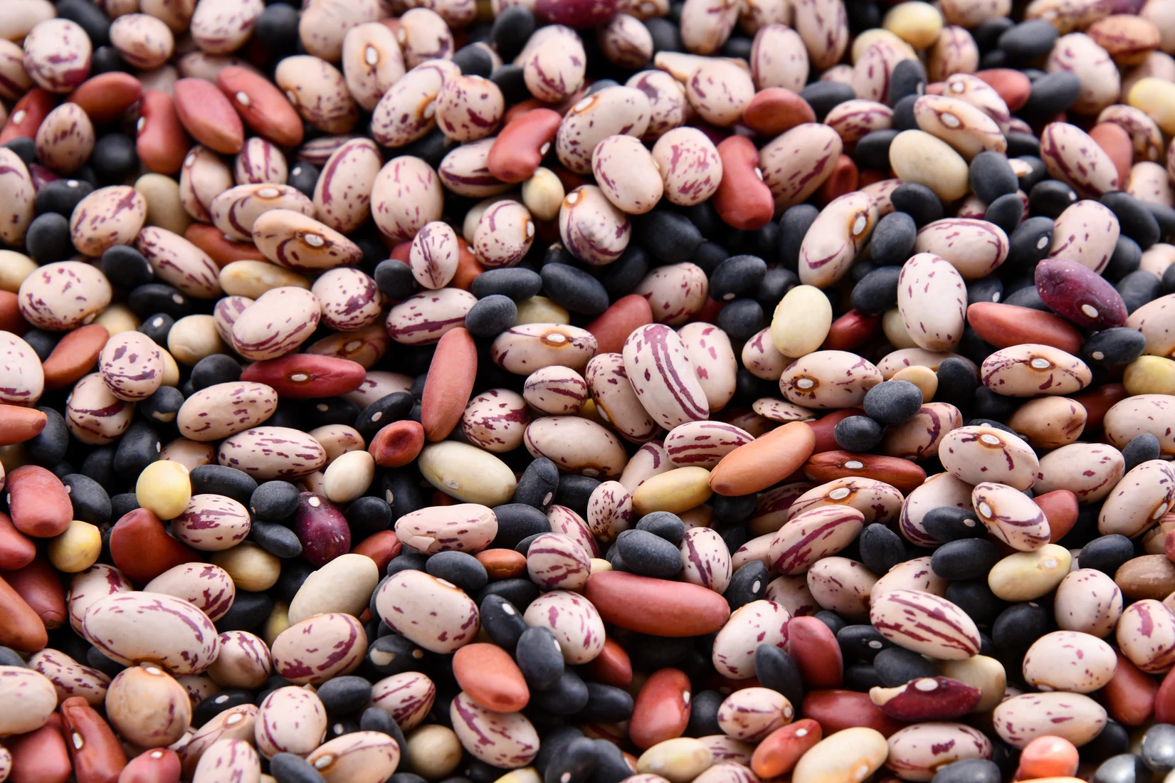
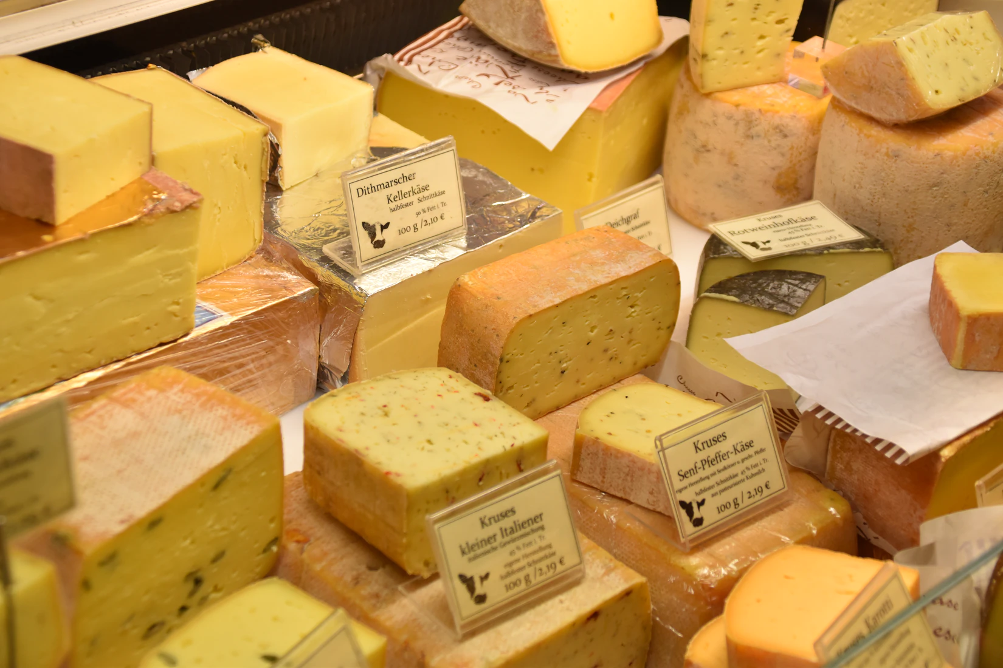
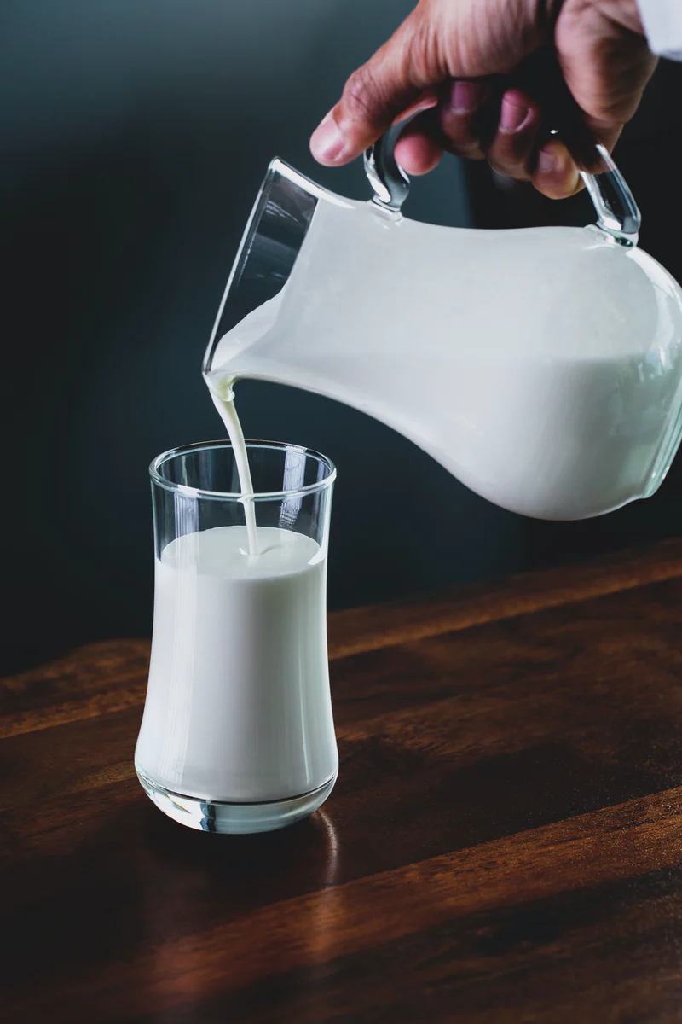
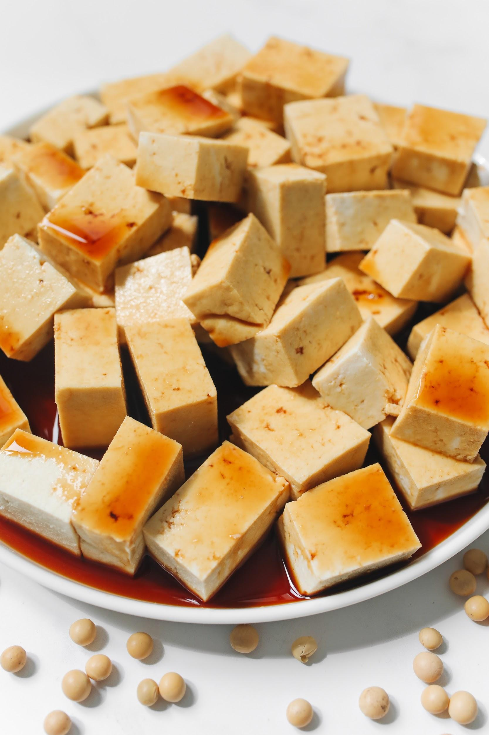
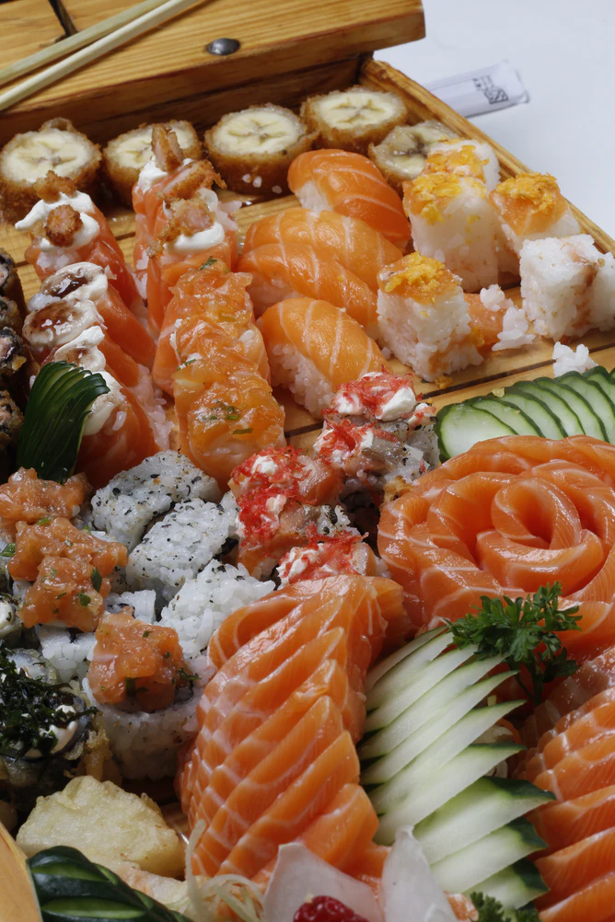
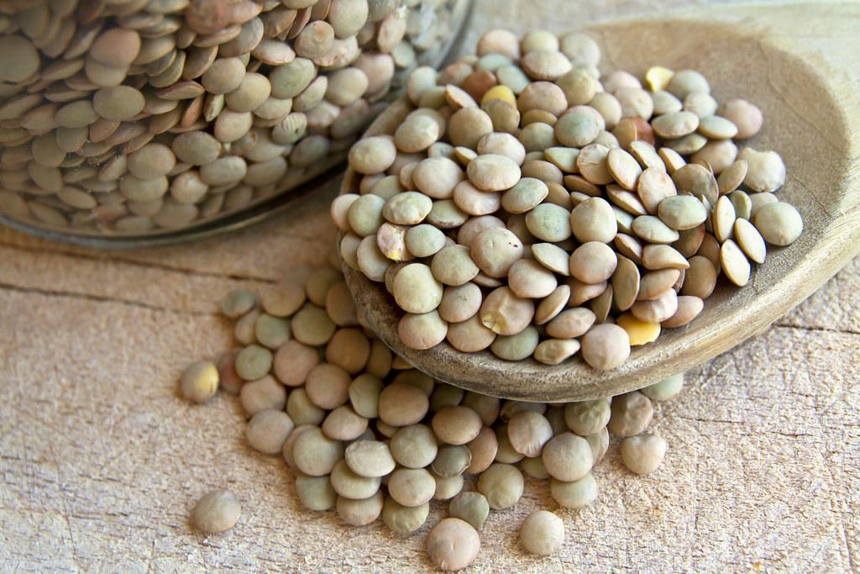
What types of food are considered protein sources?

Slide 7
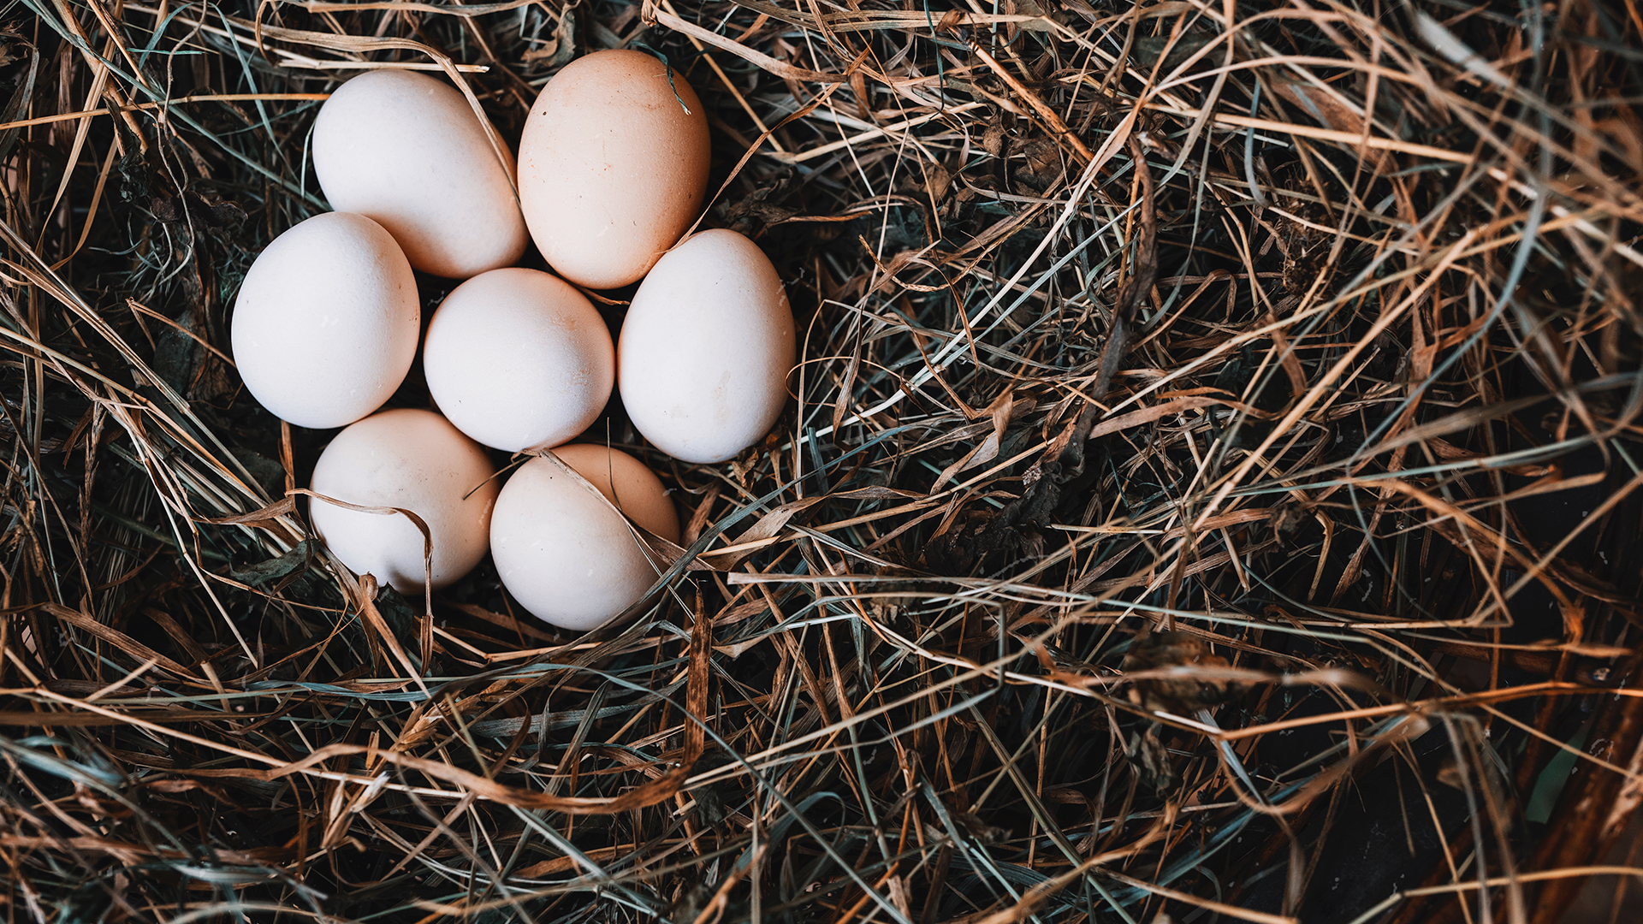
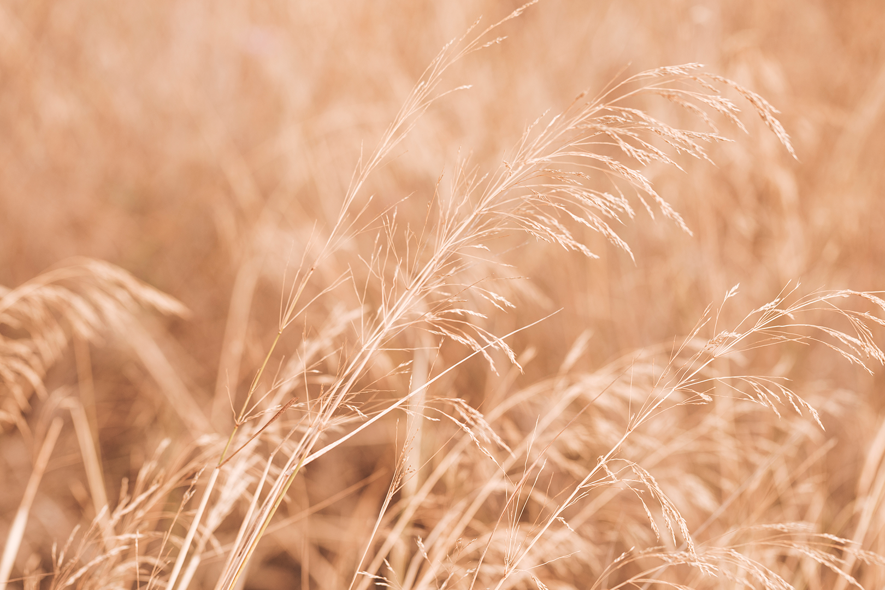
There are two categories of protein:
What is the difference?
Plant - based protein
Animal - based protein

Slide 8
Which foods do you think are animal-based protein sources?
Which foods do you think are plant-based protein sources?

Slide 9
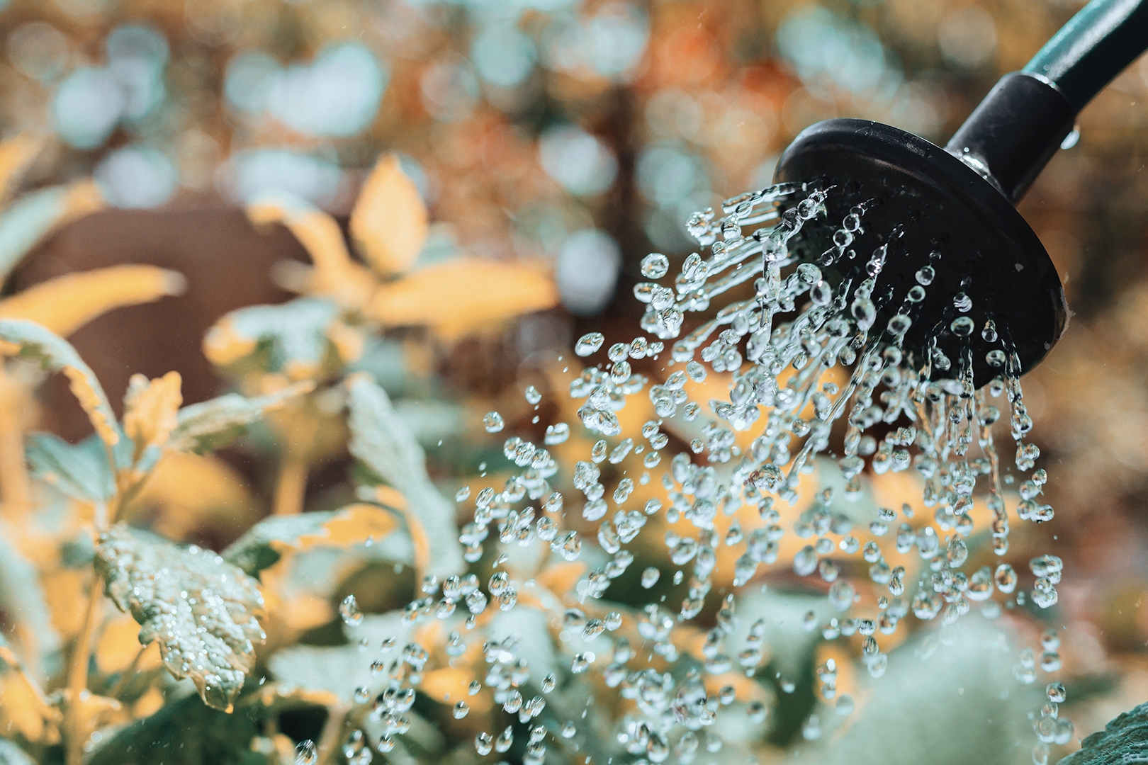
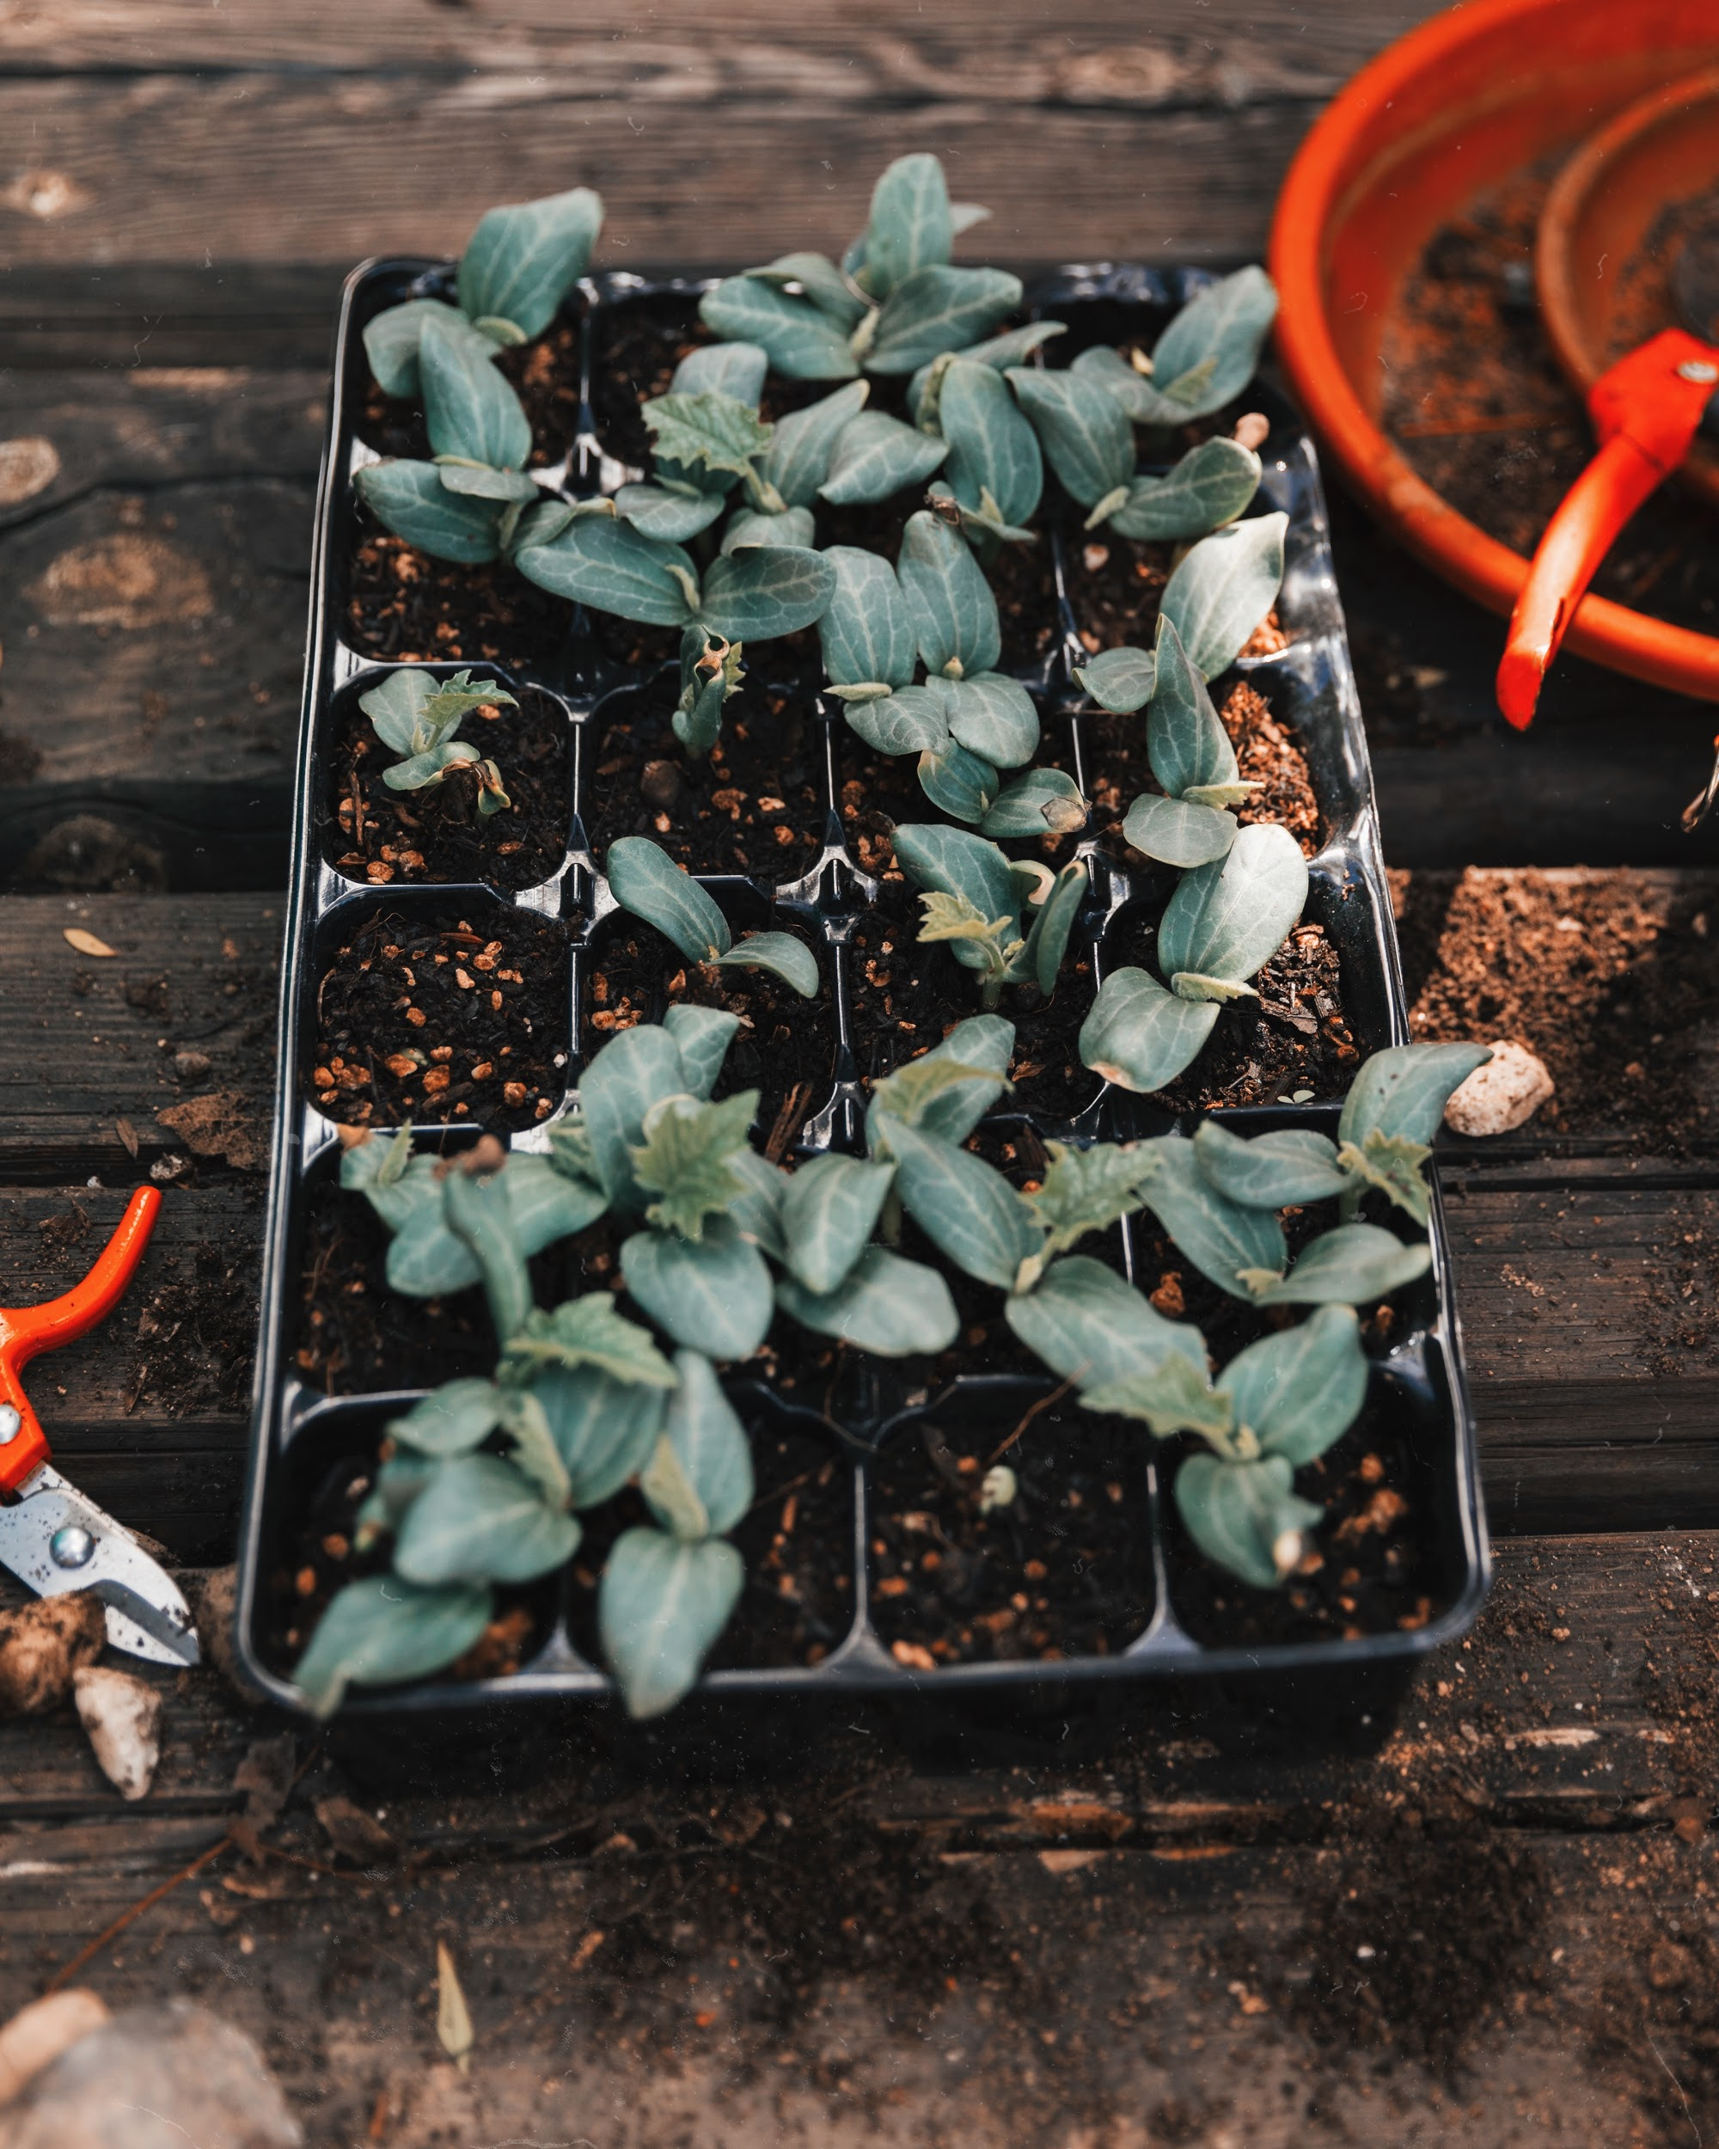
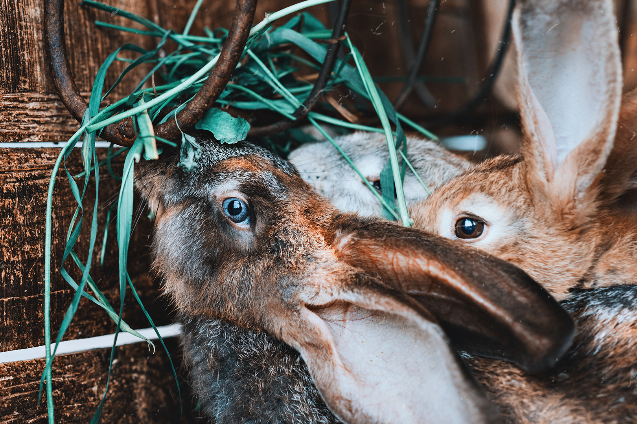
Who eats both animal and plant-based protein sources?
Does anyone eat only plant-based protein sources?
Is one source healthier than the other?
Is anyone a vegetarian or vegan?
Or do you know someone who is?
What does it mean to be a vegetarian?
What does it mean to be a vegan?

Slide 10
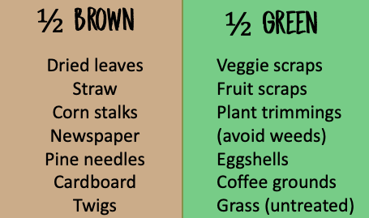
COMPOSTING REVIEW!
What CAN we compost?
What CAN’T we compost?
SO, can we compost protein sources?

Slide 11
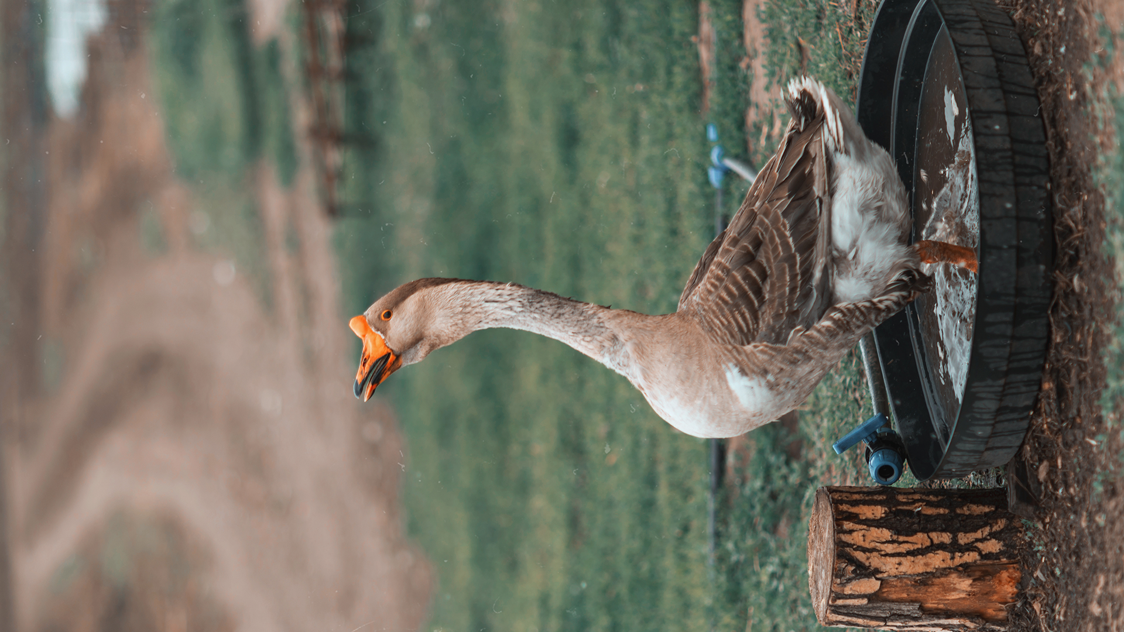
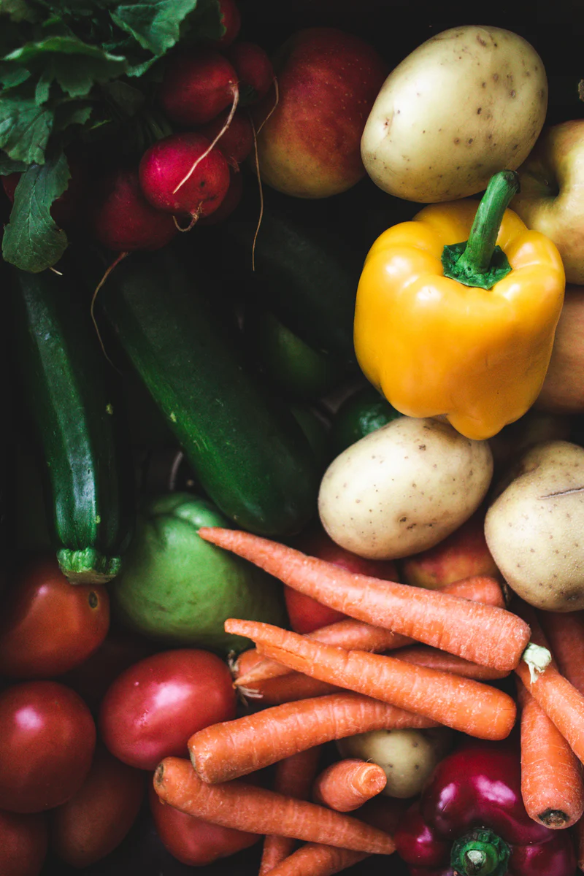
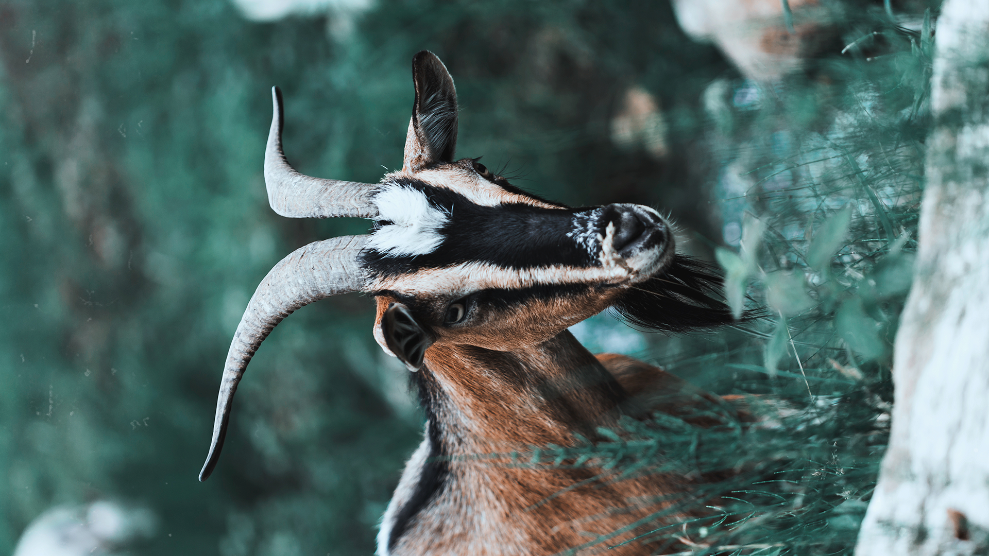
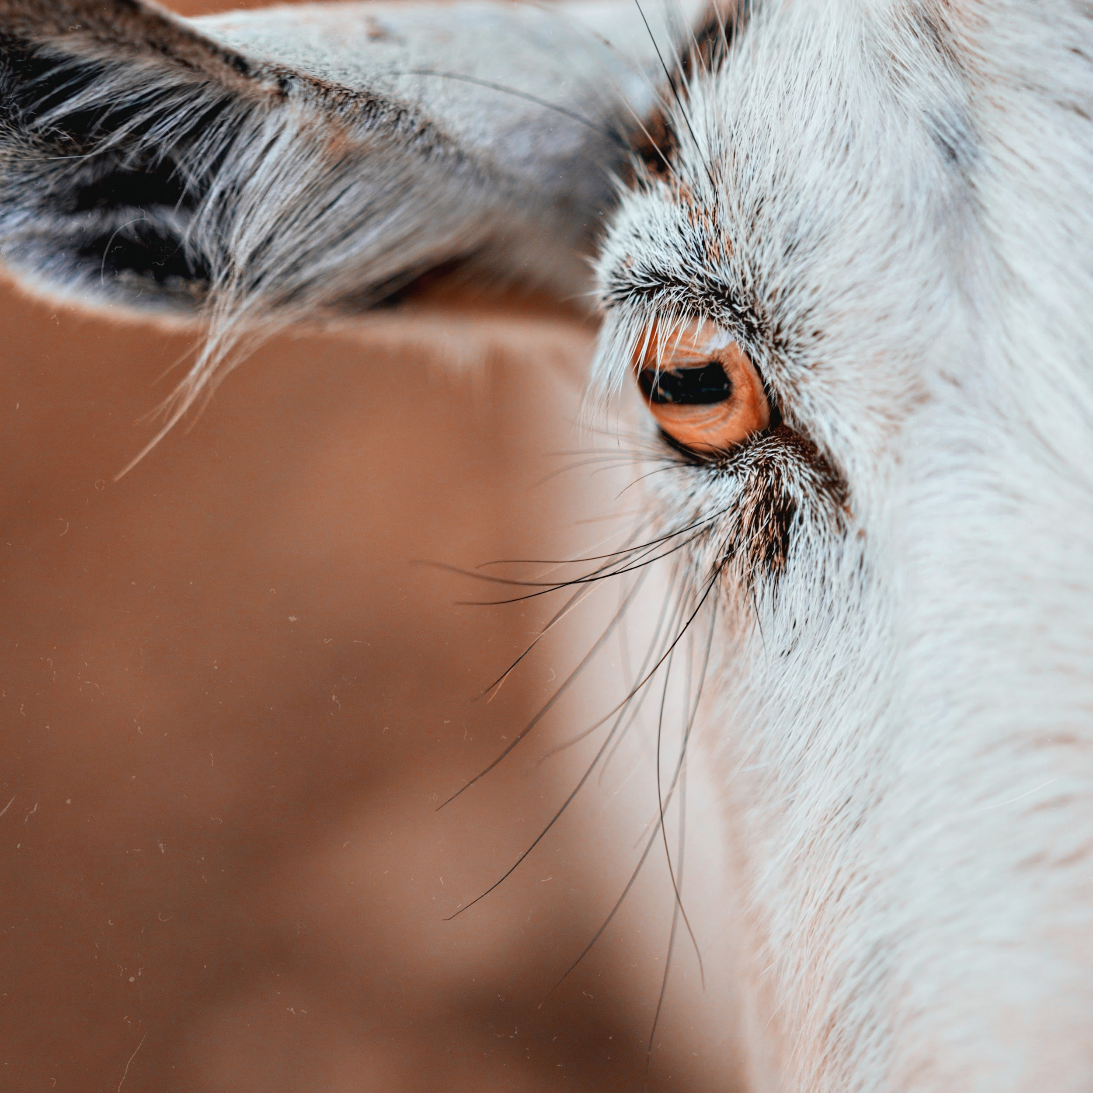
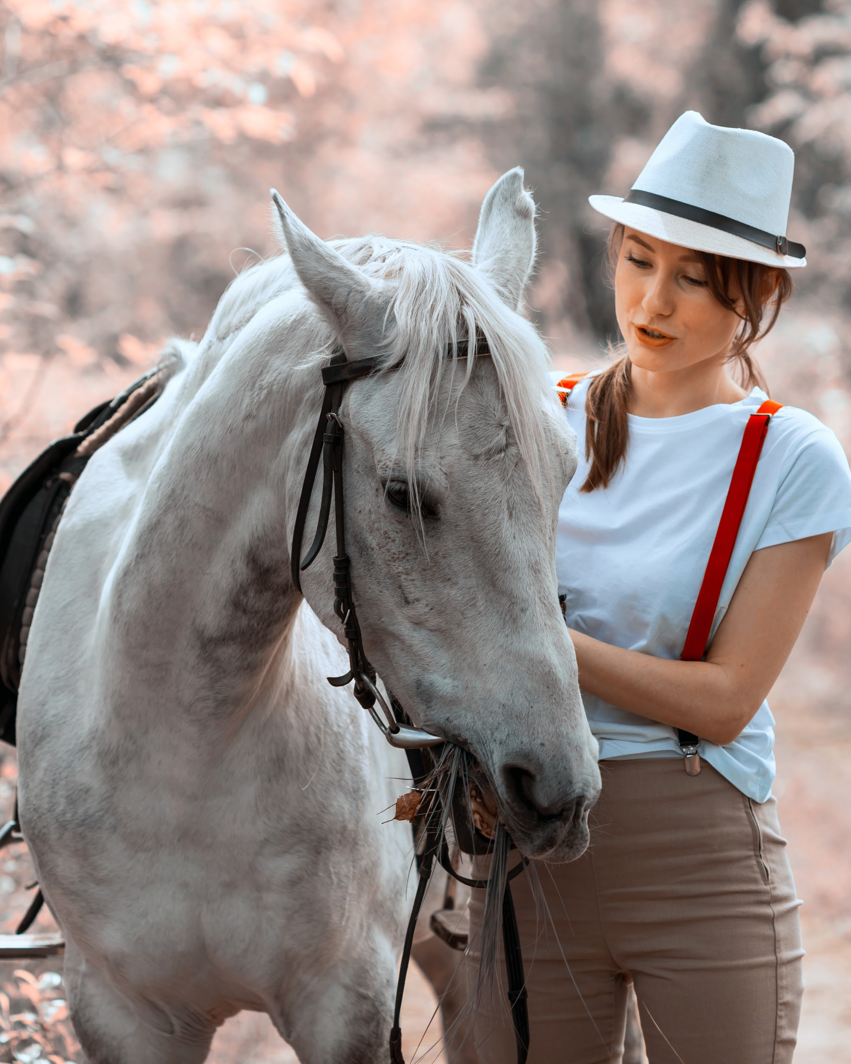
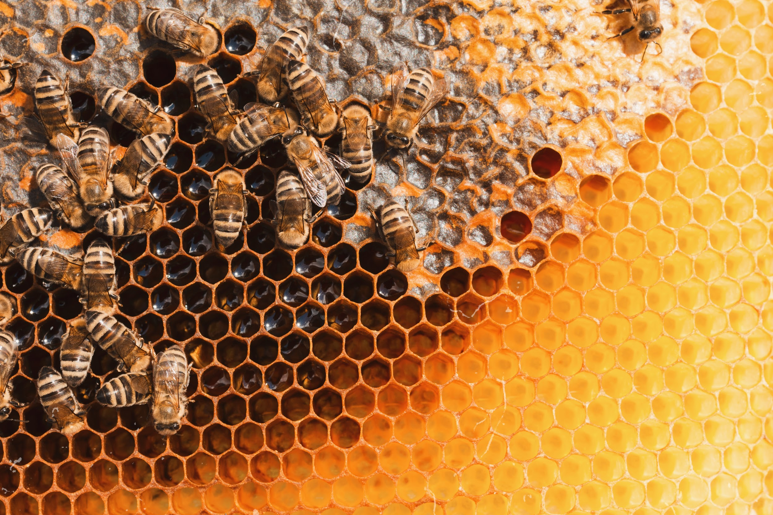
Hands-On Activity Explanation:
Step 1: Play the Cornucopia Farming Game. Start with the Garden Setting, and then play all 3 levels.
Step 2: After playing the game, draw your ideal farm. What would you grow/raise? Label any crop that you would grow and any animals you would raise and what you would raise them for (milk, eggs, meat, fur/feathers, pets, petting zoo, etc.)
Step 3: Upload a picture of your farm drawing to ClassDojo.

Slide 12
EXIT TICKET!
Get out a piece of paper and something to write with.
ANIMAL | PLANT
Make a table with 4 rows and 2 columns.
In one column write ANIMAL and in the other write PLANT.
On the next slide I’m going to show 6 foods. Sort each into whether they are animal or plant-based protein sources.

Slide 13
