Slide 1
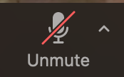
Instructions as you enter the Zoom Virtual Classroom:
01
Make sure your name in the participant list on the right-hand side of the screen shows up as your code that Mara provided you via email (example: 01 01) If your name is not your code, please leave the Zoom virtual classroom and re-enter after you have updated your listed name.
02
Mute yourself by clicking on the microphone icon at the bottom of your screen. Click the button until it has a red slash through it. You are muted if the microphone icon looks like this:
03
Make sure your camera is on by clicking on the camera button at the bottom of the screen. If it has a red slash through it, your camera is not on. Click the button until it is DOES NOT have a slash. Your camera is on if the icon looks like this:
Your settings are correct if the bottom of your screen looks something like this and you should see a small picture of yourself in the top or bottom corner:
Notes:
Reminder: find paper and writing utensil for exit ticket while waiting to start

Slide 2
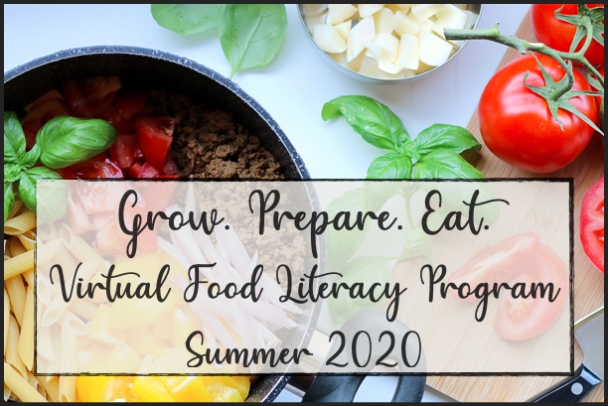
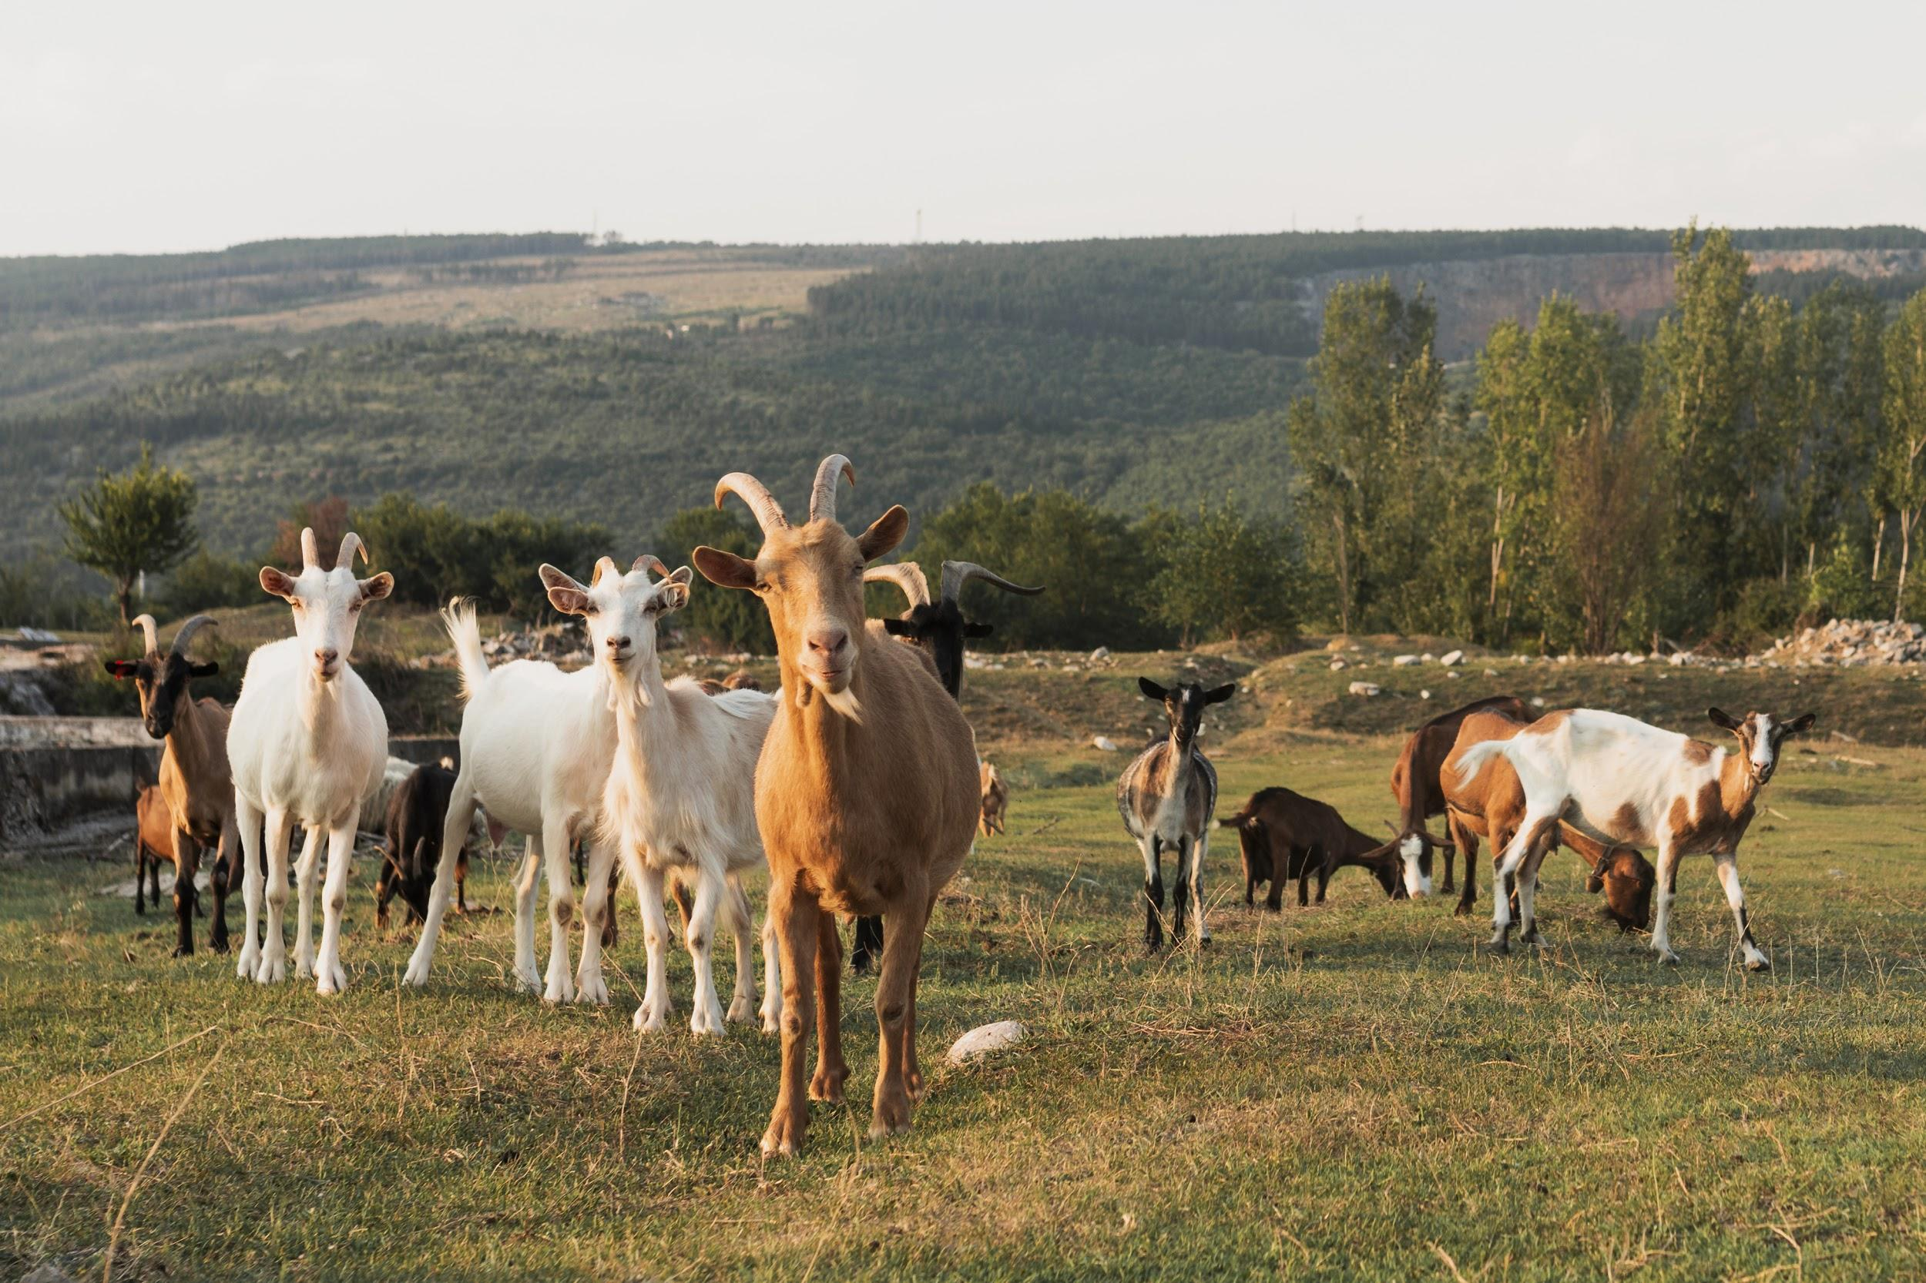
Welcome!
Lesson 8+9 of Grow. Prepare. Eat.
Monday August 3rd 2020

Slide 3
01
02
SHARE ABOUT HANDS- ON ACTIVITY
MORE ABOUT PROTEIN
03
04
4. NUTRITION OF PROTEIN
3. HOW DO WE GET OUR FOOD?
05
5. HANDS-ON ACTIVITY EXPLANATION

Slide 4
HANDS-ON ACTIVITY
Did you like the game?
Did anything about the game surprise you?
What crops and/or animals did you grow in your farm drawing? Why those?

Slide 5
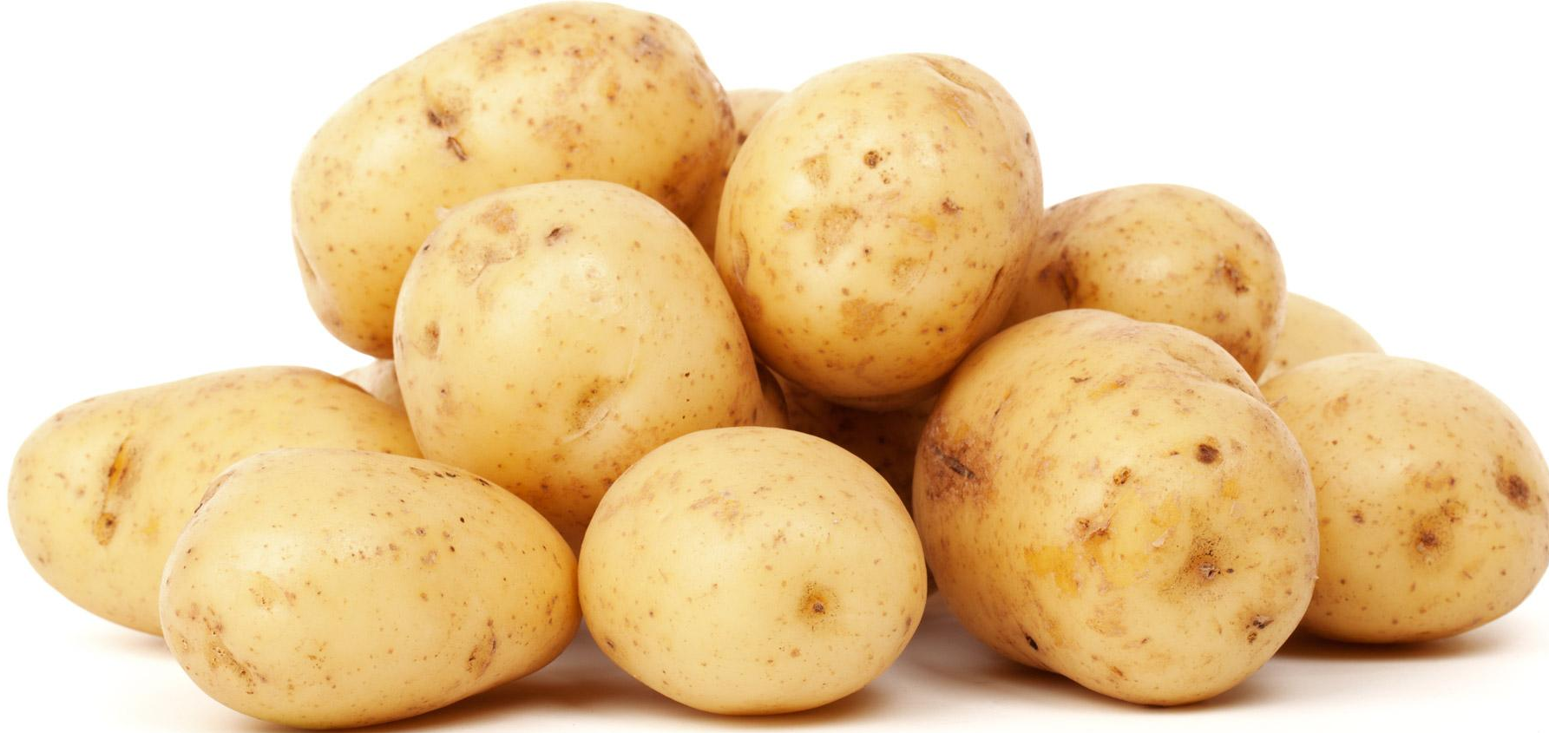
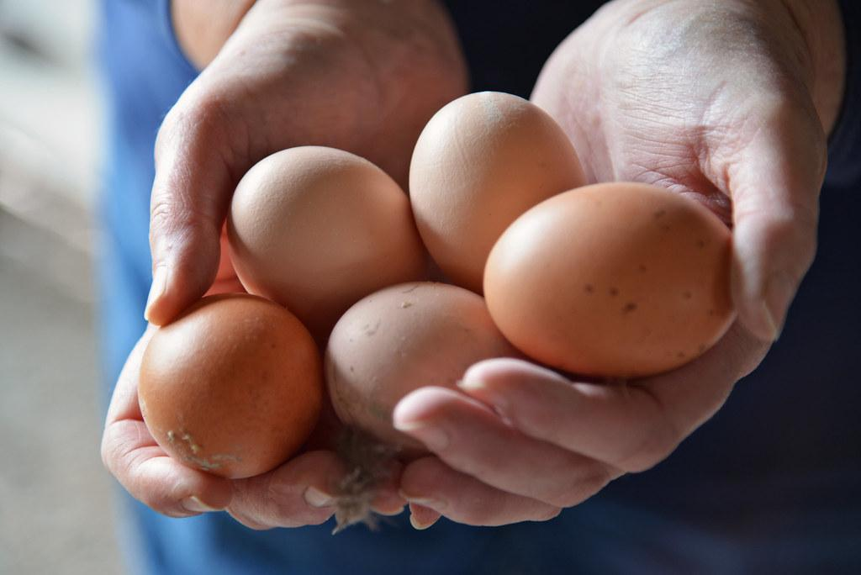
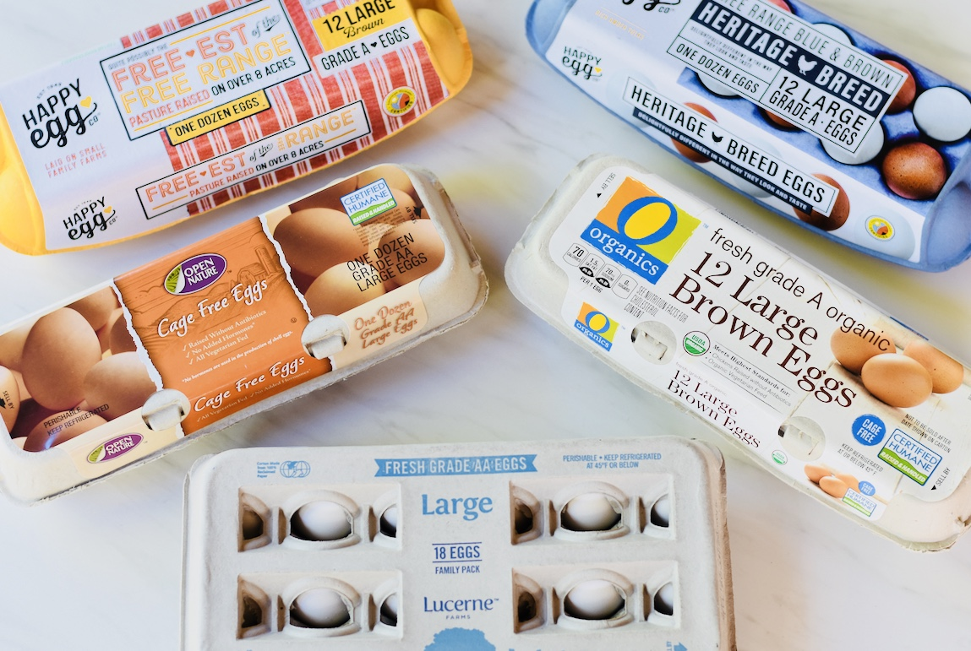
Let’s pick one plant and one animal protein source
Potatoes
Eggs
Have you seen any of these labels before?

Slide 6
Let’s pick one plant and one animal protein source
Potatoes
Eggs
Have you seen any of these labels before?
organic, non-GMO, local
Cage free, pasture-raised, fresh grade AA, free-range
What do those words mean?
Are some methods better for the health of the animals or soil?
No chemicals vs Lots of chemicals
Animals roam free outside of cages vs. live their lives in smaller spaces/cages
Animals eat mostly grasses vs eating mostly corn/man-made foods
Fewer animals, lots of space vs. lots of animals in smaller spaces
Few chemicals and medicines vs lots of chemicals and medicines usually

Slide 7
Let’s pick one plant and one animal protein source
Potatoes
Eggs
Have you seen any of these labels before?
organic, non-GMO, local
Cage free, pasture-raised, fresh grade AA, free-range
What do those words mean?
Which one takes less work by humans?
A lot of manual labor vs usually a lot more machines
A lot of workers vs a lot fewer workers

Slide 8
Let’s play a game!
Get a piece of paper and something to write with.
Farm
Grocery Store
Draw 5 BIG boxes spread out around your paper. Label the boxes with the following 5 words or phrases:
Farm, grocery store, my garden, farmer’s market, corner store
My Garden
Corner Store
I’m going to show 5 places where you could get your food.
Farmer’s Market
Then I’m going to ask questions about what the food would be like at each place and you will label based on what you think

Slide 9
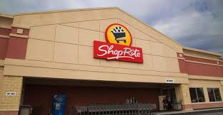
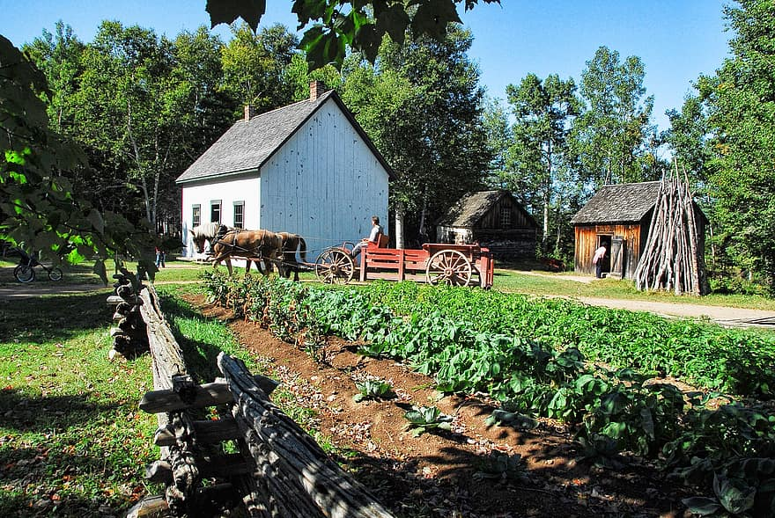
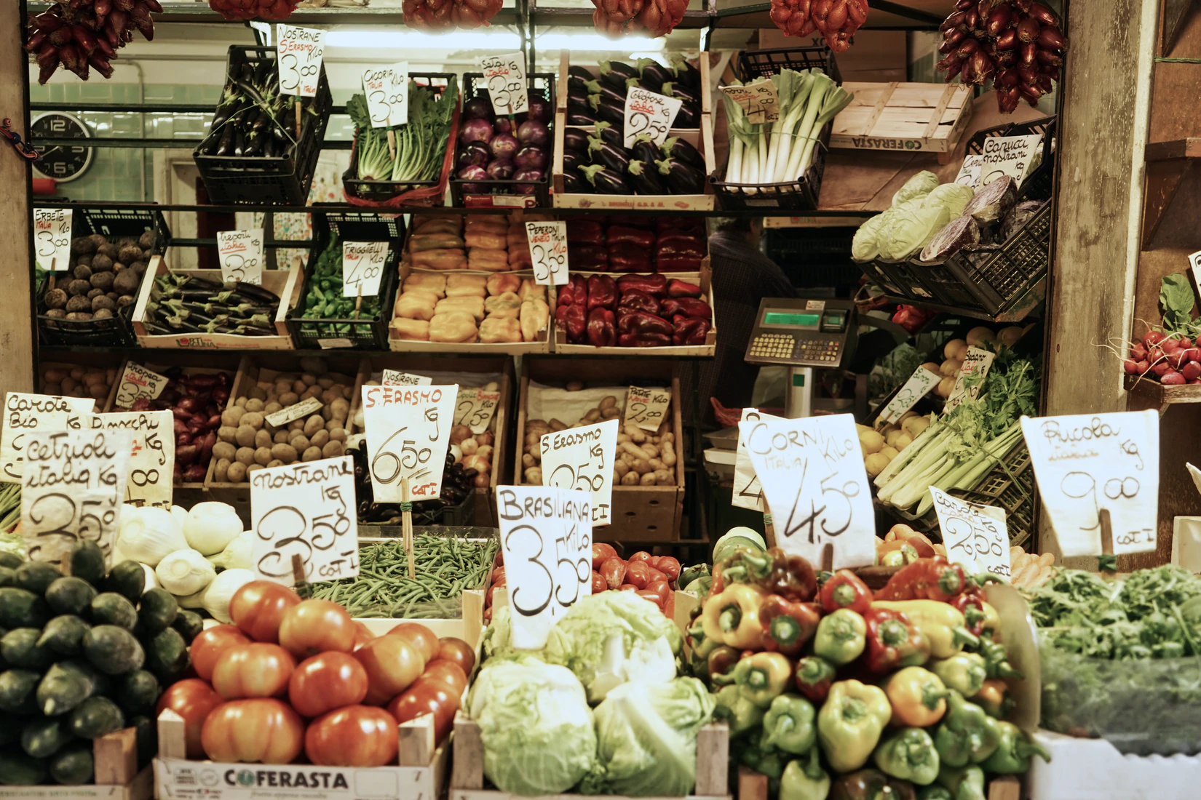
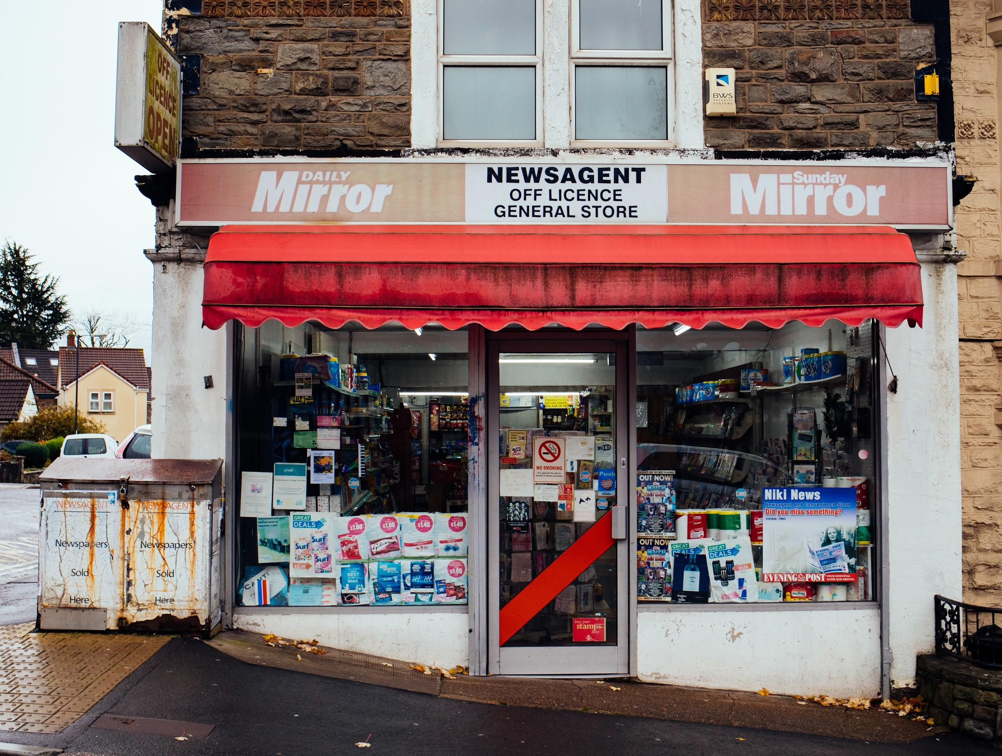
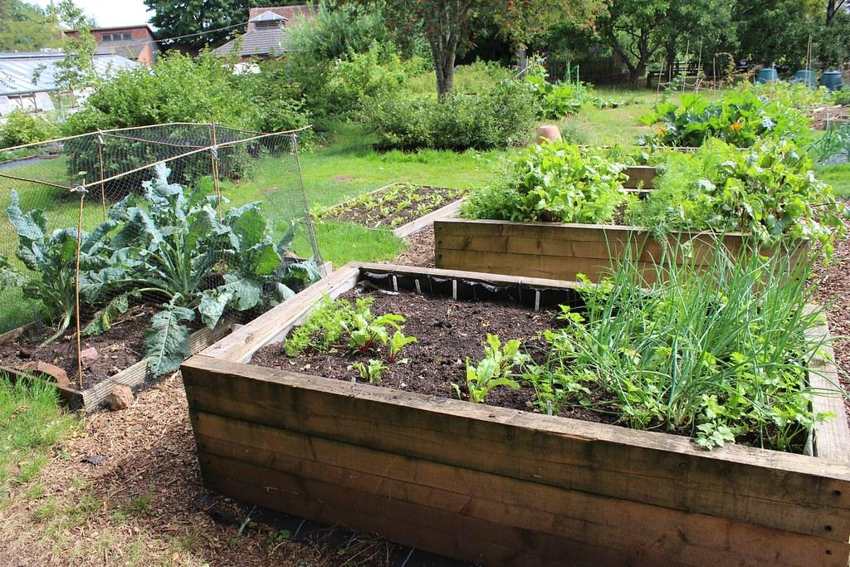
Where will it be the freshest? Least fresh? Medium fresh?
Grocery Store
Pick it up at the farm
Farmer’s market
Corner store or Bodega
Your garden
Notes:
Food system bingo

Slide 10
Where will it be the cheapest? Most expensive? Medium expensive?
Grocery Store
Pick it up at the farm
Farmer’s market
Corner store or Bodega
Your garden
Notes:
Food system bingo

Slide 11
Where requires the most transportation? The least transportation? Medium transportation?
Grocery Store
Pick it up at the farm
Farmer’s market
Corner store or Bodega
Your garden
Notes:
Food system bingo

Slide 12
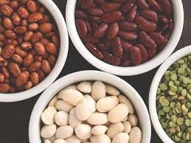
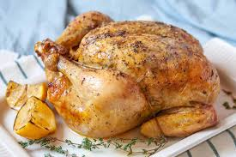
Nutrition of Animal vs. Plant Based Protein
How are they similar? How are they different?

Slide 13
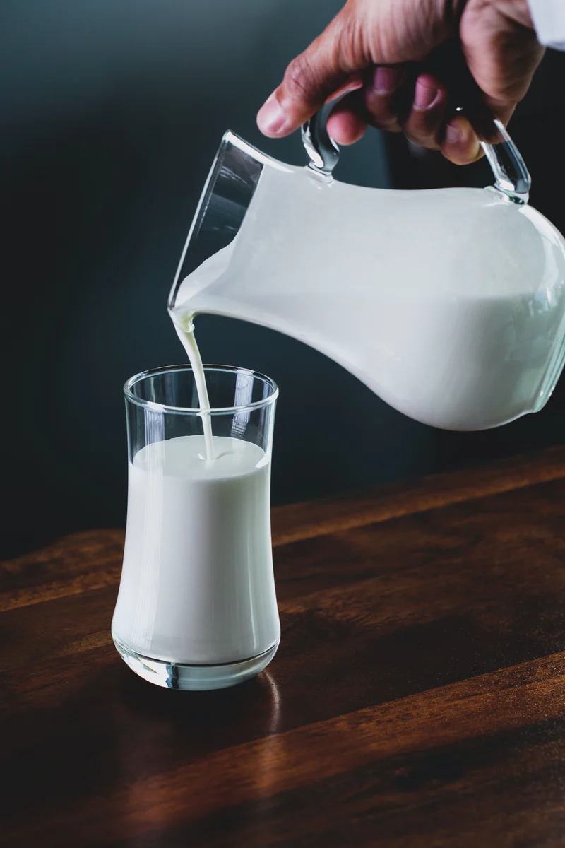
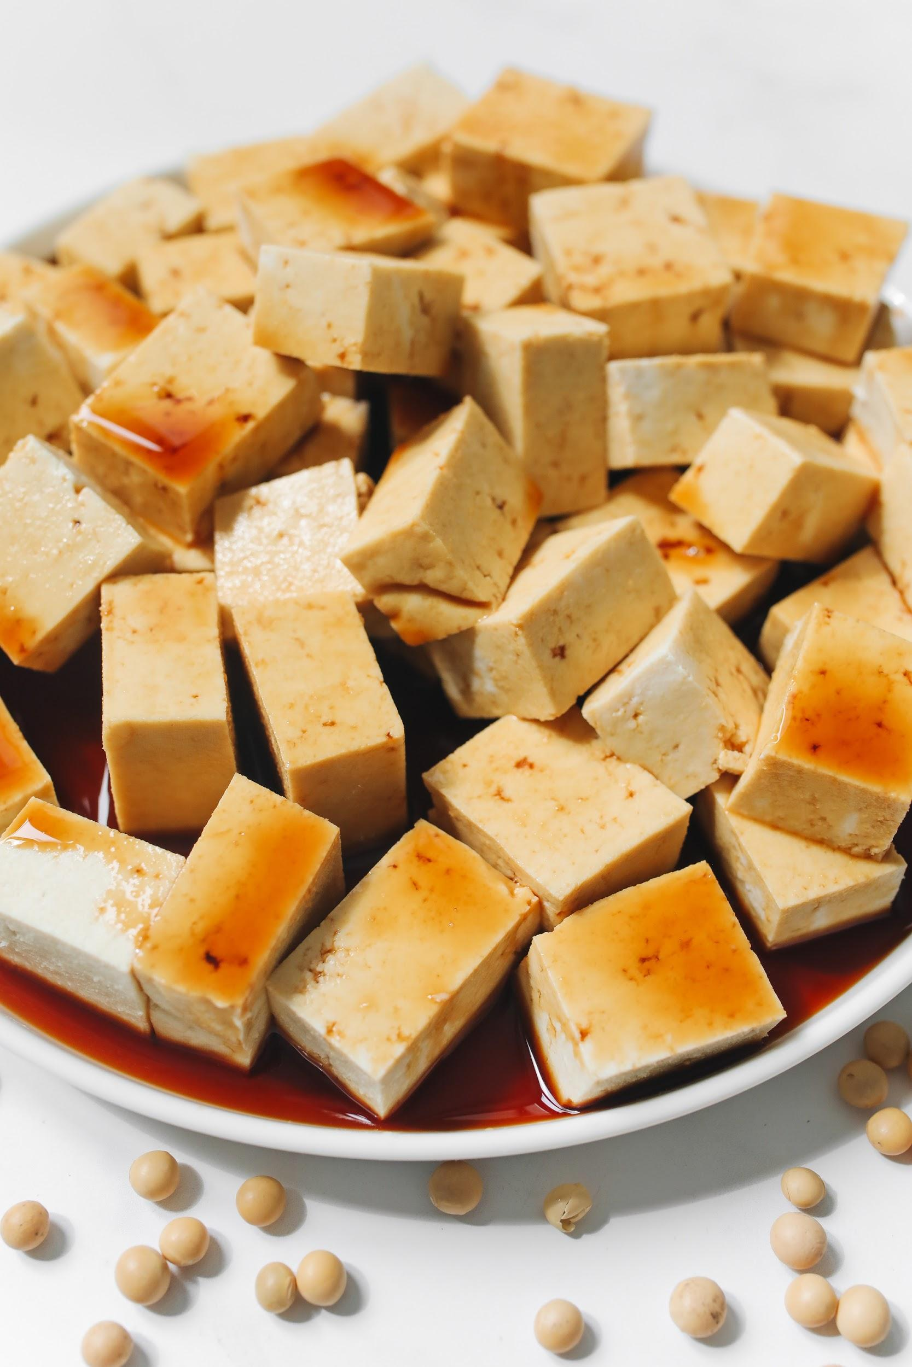
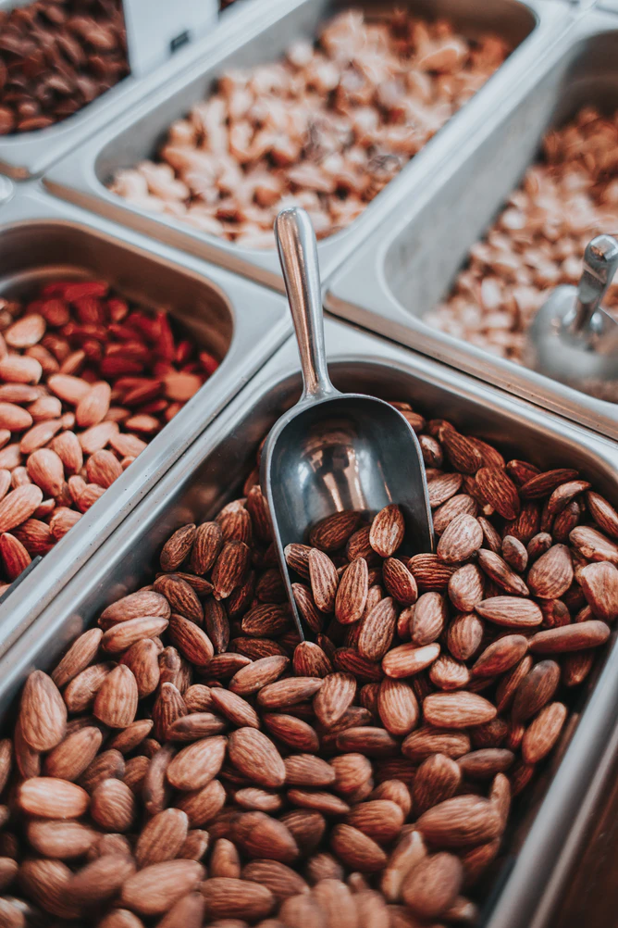
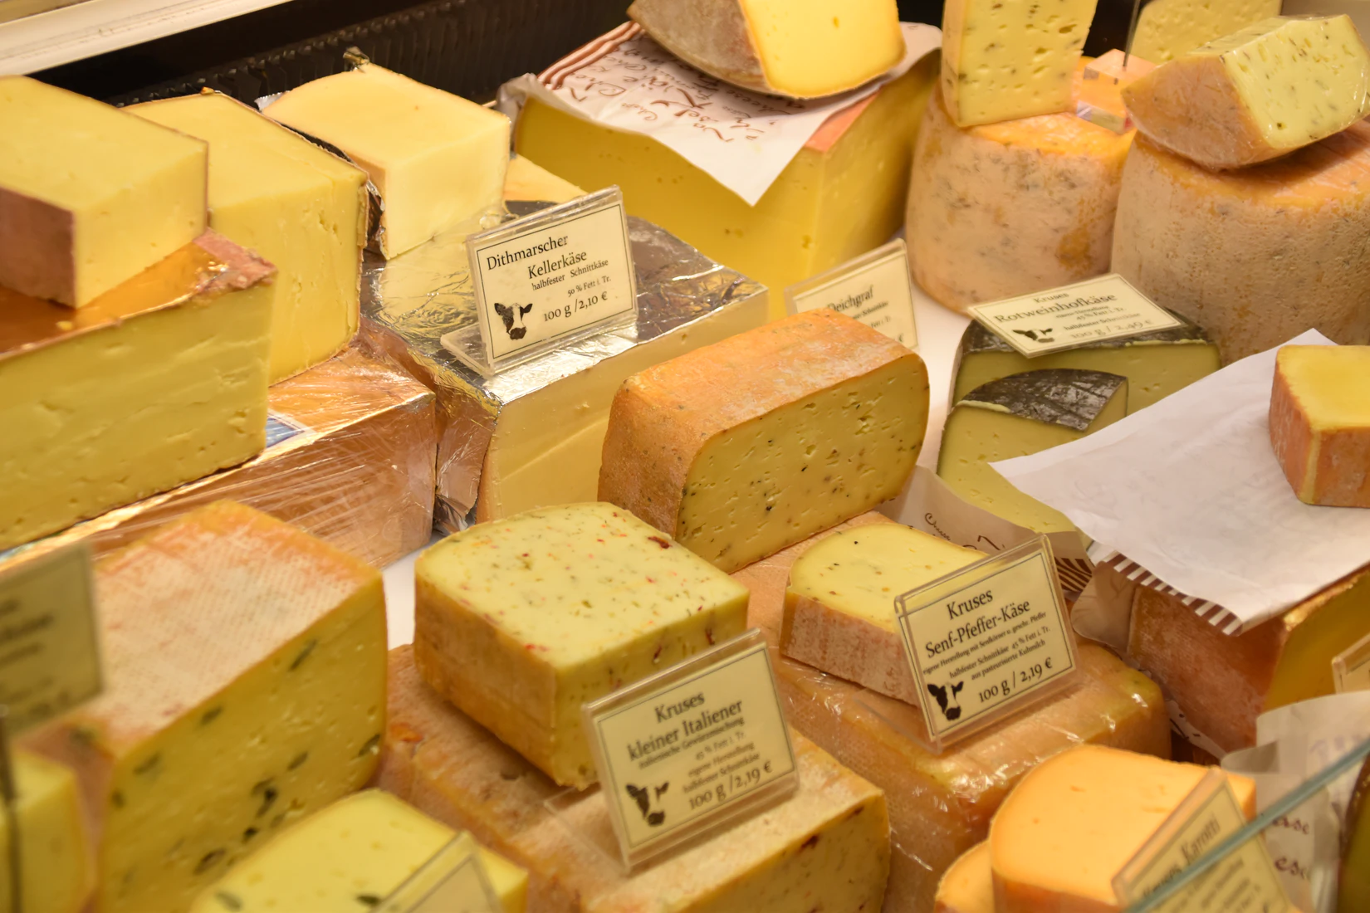
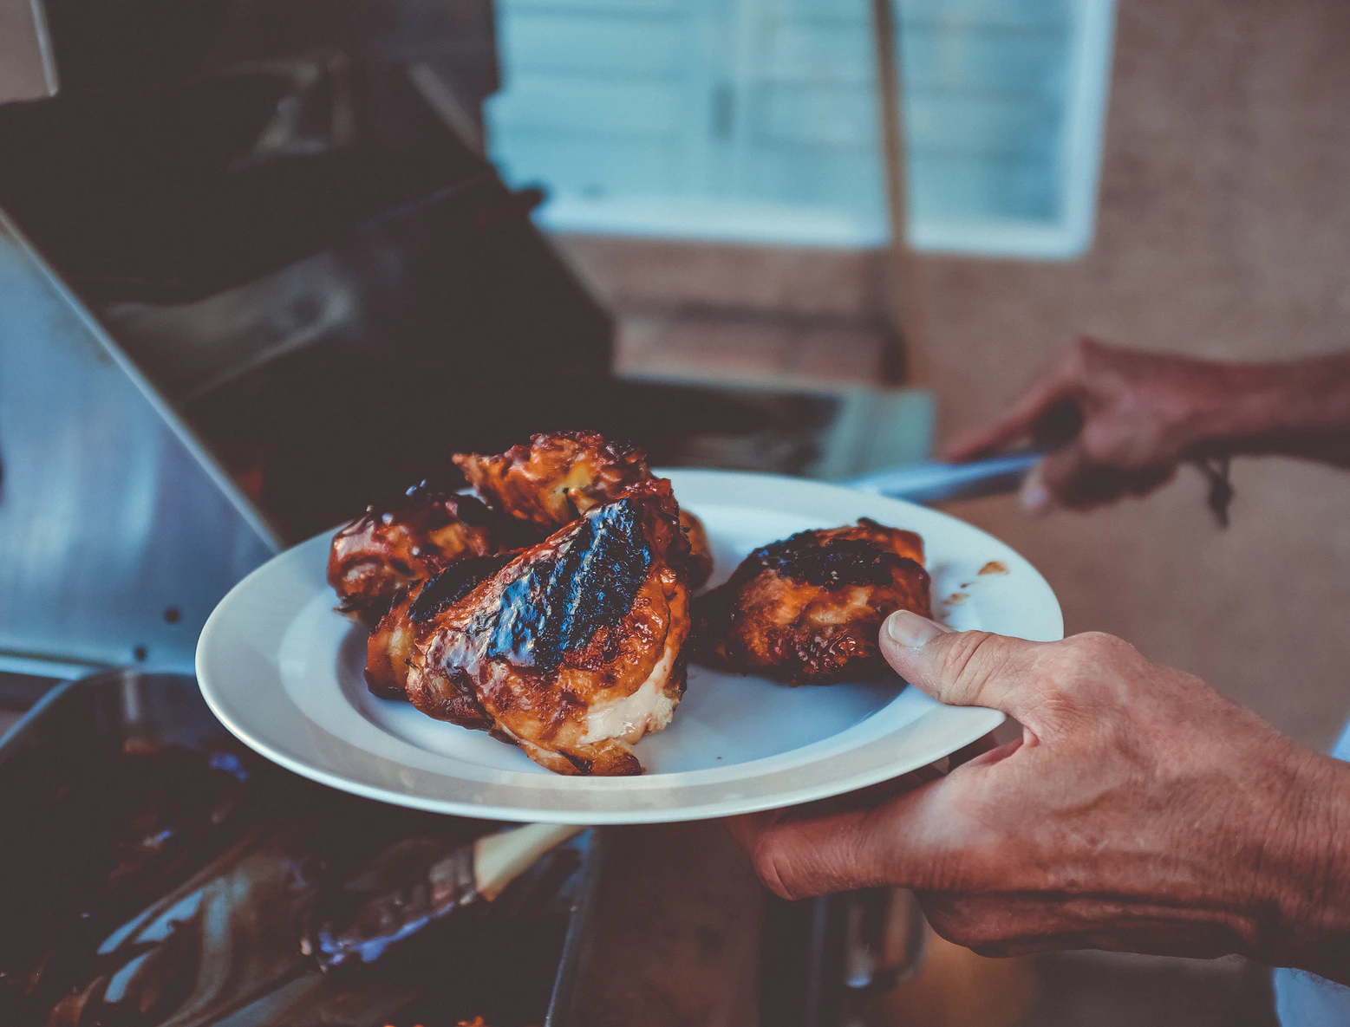
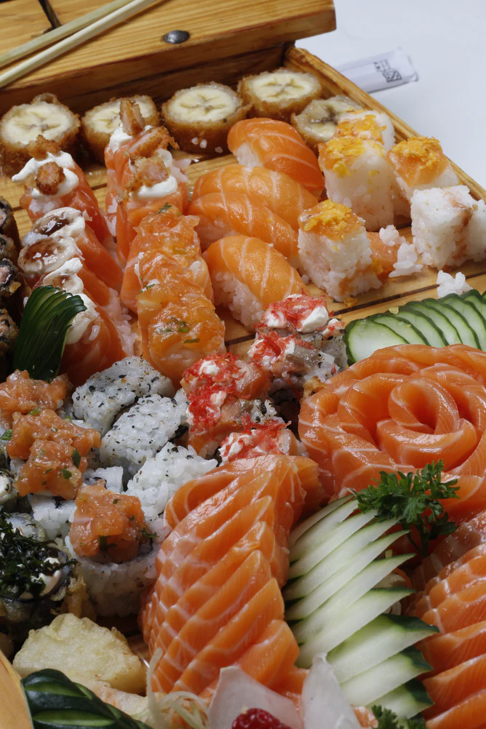
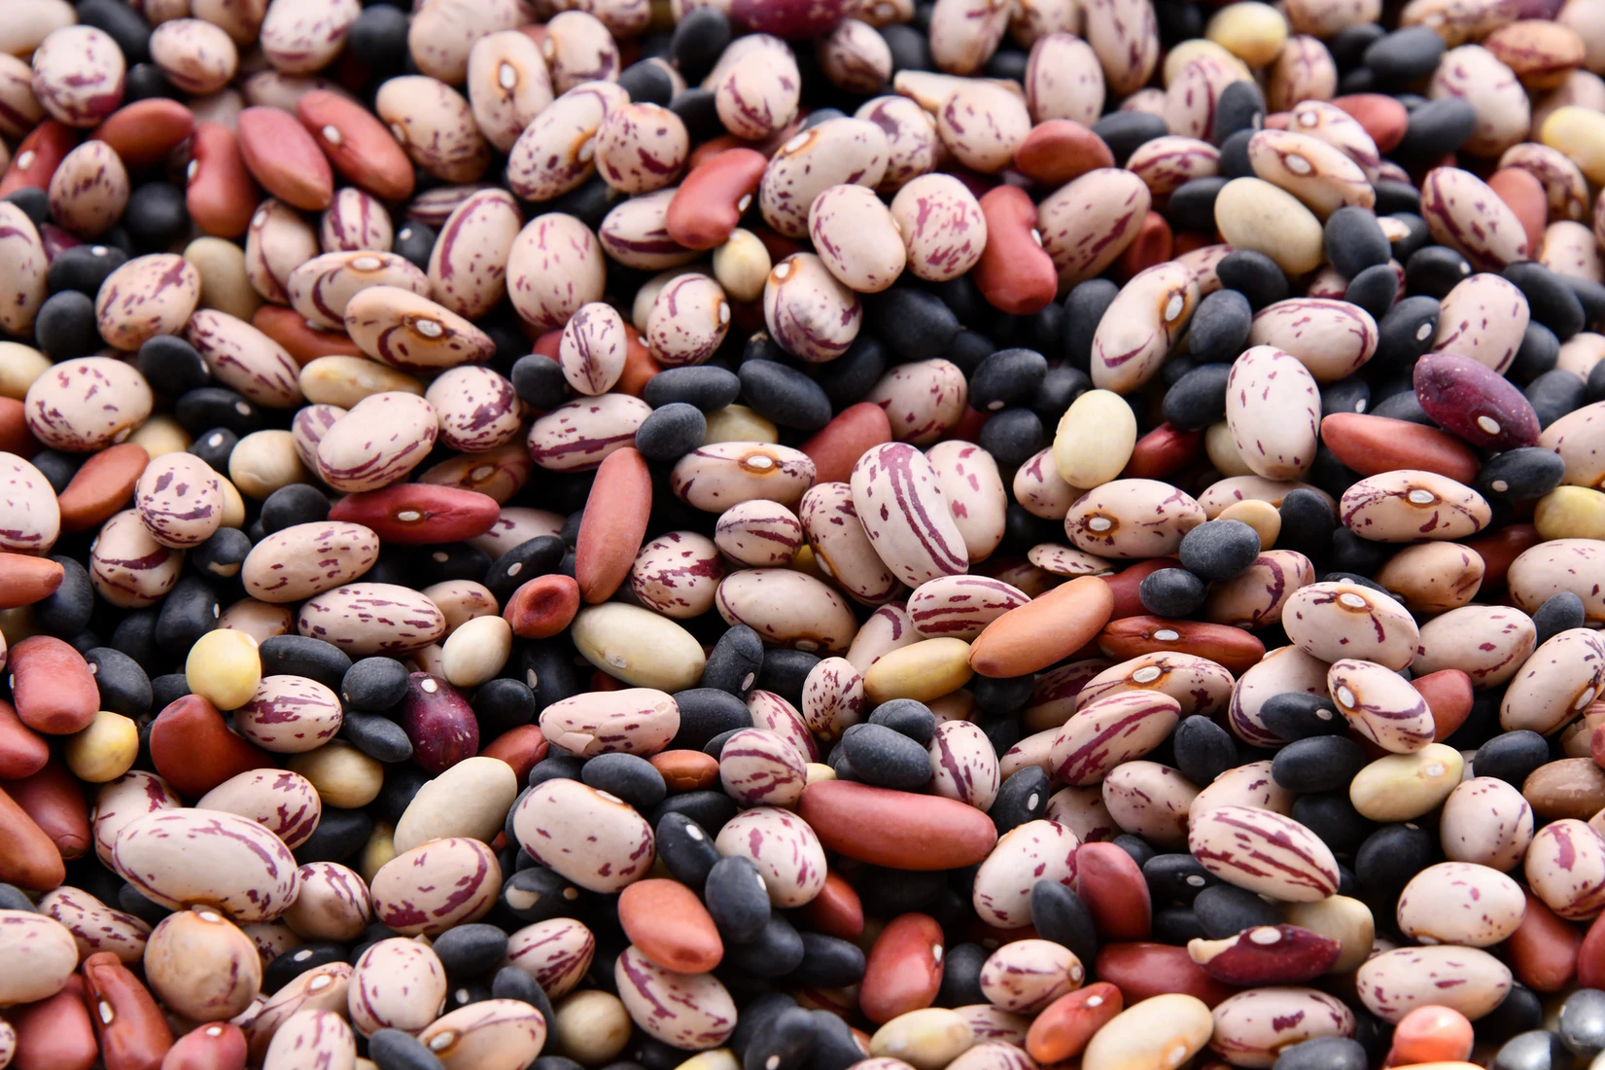
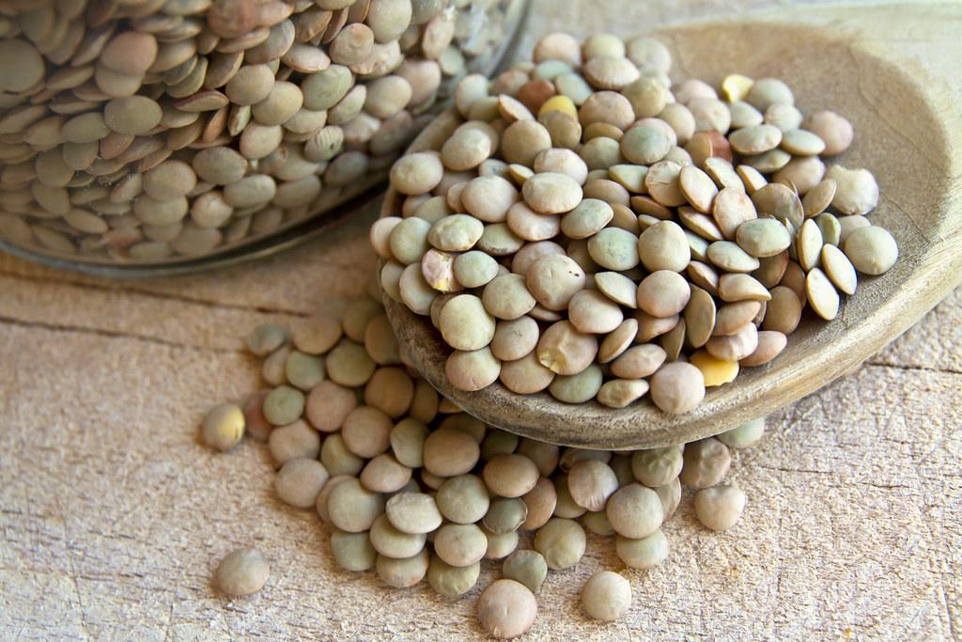
 | Animal Protein | Plant Protein
What are some examples?
Type of Fat
Mostly unsaturated fat (more healthy)
Mostly saturated fat (less healthy)
Which has more protein?
Which has more fiber?
Vitamin B12
Iron
Vitamin D
More Vitamins and Minerals (Potassium, Vit A + C)
What vitamins and minerals do they have?

Slide 14
Hands-On Activity Explanation
Take the “Eat Low Carbon” Quiz. After you get your results, read through all the FoodScores to learn more about the environmental effects of our food.
After taking the quizzes and reading through the FoodScores, draw a picture of a snack or meal you’d want to eat that you think has the lowest carbon FoodScore. Label each ingredient in the meal. If there is protein in the meal or snack, label if it is plant or animal based.
Watch the measuring and No-Bake energy seed bites videos
Upload a picture of your drawing AND your recipe creation to ClassDojo.

Slide 15
Type into the chat or unmute and explain:
Exit Ticket
Do you think you could grow enough potatoes or raise enough chickens for eggs at your home to feed your family? Why or why not?
Do you think most people grow their own food? Why or why not?
What is one of your favorite high-protein snacks? (Animal or plant-protein!)

